Slide 1
Finding climate signals in extremes
Peter Guttorp
peter.guttorp@nr.no
www.stat.washington.edu/peter

Slide 2
Acknowledgements
Anders Moberg for observed data
Erik Kjellström for model data

Slide 3
Overview
Observations
Predictions
The Stockholm series
Comparing regional model output to weather data

Slide 4
Observed European trends 1901-2000
Moberg et al. 2006

Slide 5
Trends in US record daily temperatures
Meehl et al. 2009
Notes:
Sweden 2000s 50 warm monthly records, 16 cold ratio 3

Slide 6
IPCC model results (AR4 WG1 Ch.11)
Fewer frost days
VL (consistent across model projections)
Decrease in number of days with below-freezing temperatures everywhere
Fewer cold outbreaks; fewer, shorter, less intense cold spells / cold extremes in winter
VL (consistent across model projections)
Northern Europe, South Asia, East Asia
L (consistent with warmer mean temperatures)
Most other regions
Reduced diurnal temperature range
L (consistent across model projections)
Over most continental regions, night temperatures increase faster than day temperatures

Slide 7
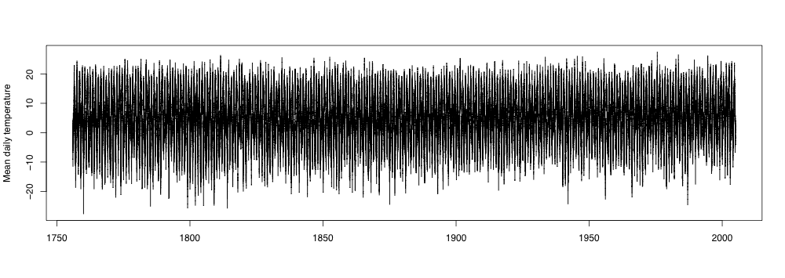
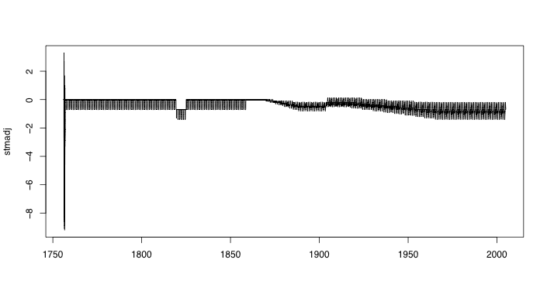
The Stockholm series
Stockholm daily
1756-2004
Moberg et al. 2002
summertime
correction
screen painted white?
miscalibrated
thermometer
urbanization

Slide 8
Trend in minimum temperature
Block bootstrap, k=3,N=99

Slide 9
What is a minimum?
Minimum daily average temperature
Minimum daily temperature
About 3°C lower, highly correlated (r=0.95)

Slide 10
How about the maximum?
No urbanization correction

Slide 11
Other series
Uppsala
Central England

Slide 12
Comparing climate model output to weather data
Global models are very coarse
Regional models are driven by boundary conditions given by global model runs
In either case, describes distribution of weather, not actual weather
Consider a regional model driven by “actual weather”
Stockholm 50 km x 50 km grid, 3 hr resolution (SMHI-RCA3; ERA40)

Slide 13
How well does the climate model reproduce data?

Slide 14
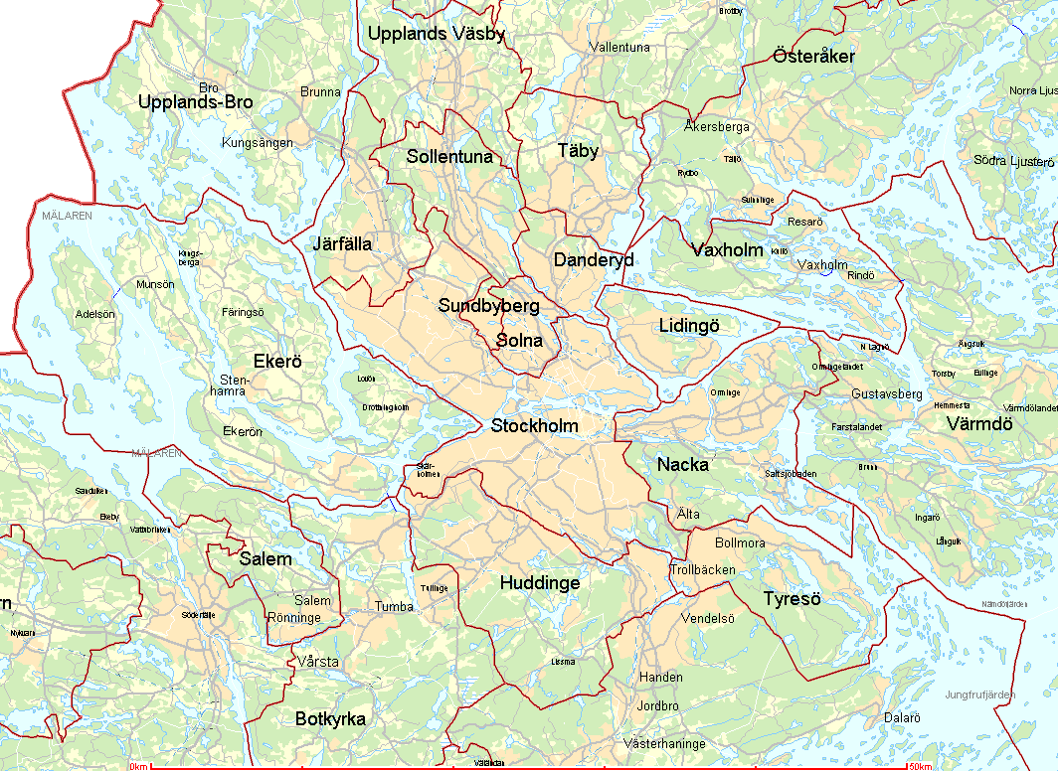
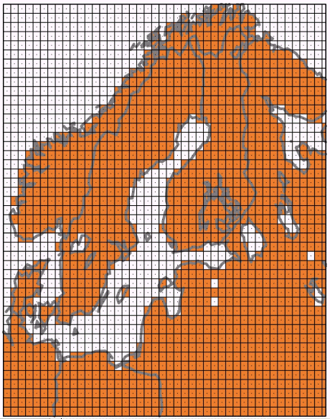
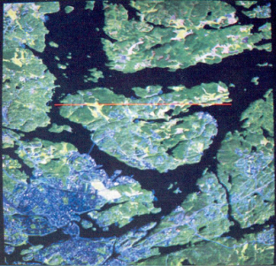
Resolution in a regional climate model
50 x 50 km

Slide 15
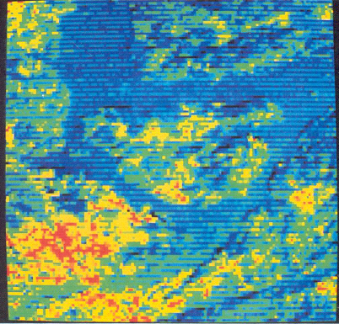
Microclimate

Slide 16
Model problem?
Cloud water content
Downward longwave radiation
Mean annual temperature about 1.7°C higher in model than Stockholm series
Should look at the part of simulation that predicts open terrain
Use more regional series to estimate grid square average

Slide 17
References
Bergström and Moberg (2002) Climate Change 53, 213–252
Kjellström et al. (2005) Reports Meteorology and Climatology 108, SMHI
Meehl et al. (2009) Geophys. Res. Lett. 36, L23701, doi:10.1029/2009GL040736
Moberg et al. (2002) Climatic Change 53, 171–212
Moberg et al. (2003) Int. J. Clim. 23, 1495–1521
Moberg et al. (2006) JGR 111, D22106, doi:10.1029/2006JD007103
Parker et al. (1992) Int. J. Clim. 12, 317–342
Uppala et al. (2005) Quart. J. R. Meteorol. Soc. 131, 2961–3012

