Slide 1
Recitation 1 April 9
Polynomial regression
Ridge regression
Lasso

Slide 2
Polynomial regression
lm( y ~ poly(x, degree = d), data=dataset)
Find the optimal degree
Check the residual plots
Training and test set
Cross-validation
R demo 1

Slide 3
Ridge regression – R package
lm.ridge() in library(“MASS”)
lm.ridge( y ~ . , data = dataset,
lambda = seq(0, 0.01, by=0.001) )
R demo 2

Slide 4
Ridge regression – from sketch
Ridge regression estimators have closed form solutions:
How to deal with intercept?
Tuning parameter:
Effective degrees of freedom
Implement: HW 2

Slide 5
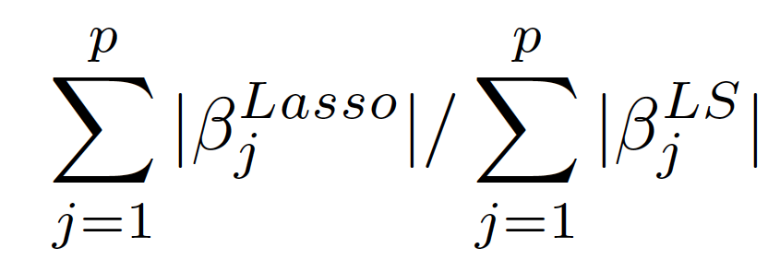
Lasso – R package
l1ce() in library(“lasso2”) or lars() in library(“lars”)
l1ce( y ~ . , data = dataset, bound = shrinkage.factor)
Lasso doesn’t have EDF (why?) . We can use the shrinkage factor to get a sense of the penalty.
R demo 3

Slide 6
Lasso – from sketch
Shooting algorithm (stochastic gradient descent)
At each iteration, randomly sample one dimension j, and update
How to deal with intercept
Center x and y
Standardize x
Tuning parameter
Shrinkage factor for a given
Convergence criterion
Implement: HW 2 Bonus problem

