Slide 1
RECITATION 1 APRIL 14
Lasso
Smoothing Parameter Selection
Splines

Slide 2
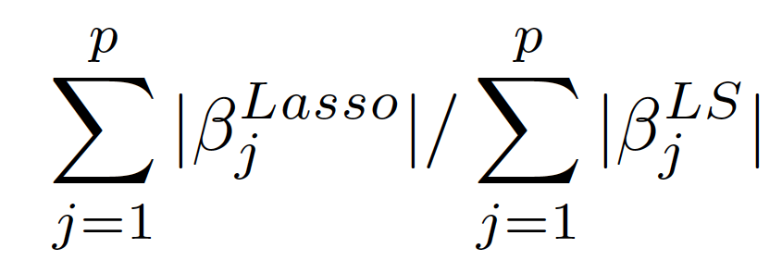
Lasso – R package
l1ce() in library(“lasso2”) or lars() in library(“lars”)
l1ce( y ~ . , data = dataset, bound = shrinkage.factor)
Lasso doesn’t have EDF (why?) . We can use the shrinkage factor to get a sense of the penalty.

Slide 3
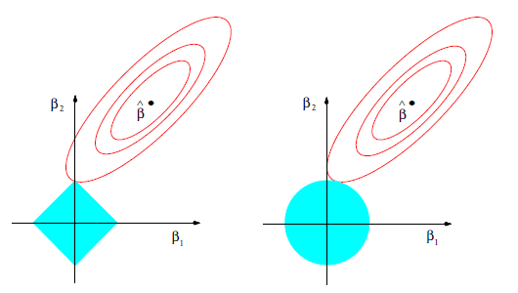
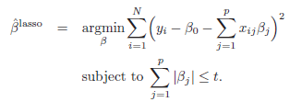
Lasso Sparsity Intuition

Slide 4
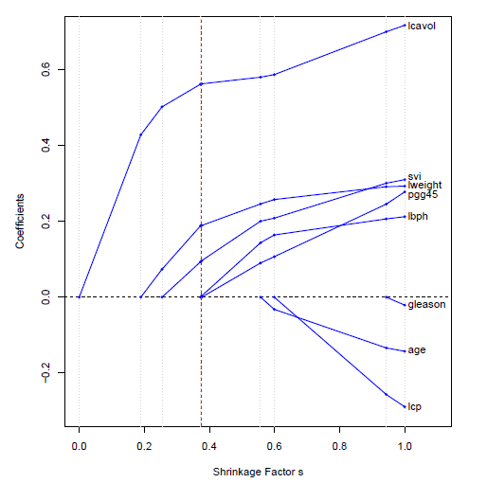
Lasso Solution Path

Slide 5
Lasso – from sketch
Shooting algorithm (stochastic gradient descent)
At each iteration, randomly sample one dimension j, and update
How to deal with intercept
Center x and y
Standardize x
Tuning parameter
Shrinkage factor for a given
Convergence criterion

Slide 6
Smoothing Parameter Selection
In data-rich settings, use training/validation/test sets for building models/selecting smoothing parameters/calculating prediction error.
Most situations are data-scarce, use approximations.
1) Leave-one-out Cross validation (n-fold CV)
2) K-fold Cross Validation
3) Generalized Cross Validation
4) Mallows Cp (not discussing)

Slide 7
Piecewise Polynomials/Splines
Polynomials are good locally not globally.
Piecewise polynomials use this to model data locally in many regions (governed by knots) to approx. global fit.
Two main types of Splines:
Regression Splines
Smoothing Splines

Slide 8
Piecewise Polynomials/Splines
Regression Splines = (# of knots) < (# of data points)
No regularization, fit by LS, nice linear smoother properties
But what order do we choose (linear, quadratic, cubic?)
How many knots and where to place them?
Hard questions!

Slide 9
Piecewise Polynomials/Splines
Smoothing Splines:
Minimizing above quantity (for any function f(x)), leads to f(x) having a functional form of a NATURAL cubic spline w/ knots at every data point.
Natural cubic splines: Cubic regression splines (as talked about before + imposing linearity beyond the leftmost/rightmost knots).
The N_{j} basis functions are derived from the cubic regression spline basis functions.

Slide 10
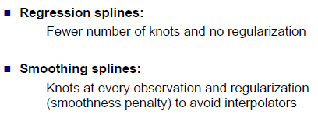
Piecewise Polynomials/Splines

Slide 11
HW Tips
Follow Recitation code, if relevant
Plot coefficients scaled (for RR and Lasso)
For the shooting algorithm, utilize the WHILE loop when running it with a convergence criterion.
Check your algorithm by using the lars() function in R.
For the convergence criteria, make sure you take into account the history of beta updates and/or RSS updates.
(Note: | beta_(l) – beta_(l-1) | < TOL probably won’t cut it).

