Slide 1
Manifold Learning
James McQueen – UW Department of Statistics

Slide 2
About Me
4th year PhD student working with Marina Meila
Work in Machine Learning focus on Manifold Learning
Worked at Amazon on Personalization Analytics team on A/B testing
Built the online product recommendation system at startup Modesens.com
Consulting Actuary at Towers Watson
Undergrad at UW in Economics/Math

Slide 3
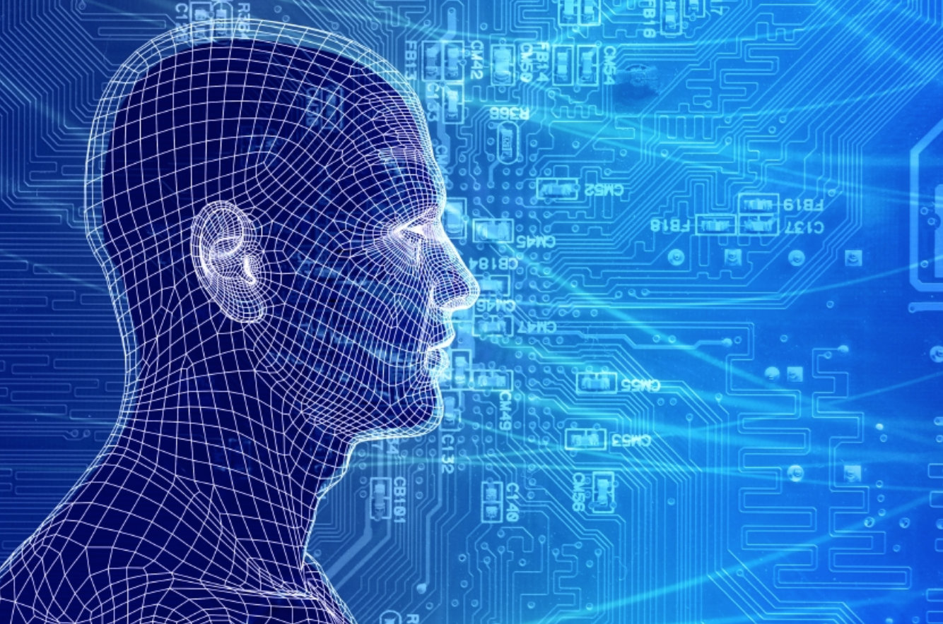
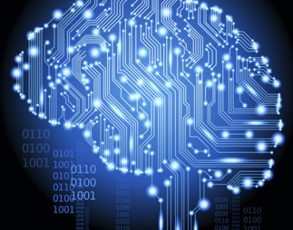
Machine Learning
Data is everywhere
Data is being recorded at an unprecedented rate
How do we find out the useful information among the noise

Slide 4
Supervised Learning
target
Labels
Features
Predictions
Model
input
output
evaluate
Examples:
Regression (e.g. predicting market-value of houses)
Classification (e.g. click-predict)

Slide 5
Unsupervised Learning
Features
Predictions
Model
input
output
evaluate
???
Examples:
Clustering (e.g. Topic Models, Hidden Markov Models)
Anomaly detection (e.g. searching for outliers)
Dimension Reduction

Slide 6
Dimension Reduction
#features = dimension D
d $≪$ D
This is not lossless compression
100x100 pixel image = 10,000 features
Pre-processing tool
Data visualization
Features
X
Features Y
transformation
N
same “information”

Slide 7
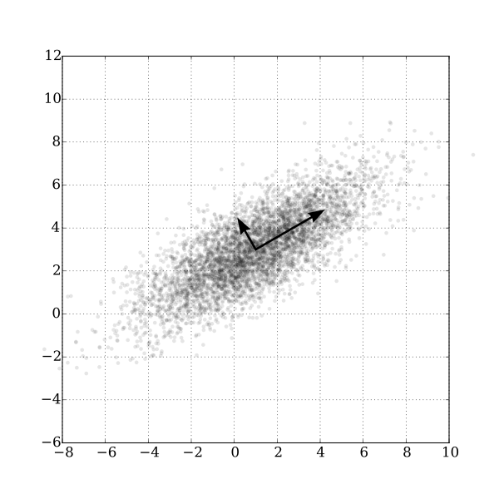
Linear Dimension Reduction
The nature of the transformation F: X -> Y
Principle Component Analysis
Rotation of the data to a new coordinate system.
Project data on to coordinates with greatest variance
PCA is a Linear Map from X to Y

Slide 8
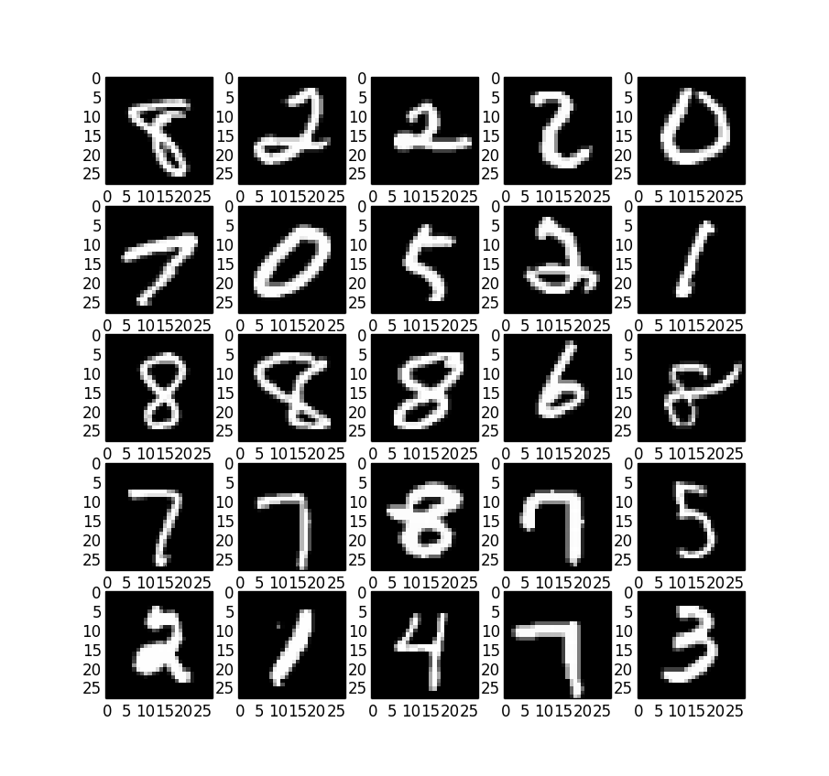
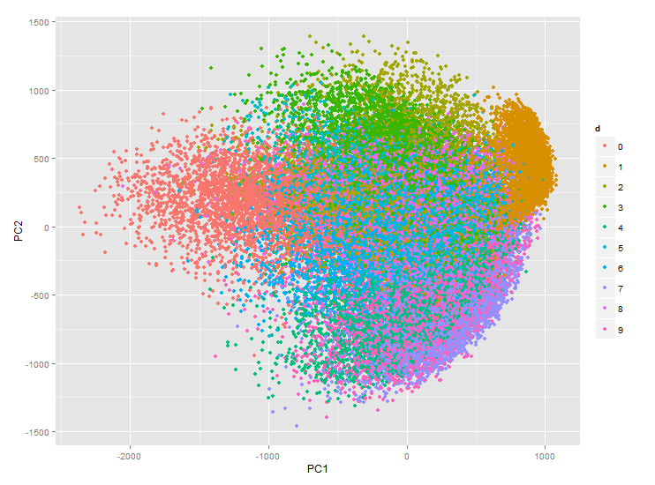
Examples: PCA
MNIST 40,000 (28x28) greyscale images of handwritten digits 0-9.
Projection of the Digit Data onto the first two principal components.
Components are ordered by variance. The first 85 (of 784) account for 90% of total variation.

Slide 9
Non-linear Dimension Reduction
What if the mapping: F: X -> Y was not a linear mapping?
Hard to optimize over “all non-linear functions”
What are we even trying to do?
Leads to many heuristics
When would this even work?
Requires the introduction of manifolds

Slide 10
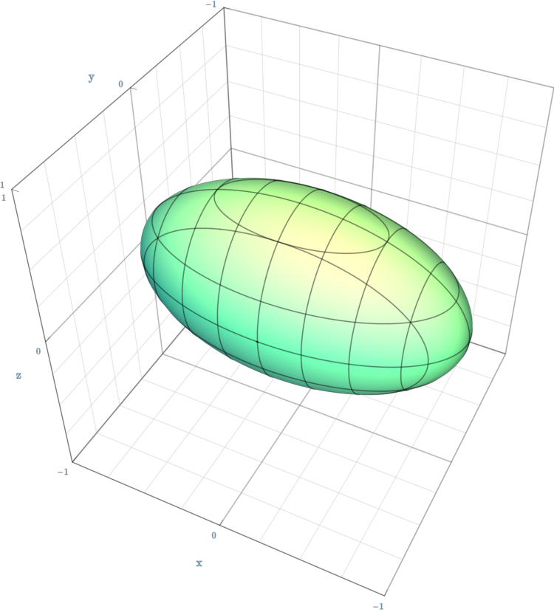
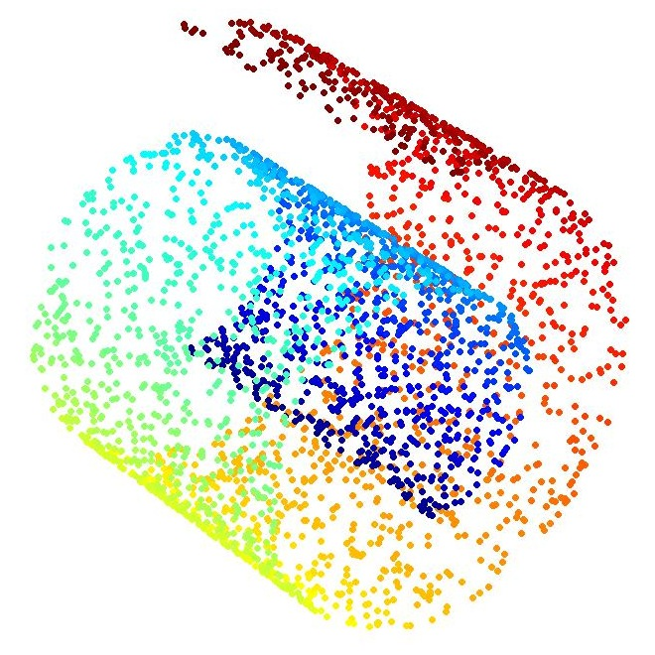
What’s a Manifold anyway?
Regular surfaces: “two dimensional object living in a three dimensional world.”
We don’t have to restrict ourselves to 3 dimensions and 2 dimensions
Manifold extends regular surfaces to: “d dimensional object living in a D dimensional world.”

Slide 11
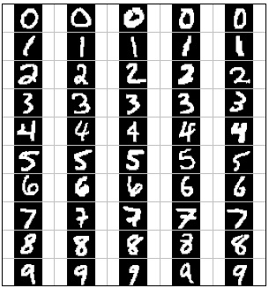
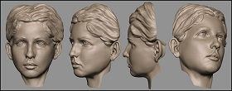
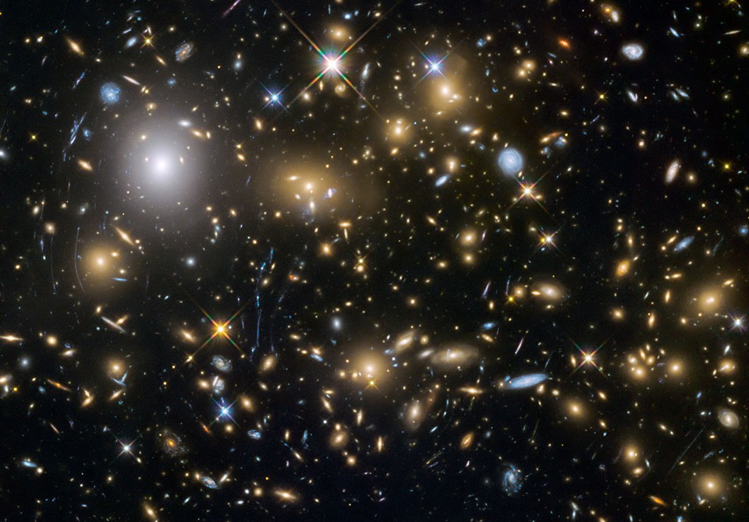
Why Should I Care?
AKA: does my data really lie on (or near) a manifold?
Some examples of where this might be true.
Sometimes linear dimension reduction doesn’t work

Slide 12
So how do we do it?
There are a lot of different heuristics:
Isomap: preserve pairwise graph distances calculated using a sparse neighbhorhood graph
Locally Linear Embedding: preserve the local regression weights that reconstruct the original data with the new data.
Local Tangent Space Alignment: Estimate the tangent space at each point and put a restriction to allow for a global alignment step
Spectral Embedding: take the eigenvectors associated with the largest eigenvalues of the Laplacian Matrix
They all result in a different embedding

Slide 13
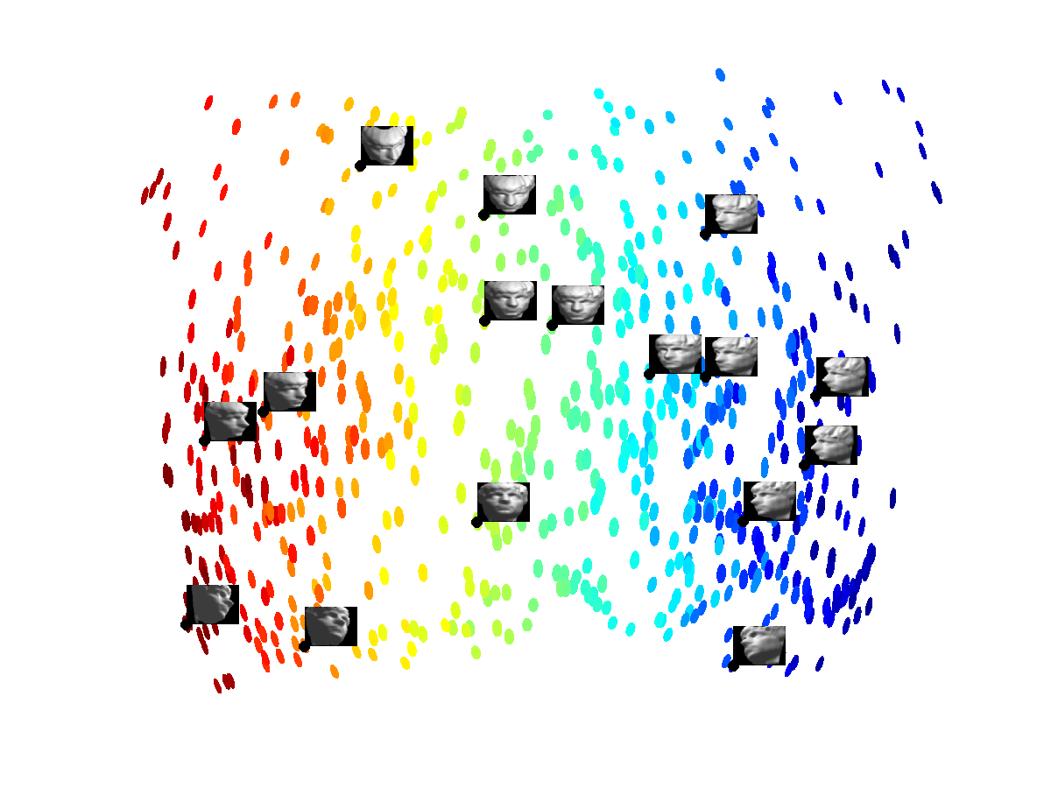
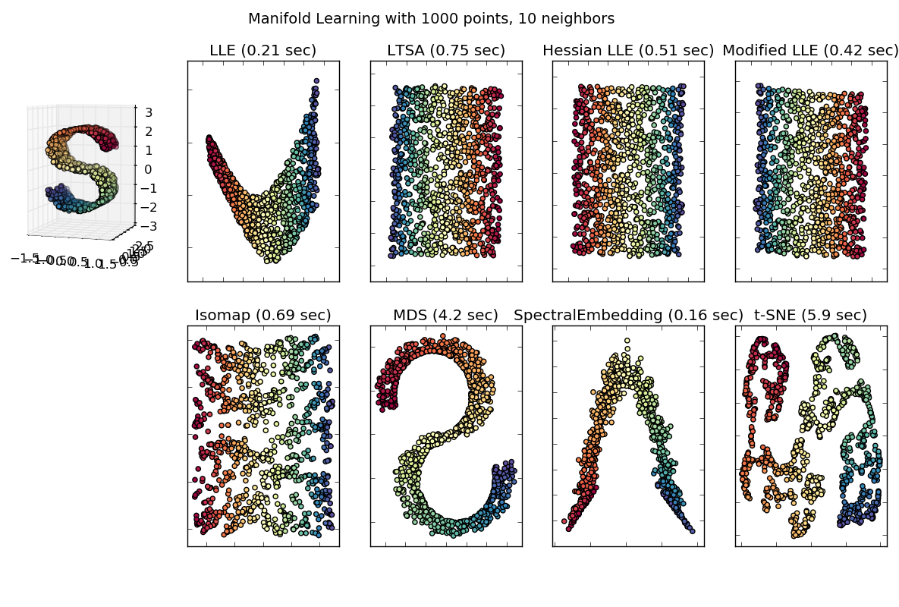
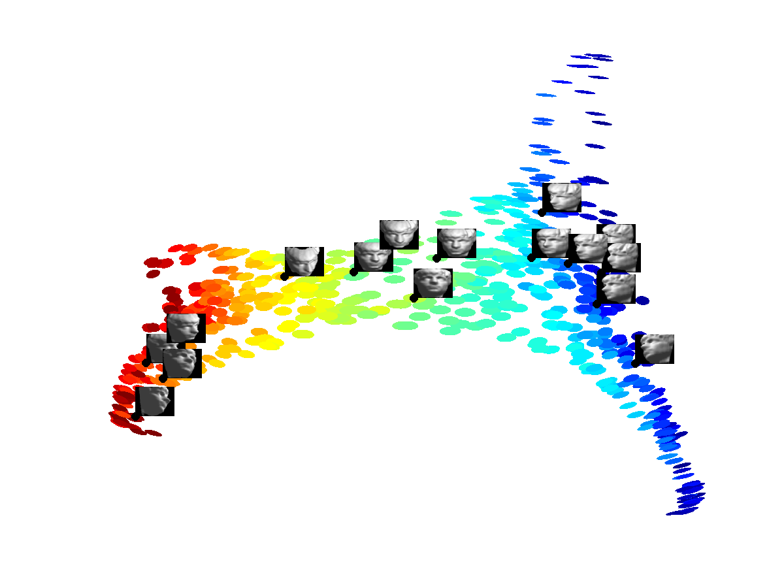
Example Manifold Learning Results

Slide 14
Challenges of Manifold Learning
Each Method is based off a Heuristic – there’s no agreement
In almost all cases there is significant distortion even when an isometric embedding is possible
How do you measure distortion?
Potentially this is due to insufficient data
So-called “curse of dimensionality”
Many Manifold Learning algorithms either do not scale well (fundamentally in their design) or have not been implemented in a scalable fashion
Problem: you need lots of data for good estimates but methods don’t scale to large data sets.

Slide 15
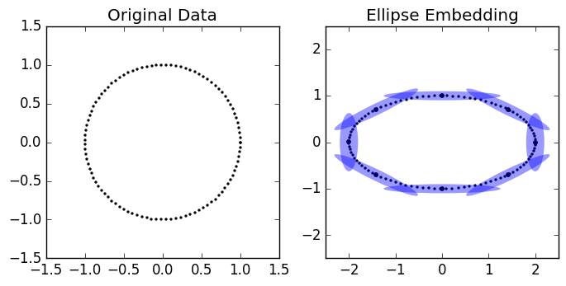
Distortion & the Riemannian Metric
“Riemannian Metric” used to measure geometric quantities on a manifold
Creates a “push-forward” metric when we transform a data set.
If we use this metric then we achieve Isometry.

Slide 16
Scaling Manifold Learning
Most manifold learning algorithms are not implemented to scale.
Sci-kit learn has most of the algorithms implemented but the primary objective of sci-kit learn is usability.
Bottlenecks:
Neighborhood graphs
Eigendecomposition
Solution:
Approximate Neighbors Graph (FLANN)
Sparse Symmetric Positive Definite Methods (LOBPCG)

Slide 17
Megaman
Scalable Manifold Learning in Python
Harnesses Cython, FLANN, LOBPCG & pre-conditioning to scale up-manifold learning algorithms.
Smart with memory and designed with research in mind.
Github: https://github.com/mmp2/megaman
Website/Documentation: http://mmp2.github.io/megaman/
Question: how many of you are familiar with the character Megaman?

Slide 18
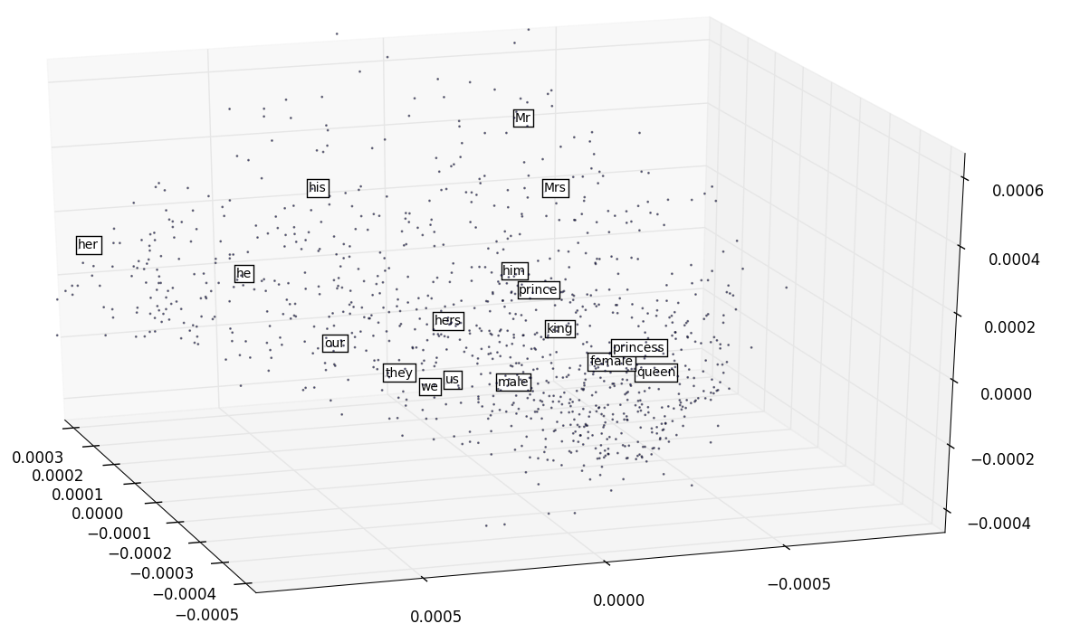
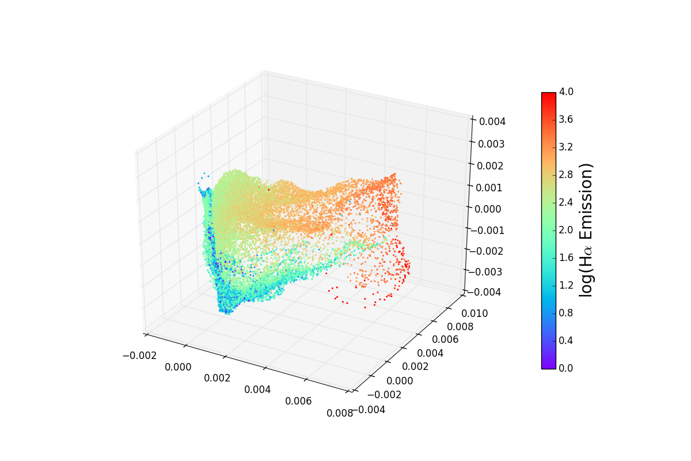
Megaman Results:
Sample of 675,000 observed spectra in 3750 dimensions. Colors indicate strength of Hydrogen alpha emissions (common in emission nebulae)
A sample of embedding 3M words & phrases in 300 dimensions taken using Word2Vec on Google News

Slide 19
Opportunity for Undergraduates
Do you have a background in Python programming and/or C++?
Work with a team developing state-of-the-art manifold learning algorithms in python
Sci-kit learn extension
Send me an email: jmcq@uw.edu

Slide 20
Questions?

