Slide 1

Modeling compositional data

Slide 2
Background
NAPAP, 1980’s
Workshop on biological monitoring, 1986
Dirichlet process: Gary Grunwald, 1987
Current framework: Dean Billheimer, 1995
Other co-workers: Adrian Raftery, Mariabeth Silkey, Eun-Sug Park

Slide 3
Compositional data
Vector of proportions
Proportion of taxes in different categories
Composition of rock samples
Composition of biological populations
Composition of air pollution

Slide 4
The triangle plot
1
Proportion 1
(0.55,0.15,0.30)
0
0
Proportion 2
1
1
0
Proportion 3

Slide 5
The spider plot
0.2
0.4
0.6
0.8
1.0
(0.40,0.20,0.10,0.05,0.25)

Slide 6
An algebra for compositions
Perturbation: For define
The composition acts as a zero, so .
Set so .
Finally define .

Slide 8
The logistic normal
If
we say that z is logistic normal, in short Z ~ LN(μ,Σ).
alr has a unique inverse.
Other distributions on the simplex:
Dirichlet — ratios of independent gammas
“Danish” — ratios of independent inverse Gaussian
Both have very limited correlation structure.

Slide 9
Scalar multiplication
Let a be a scalar. Define
is a complete inner product space, with inner product given, e.g., by
N is the precision matrix N=I+jj^{T}
j is a vector of k-1 ones.
is a norm on the simplex.
The inner product and norm are invariant to permutations of the components of the composition.

Slide 10
<a,b> = –0.67
|| b || = 1.52
|| b/2 || = 0.39
|| a || = 0.42
|| 2x a || = 1.78

Slide 11
Some models
Measurement error:
where ε_{j} ~ LN(0,Σ) .
Regression:
Correspondence in Euclidean space:
ξ_{j} ξ γ u_{j}
centered
covariate
compositions

Slide 12
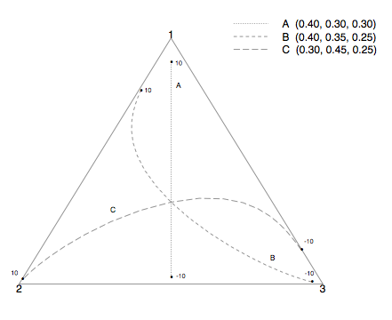
Some regression lines

Slide 13
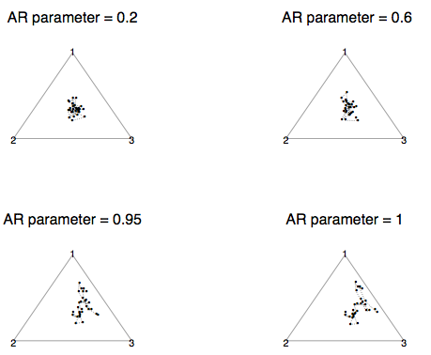
Time series (AR 1)

Slide 14
A source receptor model
Observe relative concentration Y_{i} of k species at a location over time.
Consider p sources with chemical profiles θ_{j}. Let α_{i} be the vector of mixing proportions of the different sources at the receptor on day i.
Θ ~ LN, α_{i} ~ indep LN, ε_{i} ~ zero mean LN

Slide 15
Juneau air quality
50 observations of relative mass of 5 chemical species. Goal: determine the contribution of wood smoke to local pollution load.
Prior specification:
Inference by MCMC.

Slide 16
Wood smoke contribution
95% CL
50% CL

Slide 17
Wood smoke proportion

Slide 18
Posterior source profiles
(pyrene)
(benzo(a))
(fluoranthene)
(chrysene)
(benzo(b))

Slide 19
State-space model
Space-time model of proportions
State-space model:
z_{j} unobservable composition ~ LN(μ_{j},Σ_{j})
y_{j} k-vector of counts ~ Mult(
Inference using MCMC again

Slide 20
Stability of arthropod food webs
Omnivory thought to destabilize ecological communities
Stability: Capacity to recover from shock (relative abundance in trophic classes)
Mount St. Helens experiment: 6 treatments in 2-way factorial design; 5 reps.
Predator manipulation (more omnivores, more specialists, control)
Vegetation disturbance (50% reduction, control)
Count anthropods, 6 wks after treatment. Divide into specialized herbivores, general herbivores, predators.
Notes:
Incr predator: rm resident Geocors (specialist predator), add 3 wolf spiders (Omnivores)
Veg dist: rm 50% of veg (fireweed; pearly everlasting)
11 spcies of anthropods obs

Slide 21
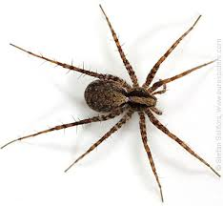
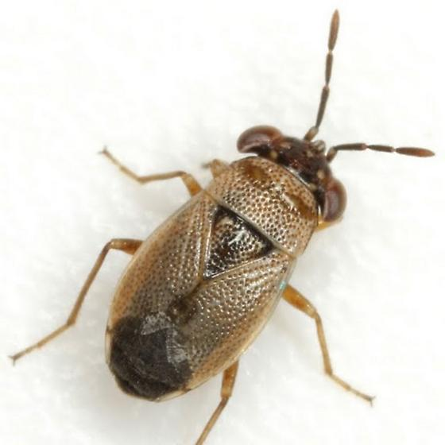
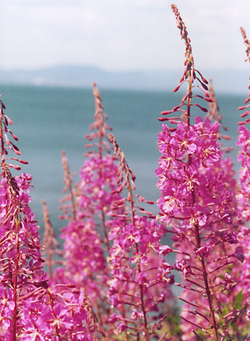
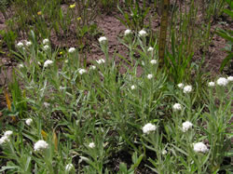
Manipulated species
Omnivore:
Wolf spider
Specialist predator
Big-eyed bug
Vegetation
fireweed pearly-
everlasting

Slide 22
Specification of structure
Σ is generated from independent observations at each treatment
mean depends only on treatment

Slide 24
Notes:
Effect of vegetation removal similar to effect of adding specialists
Thus, omnivores have a stabilizing effect

Slide 25
Interaction effect
ANOVA interaction effect
alr inverse to get

Slide 26
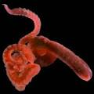
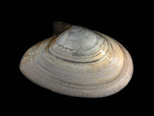
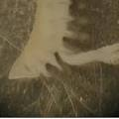
Benthic invertebrates in estuary
EMAP estuaries monitoring program: Delaware Bay 1990. 25 locations, 3 grab samples of bottom sediment during summer
Invertebrates in samples classified into
  pollution tolerant
  pollution intolerant
  suspension feeders (control group)

Slide 27
Site j, subsample t
θ_{j} ~ CAR process
standardized
covariate

Slide 28
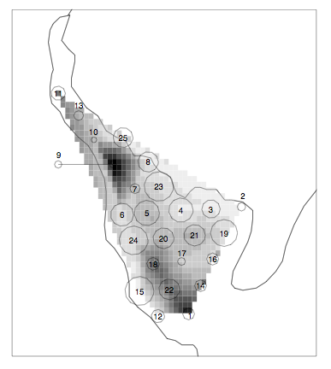

Slide 29
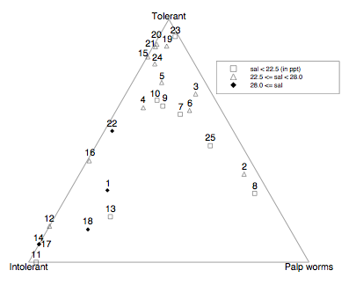
Effect of salinity

Slide 30
(0.34,0.38,0.28).
Notes:
Increase suspension feeders decrease intolerant when increasing salinity

Slide 32
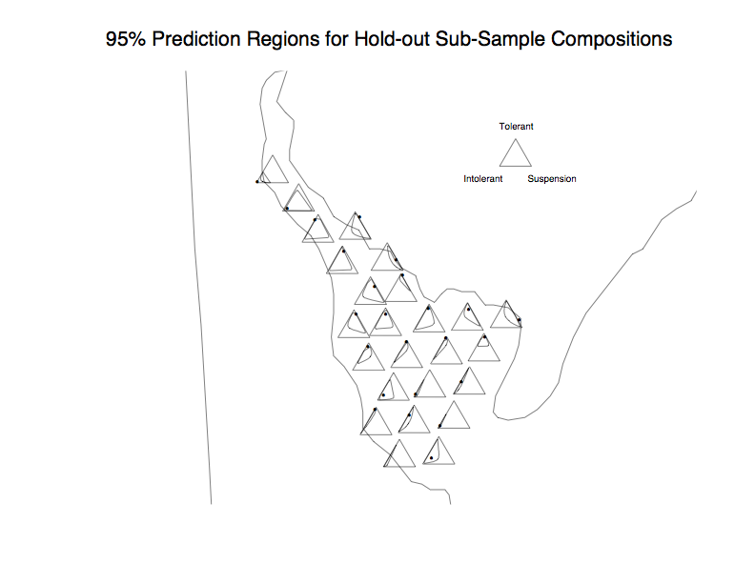

Slide 34
