Slide 1
Nonstationary spatial covariance modeling through spatial deformation
Paul D. Sampson --- Wendy Meiring
Univ of Washington --- U.C. Santa Barbara this presentation derived from that presented at the Pan-American Advanced Study Institute on Spatio-Temporal Statistics
Búzios, RJ, Brazil
June 16-26, 2014

Slide 2
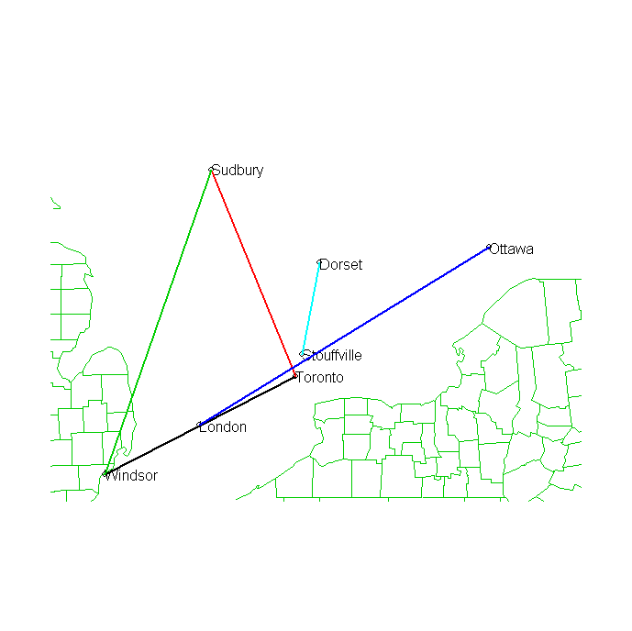
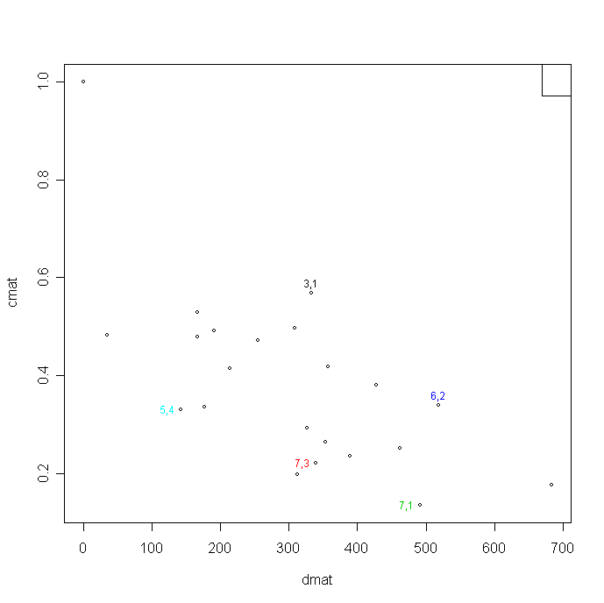
Correlation vs Distance for Ontario Ozone Data
(from Le and Zidek, UBC, Vancouver, CA)
Apparent anisotropy
in this plot of correlation vs distance

Slide 3
Perspective: 1st and 2nd order stationarity is almost never a realistic assumption for any environmental monitoring data, except at small spatial scales.
Objectives for approaches to nonstationary spatial covariance modeling.
Characterizing spatially varying (locally stationary) anisotropic structure.
Scientific understanding/representation of covariance structure—not just a method of providing covariances for kriging.
Capable of:
reflecting effects of known explanatory environmental processes such as transport/wind, topography, point sources
modeling effects of known explanatory environmental processes

Slide 4
Objectives (cont.)
Application to purely spatial problems and/or problems with data sampled irregularly in space and time
Application in context of dynamic models for space-time structure
Application to “large” problems/data sets
Diagnostics for local and large-scale correlation structure:
is the spatial structure “right”
is the nature/degree of nonstationarity (smoothness) right?
Evaluation of uncertainty in estimation (interpolation) of spatial covariance structure
Incorporation in an approach to spatial estimation accounting for uncertainty in estimation of (parameters of) spatial covariance structure

Slide 5
Selected classes of methods:
Spatial deformation models (Sampson & Guttorp, Damian, Perrin, Meiring, Monestiez, Schmidt & O’Hagan, Fouedjio, …)
Process convolution models (Higdon, Swall & Kern, Calder, …; Paciorek & Schervish, Risser & Calder)
Kernel/smoothing methods (Fuentes, …)
Models with covariates (Reich et al., Schmidt et al.)
Basis function methods, including EOF, Karhunen-Loeve, and wavelets (Nychka, Wikle, Pintore & Holmes, …)
MDS-related dimension expansion (Bornn et al.)
See “Constructions for Nonstationary Spatial Processes”, Chap 9 in 2010 Handbook of Spatial Statistics, eds. Gelfand, Diggle, Fuentes, Guttorp.
This week we will review some basics and then present our approaches to spatial deformation models. Next week we will discuss other models with a focus on process convolution models and a new R package for these models.
Note: There is also a spectral approach to nonstationary spatial processes that provides a test for nonstationarity in terms of an assessment of interaction between location and frequency.
Notes:
Note that Nychka’s wavelet method was applied to gridded model output, not irregular monitoring data.
There are also methods derived from EOF analysis common in the atmospheric sciences.

Slide 6
Review: Descriptive characteristics of (stationary) spatial covariance expressed in a variogram
The spherical correlation
Corresponding variogram
nugget
sill
range

Slide 7
Geometric anisotropy
If we have an isotropic covariance (circular isocorrelation curves).
If for a linear transformation A, we have geometric anisotropy (elliptical isocorrelation curves).
General nonstationary correlation structures are typically locally geometrically anisotropic.

Slide 8
Nonstationary spatial covariance:
Basic idea: the parameters of a local variogram model---nugget, range, sill, and anisotropy---vary spatially.
Look at some pictures of applications from methodology publications.

Slide 9
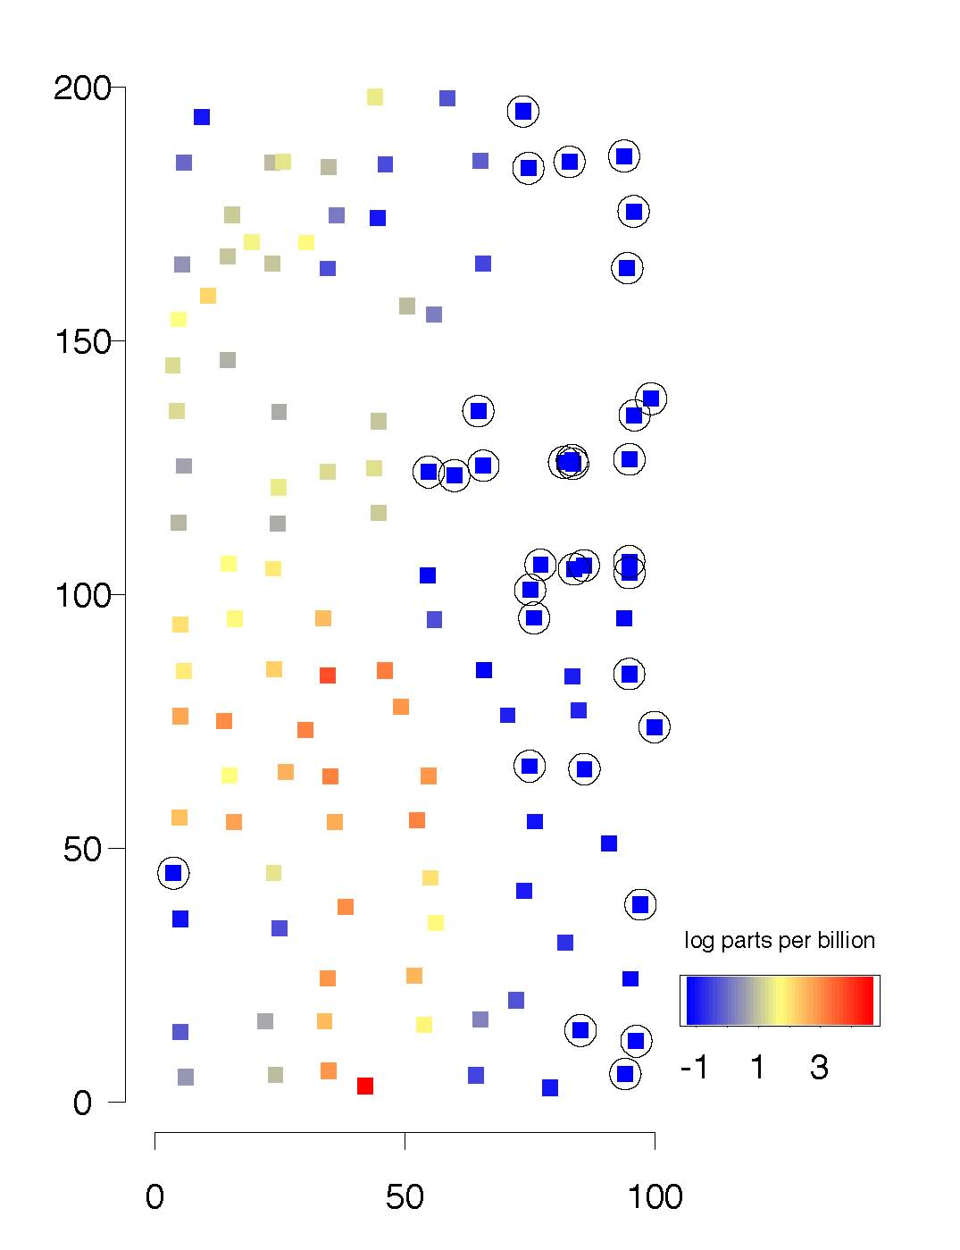
Swall & Higdon. Process convolution approach,
Soil contamination example --- Piazza Rd site.

Slide 10
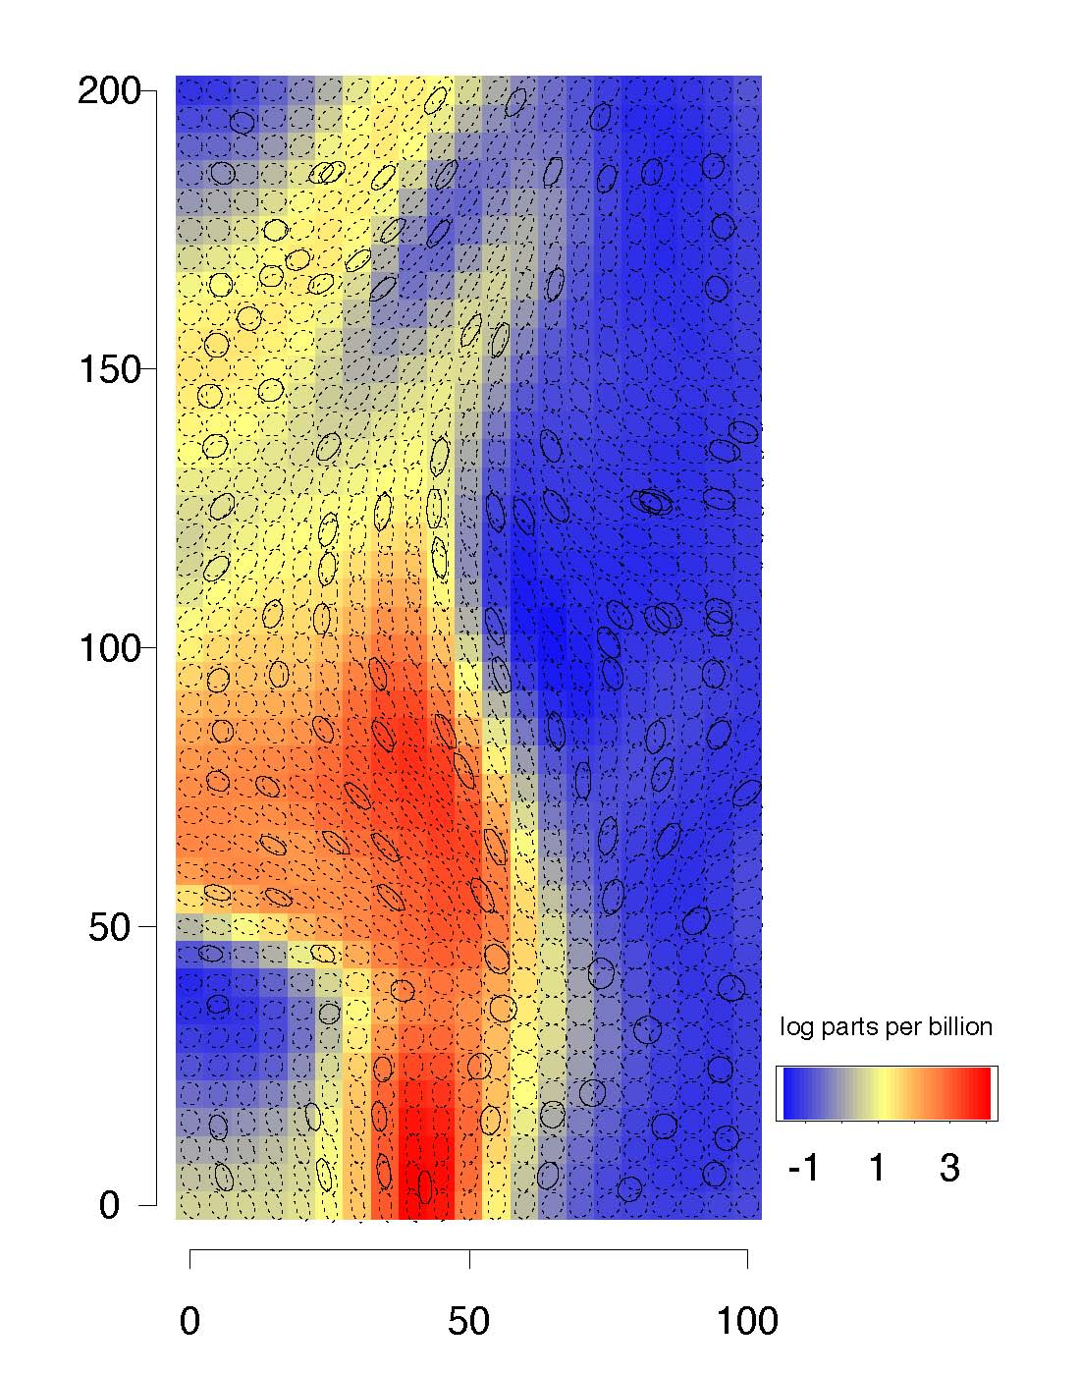
Swall & Higdon. Process convolution approach,
Posterior mean and covariance kernel ellipses.

Slide 11
Paciorek & Schervish, 2006 –
Colorado 1981 annual precip (log)

Slide 12
Paciorek & Schervish, 2006 – kernels (ellipses of constant Gaussian density) representing estimated correlation structure

Slide 13
The deformation idea
In the geometric anisotropic case, write
where f(x) = Ax. This suggests using a general nonlinear transformation
“G-plane” → “D-space”
Usually d = 2 or 3.
We do not want f to fold.
Remark: Originally introduced as a multidimensional scaling problem: find Euclidean representation with intersite distances monotone in spatial dispersion, D(x,y)

Slide 14
Space-time Model with Spatial Deformation
Damian et al., 2000 (Environmetrics), 2003 (Journal of Geophysical Research)

Slide 15
Model (cont.)
i.e. The correlation structure of the spatial process is an (isotropic) function of Euclidean distances between site locations after a bijective transformation of the geographic coordinate system.

Slide 16
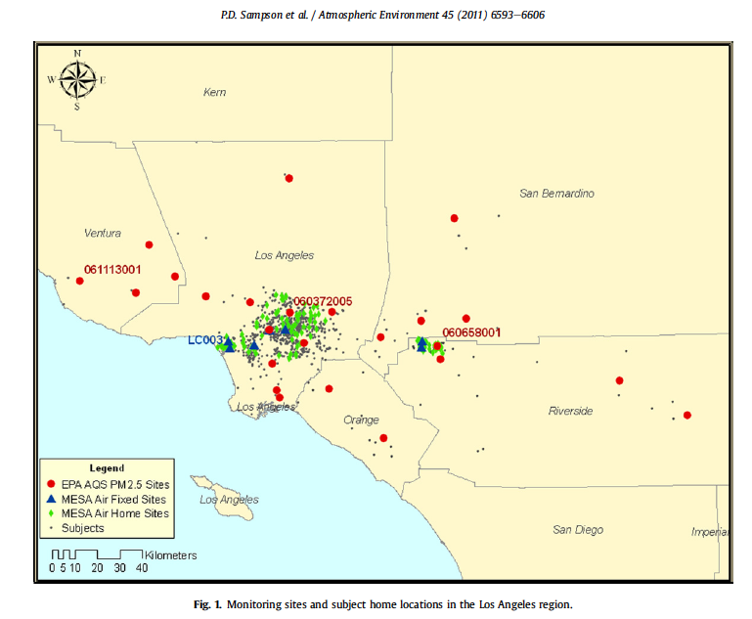

Slide 17
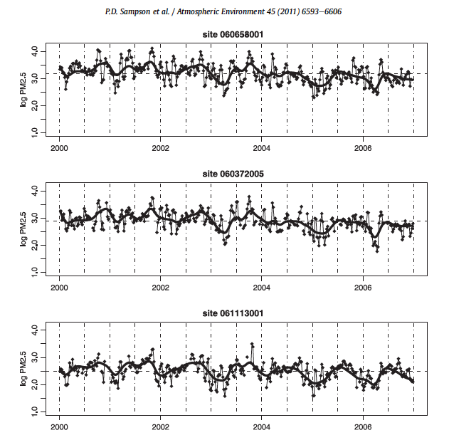

Slide 18
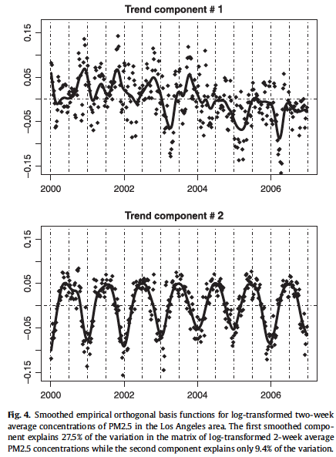

Slide 19
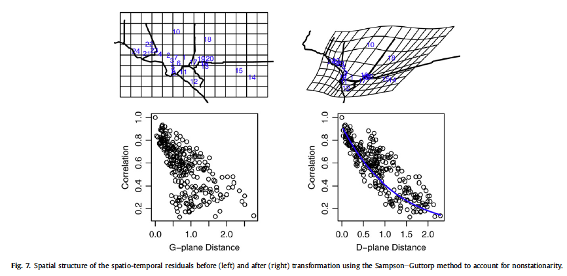

Slide 20
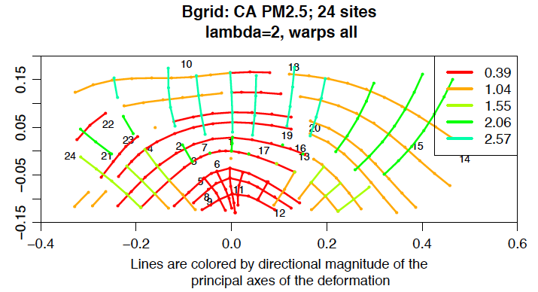
An alternative to a gridded map of ellipsoids for local anisotropy is a “biorthogonal grid” which integrates the principal axes of the local affine derivative of the deformation.

Slide 21
Back to the model:
The spatial deformation f encodes the nonstationarity: spatially varying local anisotropy.
We model this in terms of observation sites as a pair of thin-plate splines:
Linear part: global/large scale anisotropy
Non-linear part, decomposable into components of varying spatial scale:
Lots of model parameters!

Slide 22
More on the equations of the thin-plate spline

Slide 23
Theoretical properties of the deformation model
Identifiability
Perrin and Meiring (1999): Let
If (1) and are differentiable in R^{n}
(2) is differentiable for u > 0
then is unique, up to a scaling for
and a homothetic transformation for
(rotation, scaling, reflection)
Notes:
Note: All nonstationary spatial correlation structures of practical interest are not included in this class of models (we’ll return to limitations later), but it is important that we have the following property established.

Slide 24
Implementation 1. Weighted least squares
Consider observations at sites x₁, ...,x_{n}. Let
be the empirical covariance between sites x_{i} and x_{j}. Minimize
where J(f) is a penalty for non-smooth transformations, such as the bending energy
When f is computed as a thin-plate spline, the minimization above can be considered in terms of the deformed coordinates, , or the parameters of the analytic representation of the thin-plate spline,

Slide 25
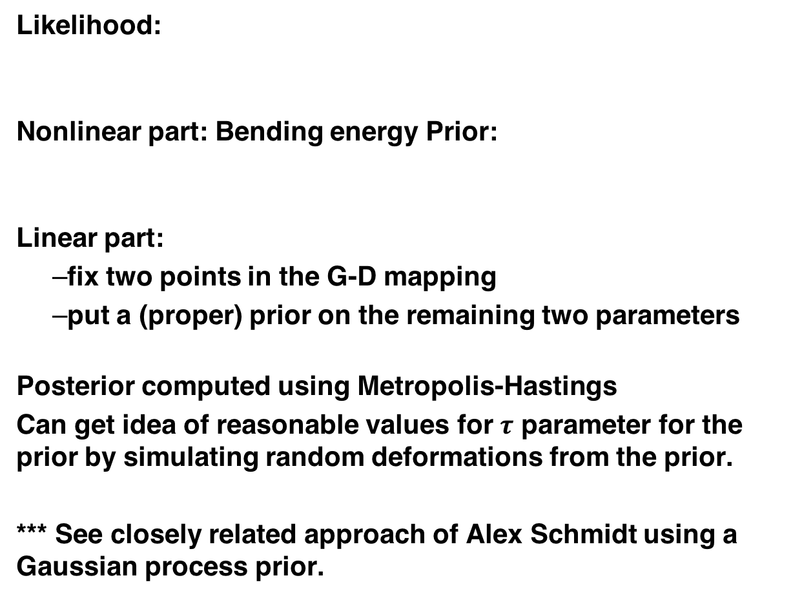
Implementation 2. Bayesian
Likelihood:
Nonlinear part: Bending energy Prior:
Linear part:
  fix two points in the G-D mapping
  put a (proper) prior on the remaining two parameters
Posterior computed using Metropolis-Hastings
Can get idea of reasonable values for $τ$ parameter for the prior by simulating random deformations from the prior.
*** See closely related approach of Alex Schmidt using a Gaussian process prior.

Slide 26
Computation
Metropolis-Hastings algorithm for sampling from the highly multidimensional posterior. (Naïve implementation not very well behaved due to correlation among a very large number of parameters.)
Given estimates of D-plane locations, f(x_{i}), the transformation is extrapolated to the whole domain using thin-plate splines. (Visualization and diagnostics.)
Predictive distributions for
(a) temporal variance at unobserved sites,
(b) the spatial covariance for pairs of observed and/or unobserved sites,
(c) the observation process at unobserved sites.

Slide 27
Problems with the WLS and Bayesian computational approaches
There are serious practical problems with the approaches to deformation mapping presented here.
They are computationally intensive, involving constrained or regularized optimization of approximately 2 parameters per spatial monitoring site. Large problems are not practical.
Whether parameterized in terms of the coefficients W of the radial basis functions (d² log d), or the coordinates of the D-plane representation,
the WLS or likelihood objective functions are likely to have multiple local maxima,
in the case of Bayesian estimation by MCMC, the parameters are highly correlated, making convergence of the Markov Chain problematic

Slide 28
Implementation 3. Reduced rank thin-plate spline mappings via partial warps
A more efficient and practical approach is to
reparameterize the spline in terms of coefficients of a set of orthogonal spatial basis functions
reduce the dimension of the problem by selecting/fitting a subset of the basis functions. We do this using an L1 penalty (instead of the TPS bending energy).
Thin-plate spline deformations were introduced in morphometrics (shape analysis) by Bookstein (1986), where he also proposed the decomposition of deformations (warps) according to “principal warps” derived from eigenvectors of the bending energy matrix.

Slide 29
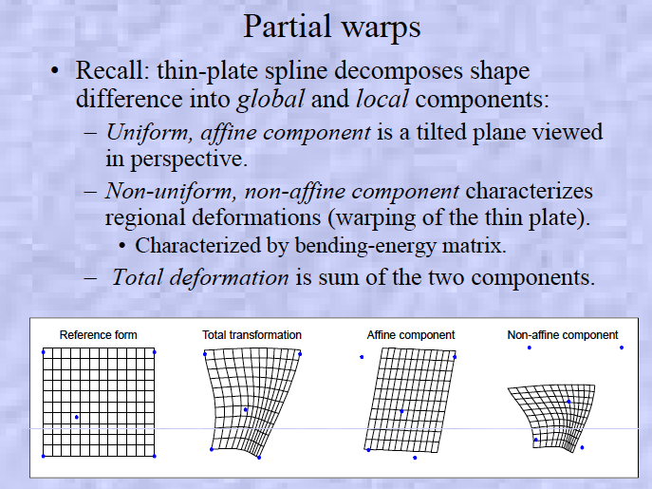

Slide 30
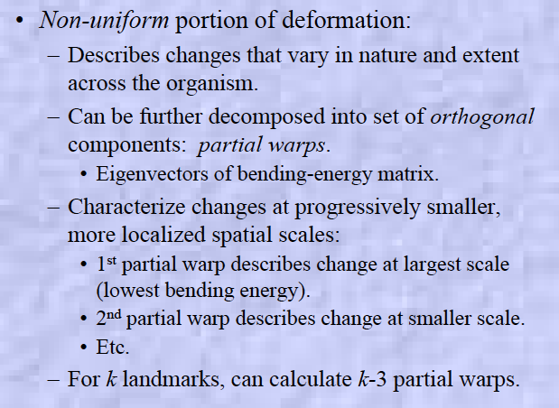

Slide 31
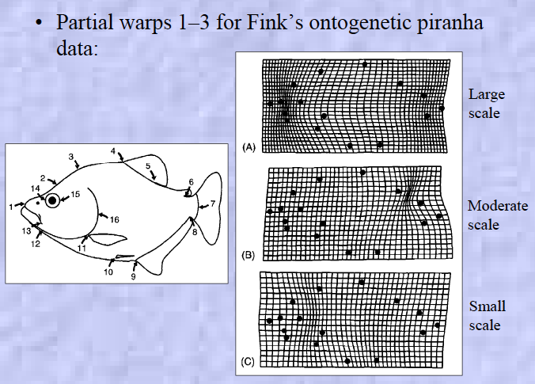

Slide 32
Recall the algebra of thin-plate splines, driven by the the matrix containing the terms
Partial warps can be computed as follows:
Compute the upper n x n component of the inverse of the
“ “ matrix of the system of linear equations of the thin-
plate spline. This is the bending energy matrix B.
Compute the eigenvectors of B, the principal warps,
Partial warps are linear combinations of of these (spatial) eigenvectors, , where is a 2-vector of coefficients for the elements of the 2D mapping.
The image coordinates for the thin-plate spline in terms of partial warps is
where

Slide 33
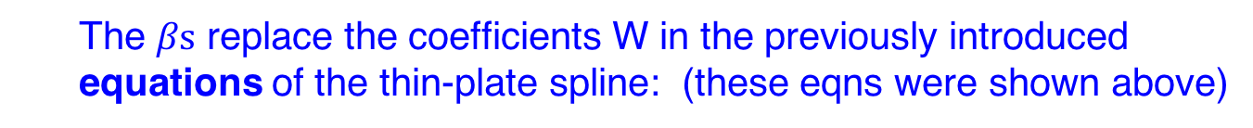
The $βs$ replace the coefficients W in the previously introduced equations of the thin-plate spline: (these eqns were shown above)

Slide 34
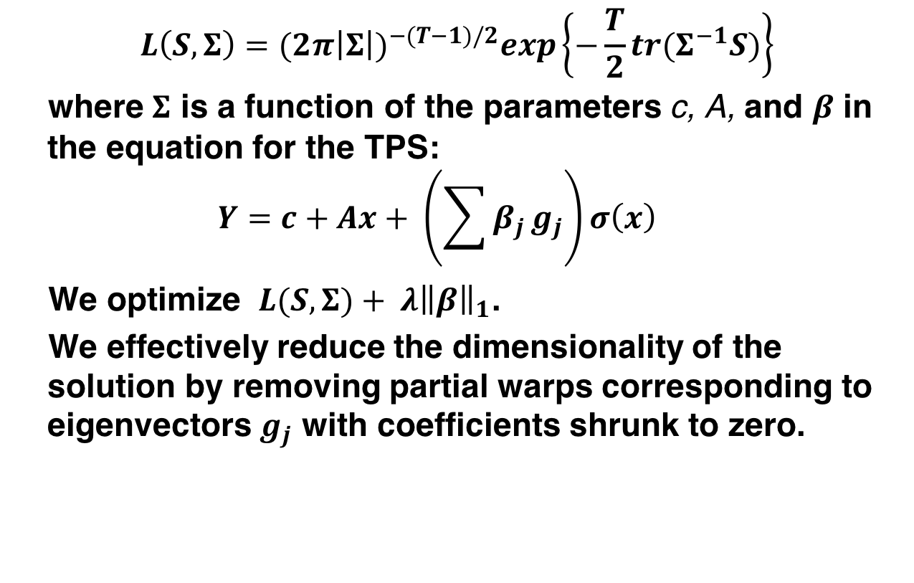
Implementation 3. Reduced rank thin-plate spline mappings via partial warps
$$L\left(S,Σ\right)=(2π{\left|Σ\right|)}^{−(T−1)/2}exp\left\{−\frac{T}{2}tr(Σ^{−1}S)\right\}$$
where $Σ$ is a function of the parameters c, A, and $β$ in the equation for the TPS:
$$Y=c+Ax+ \left(\sum{β_{j}}g_{j}\right)σ\left(x\right)$$
We optimize $L(S,Σ)+ λ{\left\|β\right\|}_{1}$.
We effectively reduce the dimensionality of the solution by removing partial warps corresponding to eigenvectors $g_{j}$ with coefficients shrunk to zero.

Slide 35
Following are a series of plots to illustrate
the definition of the eigenvectors of the bending energy matrix for a configuration of 7 points
Affine and partial warps corresponding to the above eigenvectors, with each warp illustrated
  for deformations in the ‘x’ and ‘y’ directions separately, and
  for two different coefficient multipliers (‘scale’)

Slide 36
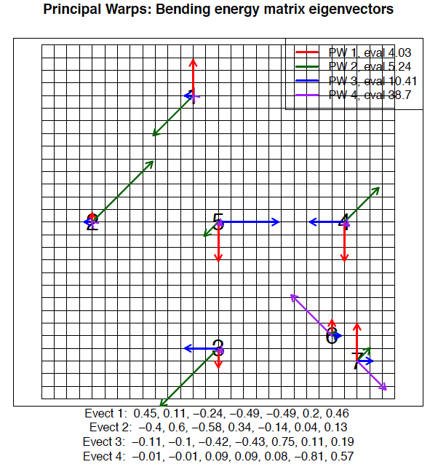

Slide 37
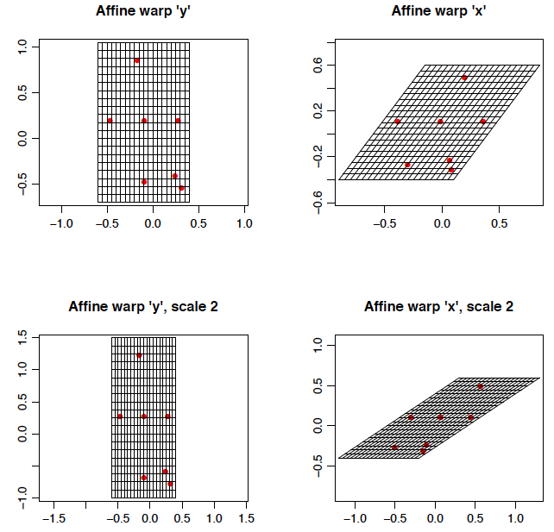

Slide 38
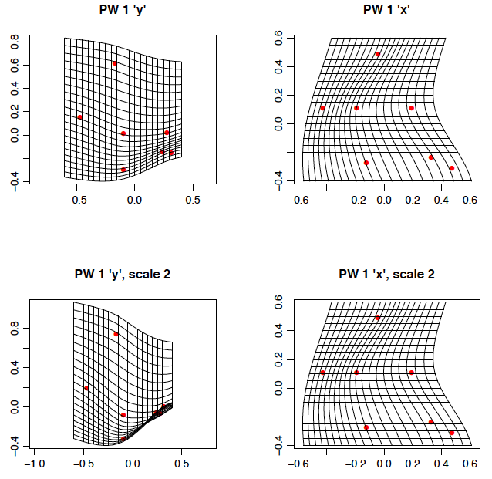

Slide 39
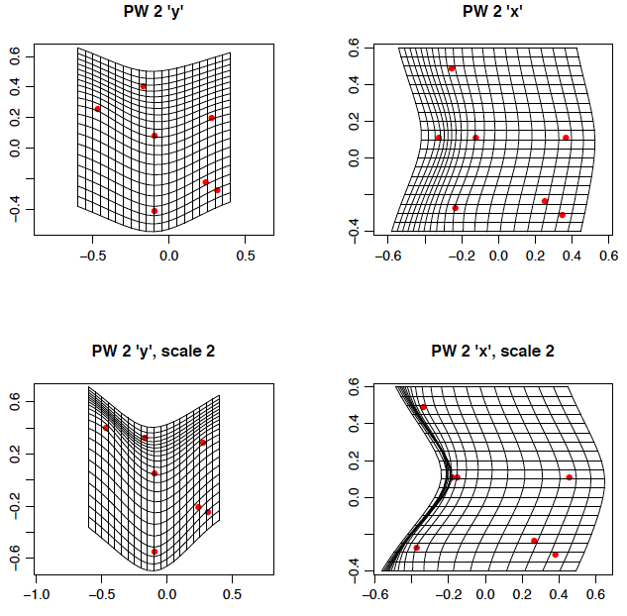

Slide 40
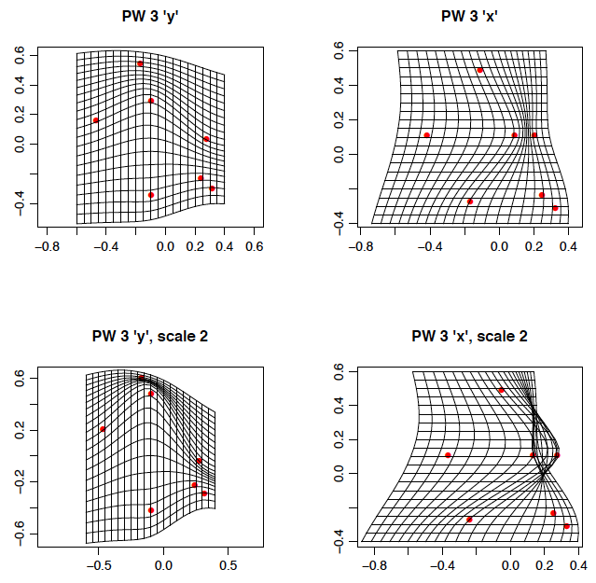

Slide 41
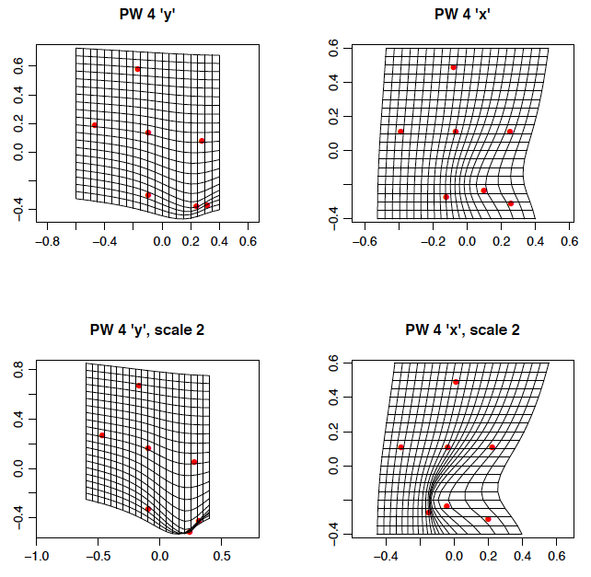

Slide 42
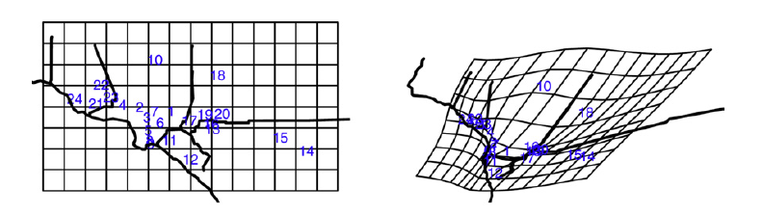
Return to the application to PM2.5 data at 24 sites in the region of southern CA around Los Angeles and Riverside. Analysis based on time series of about 150 2-week average concentrations from 2000 through 2006.
We illustrate below the fitted deformation and spatial correlation function based on maximum likelihood with an L1 constraint chosen ‘by eye’. First, the fit in the published paper computed (with great effort!) by the Bayesian algorithm

Slide 43
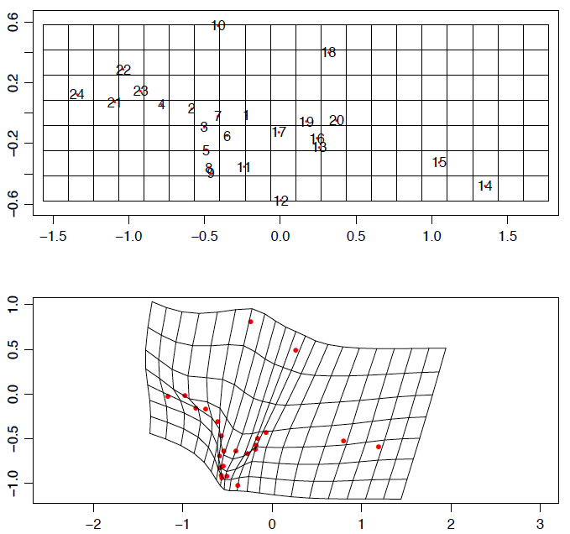

Slide 44
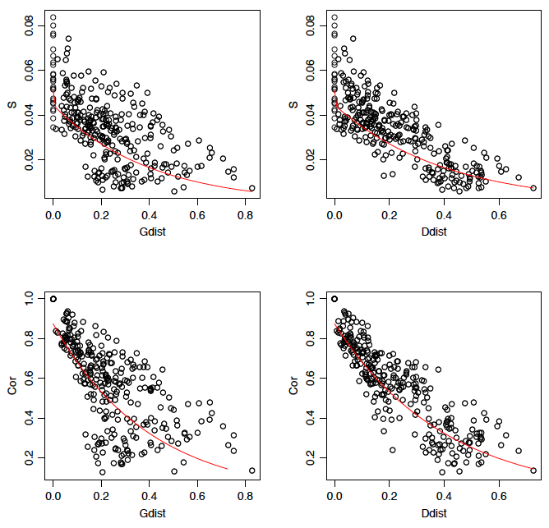
Covariance (top) and Correlation (bottom) vs.
G-plane dist (left) and
D-plane dist (right)

Slide 45
Examine the decomposition of the fitted deformation in terms of partial warps and the effect of the L1 penalty in zeroing out any contributions from all the higher bending energy (smaller spatial scale) warps.

Slide 46
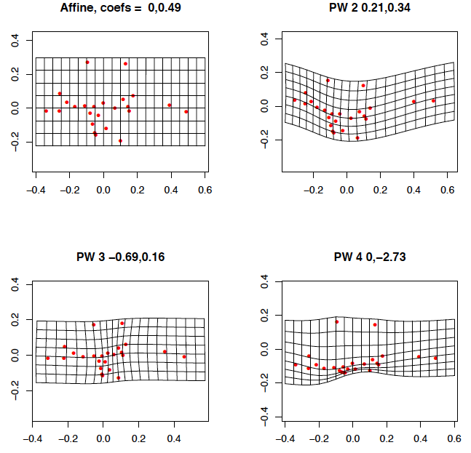

Slide 47
Among work to be considered:
Work to be done to facilitate choice of parameter for the L1 penalty, possibly in a Bayesian framework.
Incorporate this deformation model in a full spatio-temporal model with mean structure.
Further investigate and demonstrate the application to spatial only problems.
Incorporate covariate in the partial warp modeling.

Slide 48
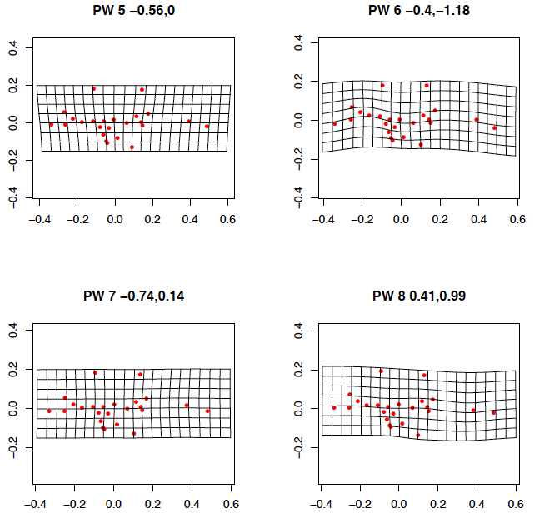

Slide 49
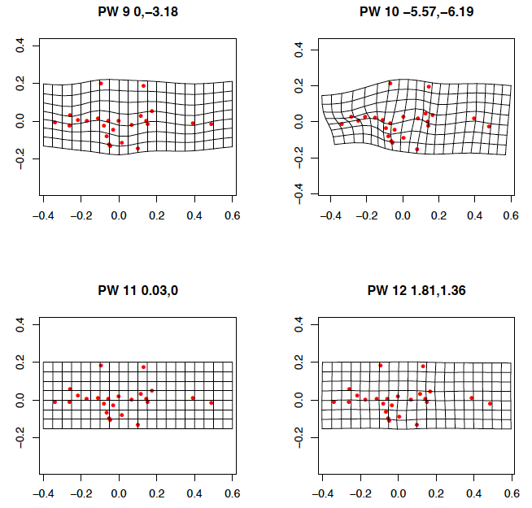

Slide 50
