Slide 1
Nonstationary spatial process modeling
Part II
Paul D. Sampson --- Catherine Calder
Univ of Washington --- Ohio State University this presentation derived from that presented at the Pan-American Advanced Study Institute on Spatio-Temporal Statistics
Búzios, RJ, Brazil
June 16-26, 2014

Slide 14
If the kernels k_{s}(u) are of fixed shape, such as Gaussian kernels varying only in location, the covariance is stationary, a function only of |s₁-s₂ |.
If the parameters of the kernels, such as orientation and anisotropy of elliptical contours, vary in space, we have a nonstationary model.

Slide 18
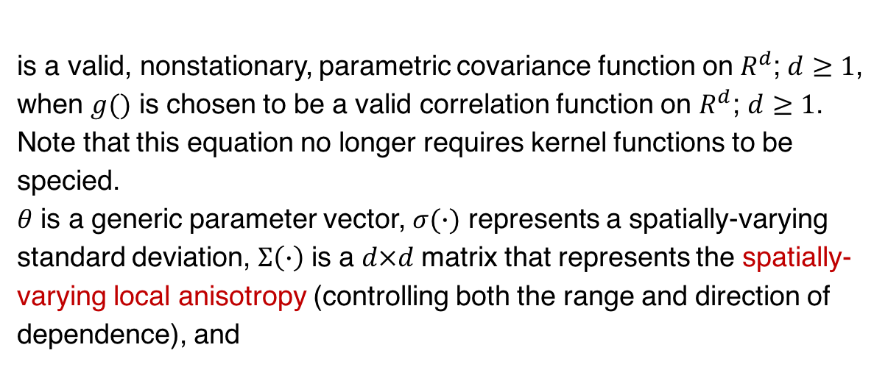
Nonstationary Models II
A famous result (Thiebaux 1976; Thiebaux and Pedder 1987) uses a parametric class of Gaussian kernel functions in Equation 2 to give a closed-form covariance function; this result was later extended (Paciorek 2003; Paciorek and Schervish 2006; Stein 2005) to show that
is a valid, nonstationary, parametric covariance function on$R^{d}$; $d≥1$, when $g()$ is chosen to be a valid correlation function on $R^{d}$; $d≥1$.
Note that this equation no longer requires kernel functions to be specied.
$θ$ is a generic parameter vector, $σ(∙)$ represents a spatially-varying standard deviation, $Σ\left(∙\right)$ is a $d×d$matrix that represents the spatially-varying local anisotropy (controlling both the range and direction of dependence), and

Slide 19
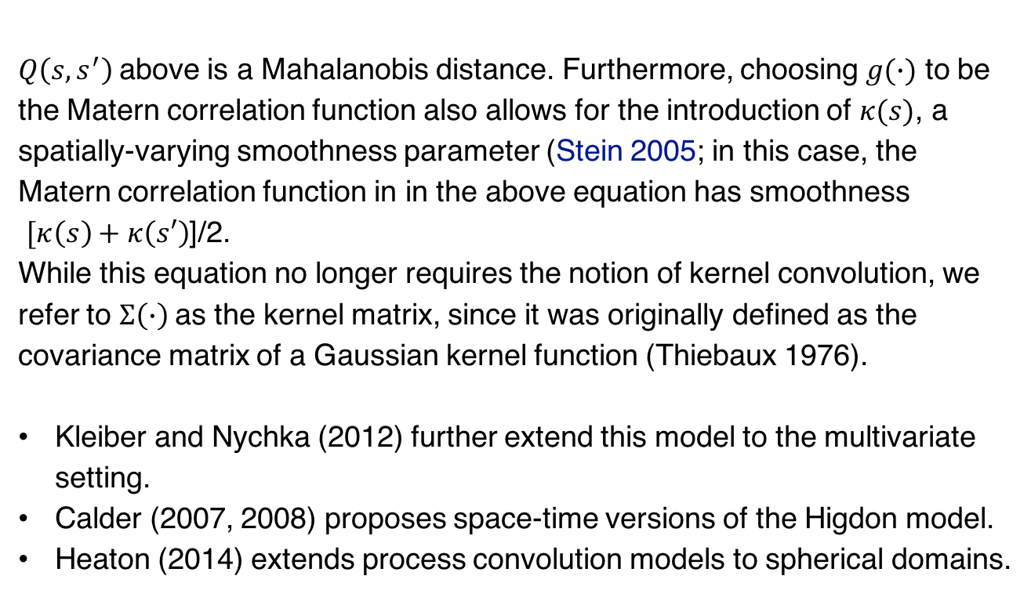
Nonstationary Models II
$Q\left(s,s^{′}\right)$above is a Mahalanobis distance. Furthermore, choosing $g(∙)$ to be the Matern correlation function also allows for the introduction of $κ(s)$, a spatially-varying smoothness parameter (Stein 2005; in this case, the Matern correlation function in in the above equation has smoothness
$[κ\left(s\right)+κ\left(s′\right)$]/2.
While this equation no longer requires the notion of kernel convolution, we refer to $Σ\left(∙\right)$as the kernel matrix, since it was originally defined as the covariance matrix of a Gaussian kernel function (Thiebaux 1976).
Kleiber and Nychka (2012) further extend this model to the multivariate setting.
Calder (2007, 2008) proposes space-time versions of the Higdon model.
Heaton (2014) extends process convolution models to spherical domains.

Slide 21
Nonstationary Models II
To appear in the Journal of Statistical Software:
Local Likelihood Estimation for Covariance Functions with Spatially-Varying Parameters: The convoSPAT Package for R
Mark D. Risser
Catherine A. Calder

Slide 22
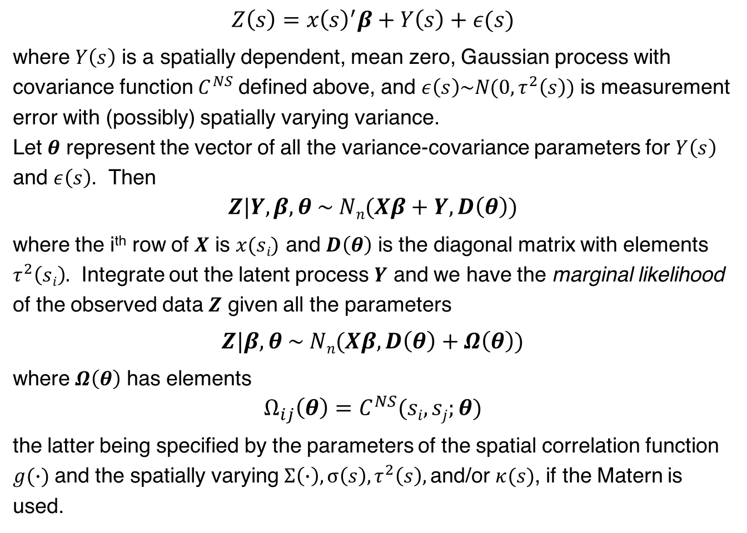
Nonstationary Models II
$$Z\left(s\right)=x{\left(s\right)}^{′}β+Y\left(s\right)+ε(s)$$
where $Y\left(s\right)$ is a spatially dependent, mean zero, Gaussian process with covariance function $C^{NS}$ defined above, and $ε\left(s\right)\sim N(0,τ^{2}\left(s\right))$ is measurement error with (possibly) spatially varying variance.
Let $θ$ represent the vector of all the variance-covariance parameters for $Y\left(s\right)$ and $ε\left(s\right)$. Then
$$Z|Y,β,θ \sim Nn(Xβ+Y,D\left(θ\right))$$
where the i^{th} row of $X$ is $x(si)$ and $D\left(θ\right)$ is the diagonal matrix with elements $τ^{2}\left(si\right).$ Integrate out the latent process $Y$ and we have the marginal likelihood of the observed data $Z$ given all the parameters
$$Z|β,θ \sim Nn(Xβ,D\left(θ\right)+Ω\left(θ\right))$$
where $Ω\left(θ\right)$ has elements
$$Ω_{ij}\left(θ\right)=C^{NS}(si,sj;θ)$$
the latter being specified by the parameters of the spatial correlation function $g(∙)$ and the spatially varying $Σ\left(∙\right), σ\left(s\right), τ^{2}\left(s\right),$and/or $κ(s)$, if the Matern is used.

Slide 23
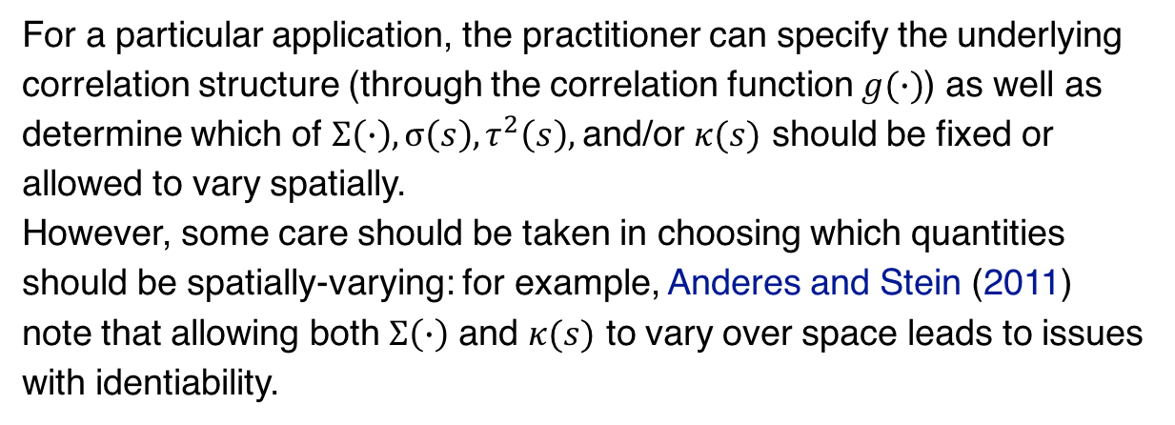
For a particular application, the practitioner can specify the underlying correlation structure (through the correlation function $g(∙)$) as well as determine which of $Σ\left(∙\right), σ\left(s\right), τ^{2}\left(s\right),$and/or $κ(s)$ should be fixed or allowed to vary spatially.
However, some care should be taken in choosing which quantities should be spatially-varying: for example, Anderes and Stein (2011) note that allowing both $Σ\left(∙\right)$ and $κ(s)$ to vary over space leads to issues with identiability.

Slide 24
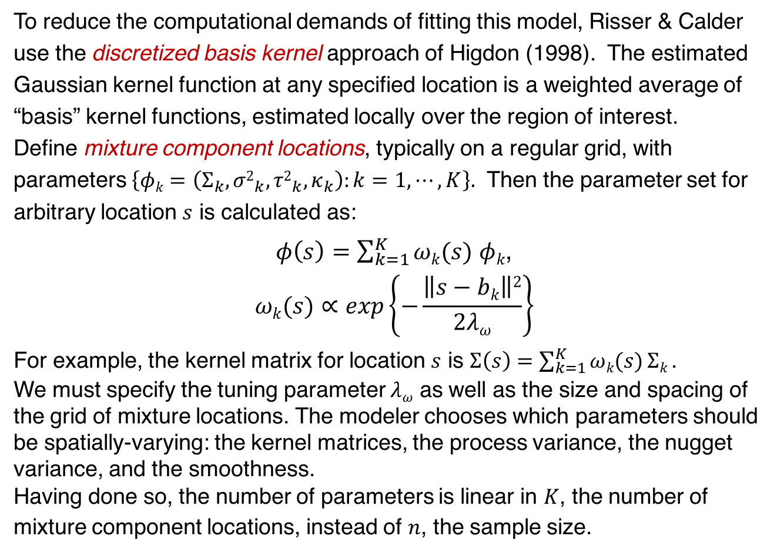
Nonstationary Models II
To reduce the computational demands of fitting this model, Risser & Calder use the discretized basis kernel approach of Higdon (1998). The estimated Gaussian kernel function at any specified location is a weighted average of “basis” kernel functions, estimated locally over the region of interest.
Define mixture component locations, typically on a regular grid, with parameters $\left\{φk=\left(Σ_{k},{σ2}_{k},{τ2}_{k},κ_{k}\right):k=1,⋯,K\right\}.$ Then the parameter set for arbitrary location $s$ is calculated as:
$φ\left(s\right)=\sum_{k=1}^{K}{ωk(s)}$ $φk$,
$$ωk(s)∝exp\left\{−\frac{\left\|s−bk\right\|2}{2λω}\right\}$$
For example, the kernel matrix for location $s$ is $Σ\left(s\right)=\sum_{k=1}^{K}{ωk(s)}Σk$.
We must specify the tuning parameter $λω$ as well as the size and spacing of the grid of mixture locations. The modeler chooses which parameters should be spatially-varying: the kernel matrices, the process variance, the nugget variance, and the smoothness.
Having done so, the number of parameters is linear in $K$, the number of mixture component locations, instead of $n$, the sample size.

Slide 25
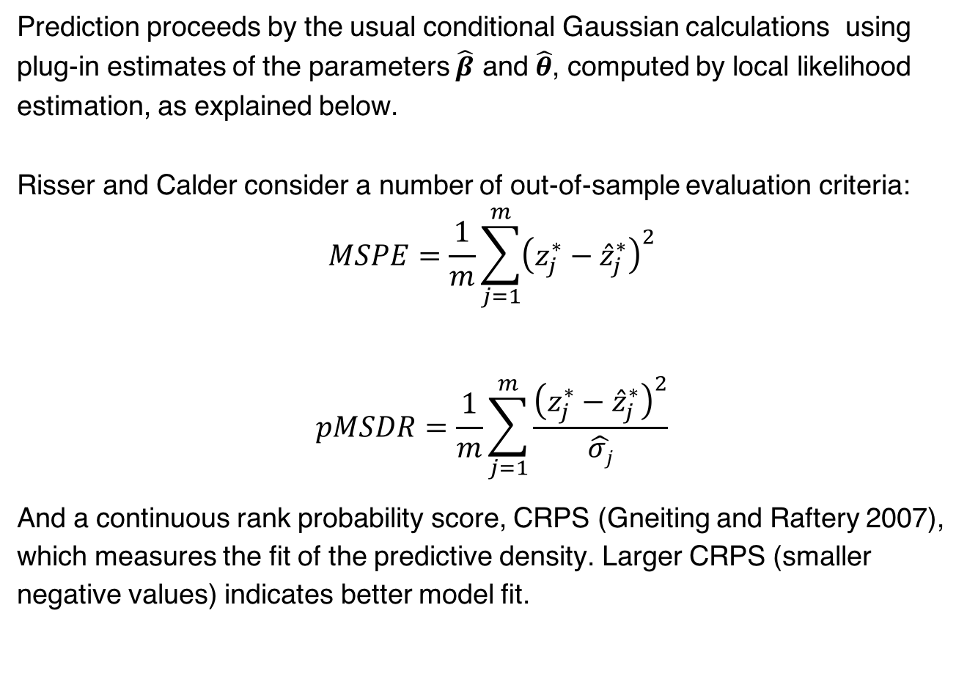
Nonstationary Models II
Prediction proceeds by the usual conditional Gaussian calculations using plug-in estimates of the parameters $\hat{β}$ and $\hat{θ}$, computed by local likelihood estimation, as explained below.
Risser and Calder consider a number of out-of-sample evaluation criteria:
$$MSPE=\frac{1}{m}\sum_{j=1}^{m}{{\left(z_{j}^{∗}−{\hat{z}}_{j}^{∗}\right)}^{2}}$$
$$pMSDR=\frac{1}{m}\sum_{j=1}^{m}{\frac{{\left(z_{j}^{∗}−{\hat{z}}_{j}^{∗}\right)}^{2}}{\hat{σj}}}$$
And a continuous rank probability score, CRPS (Gneiting and Raftery 2007), which measures the fit of the predictive density. Larger CRPS (smaller negative values) indicates better model fit.

Slide 26
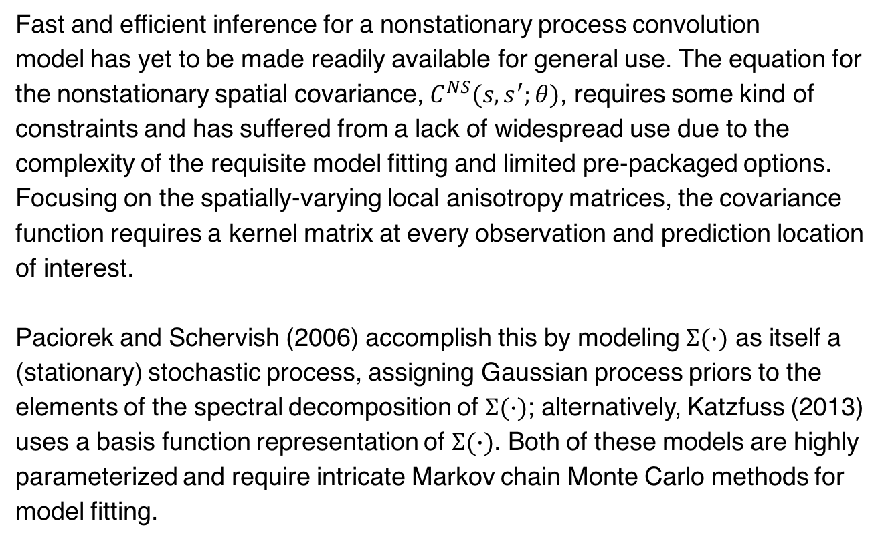
Nonstationary Models II
Computationally efficient inference.
Fast and efficient inference for a nonstationary process convolution
model has yet to be made readily available for general use. The equation for the nonstationary spatial covariance, $C^{NS}(s,s^{′};θ)$, requires some kind of constraints and has suffered from a lack of widespread use due to the complexity of the requisite model fitting and limited pre-packaged options. Focusing on the spatially-varying local anisotropy matrices, the covariance function requires a kernel matrix at every observation and prediction location of interest.
Paciorek and Schervish (2006) accomplish this by modeling $Σ(∙)$ as itself a (stationary) stochastic process, assigning Gaussian process priors to the elements of the spectral decomposition of $Σ(∙)$; alternatively, Katzfuss (2013) uses a basis function representation of $Σ(∙)$. Both of these models are highly parameterized and require intricate Markov chain Monte Carlo methods for model fitting.

Slide 27
Nonstationary Models II
Computationally efficient inference.
Risser and Calder achieve computational efficiency using
(1) the discrete mixture representation above, and its requisite specification of the size/spacing of the basis grid, and the tuning parameter for the weight function, and
(2) the idea of using local likelihood estimation (Tibshirani and Hastie, 1987), rather than aim to optimize the full log-likelihood.

Slide 28
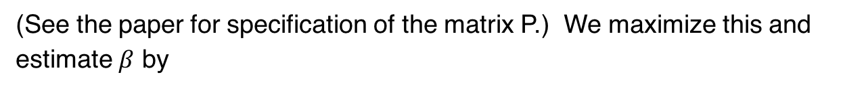
Nonstationary Models II
Computationally efficient inference.
First, recall REML estimation. The full log likelihood is
The “restricted” log likelihood (based on “n-p” linear combinations having expected value zero for all possible parameter values, can be written.
(See the paper for specification of the matrix P.) We maximize this and estimate $β$ by

Slide 29
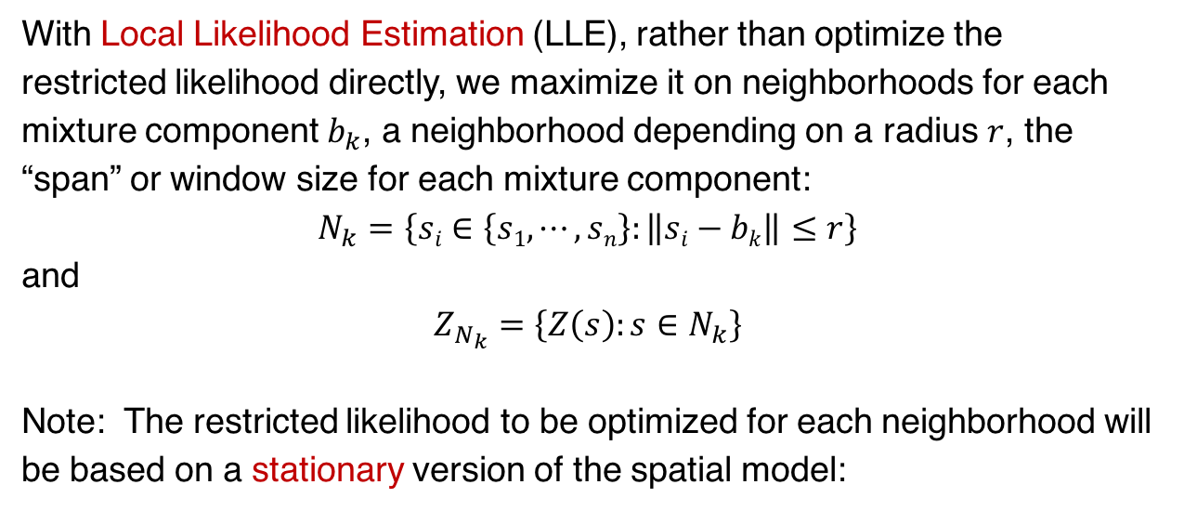
Nonstationary Models II
Computationally efficient inference.
With Local Likelihood Estimation (LLE), rather than optimize the restricted likelihood directly, we maximize it on neighborhoods for each mixture component $b_{k}$, a neighborhood depending on a radius $r$, the “span” or window size for each mixture component:
$$N_{k}=\left\{si∈\left\{s1,⋯,sn\right\}:\left\|si−bk\right\|≤r\right\}$$
and
$$Z_{N_{k}}=\left\{Z\left(s\right):s∈N_{k}\right\}$$
Note: The restricted likelihood to be optimized for each neighborhood will be based on a stationary version of the spatial model:
where $\tilde{Y}$ is a stationary process with covariance function

Slide 30
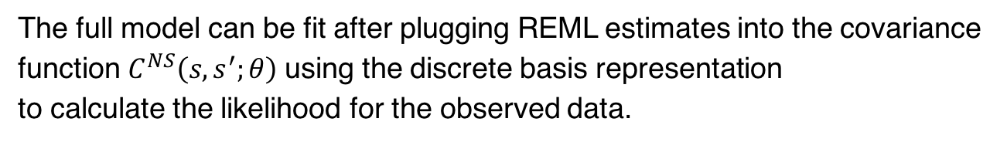
Nonstationary Models II
Computationally efficient inference.
Note: The kernel matrices are parameterized in terms of of the eigenvalues and angle of rotation of its spectral decomposition
The full model can be fit after plugging REML estimates into the covariance function $C^{NS}\left(s,s^{′};θ\right)$using the discrete basis representation
to calculate the likelihood for the observed data.

Slide 31
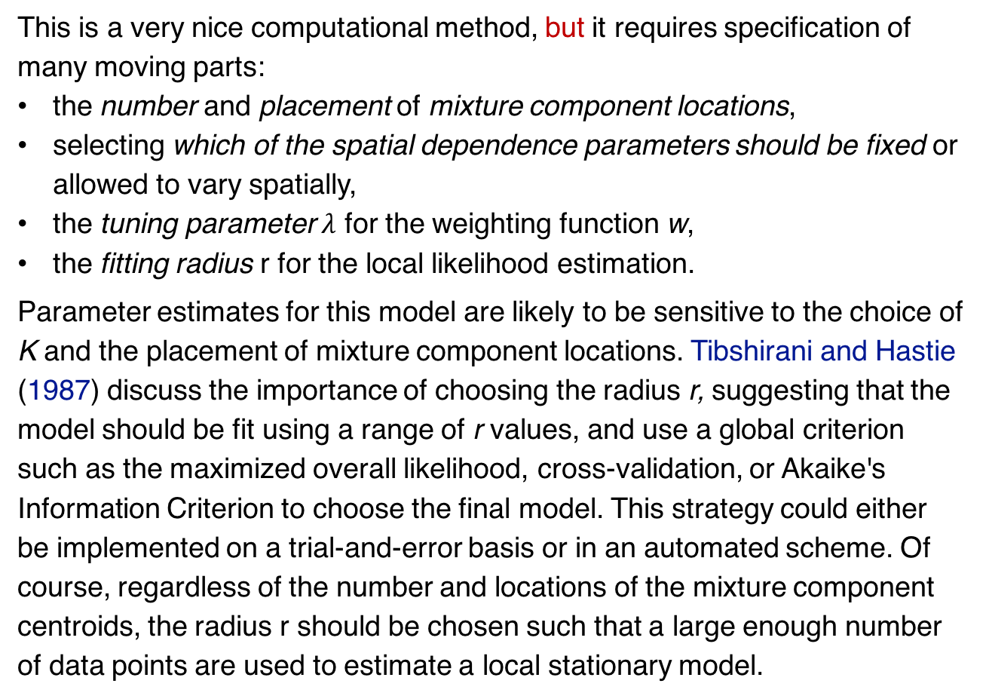
Nonstationary Models II
Computationally efficient inference.
This is a very nice computational method, but it requires specification of many moving parts:
the number and placement of mixture component locations,
selecting which of the spatial dependence parameters should be fixed or allowed to vary spatially,
the tuning parameter $λ$ for the weighting function w,
the fitting radius r for the local likelihood estimation.
Parameter estimates for this model are likely to be sensitive to the choice of K and the placement of mixture component locations. Tibshirani and Hastie (1987) discuss the importance of choosing the radius r, suggesting that the model should be fit using a range of r values, and use a global criterion such as the maximized overall likelihood, cross-validation, or Akaike's Information Criterion to choose the final model. This strategy could either be implemented on a trial-and-error basis or in an automated scheme. Of course, regardless of the number and locations of the mixture component centroids, the radius r should be chosen such that a large enough number of data points are used to estimate a local stationary model.

Slide 32
The convoSPAT package for R

