Slide 1
Space-Time Modeling Part I this presentation borrows from presentations of Catherine Calder, Peter Guttorp, Johan Lindstrom, and Paul Sampson

Slide 2
Space-Time Modeling
Important resources to which we will give little attention. Any one of these could provide the basis for a full course.

Slide 3
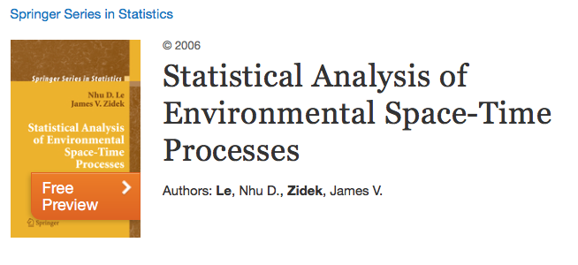
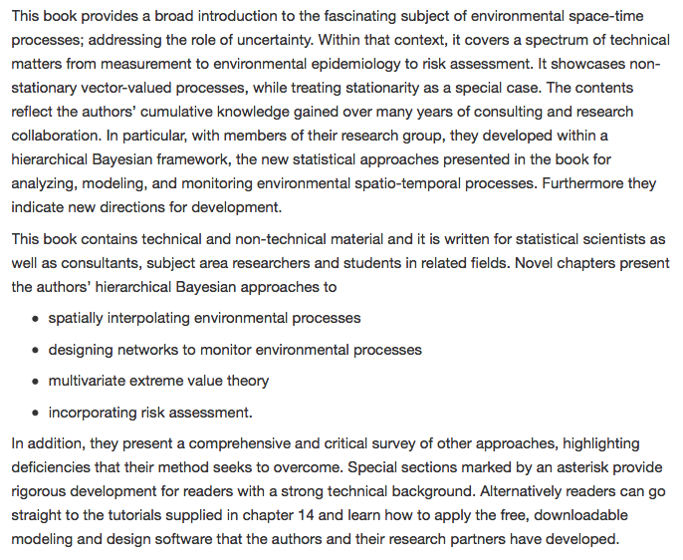
2006
R package: EnviroStat
Tutorial: Chap 14

Slide 4
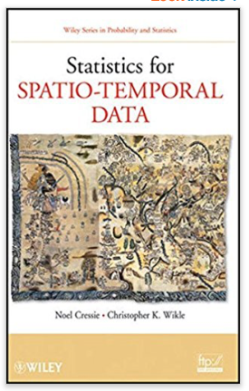
2011

Slide 5
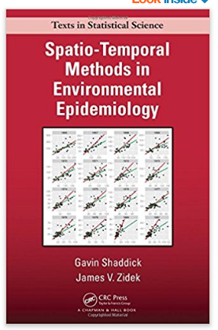
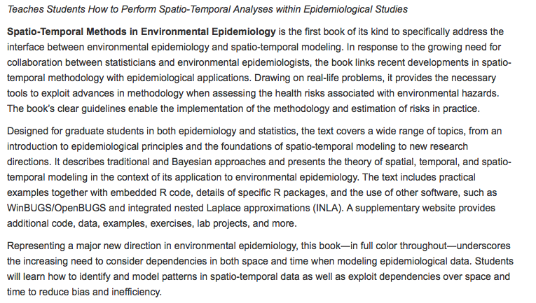
20015
Many resources available at
https://www.stat.ubc.ca/~gavin/STEPIBookNewStyle/

Slide 6
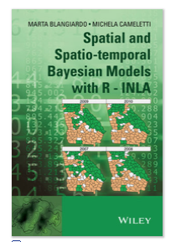
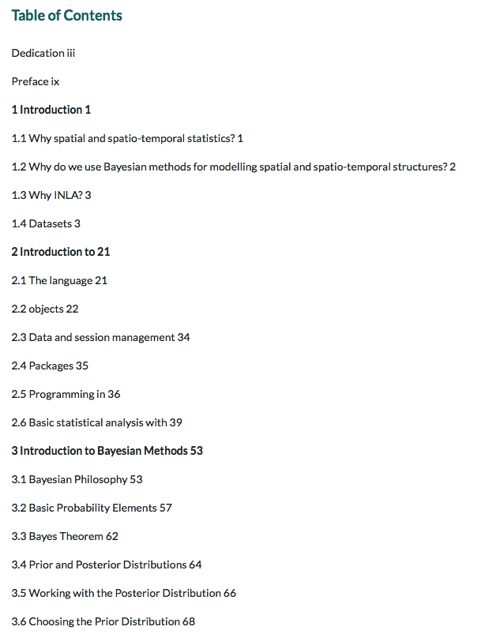
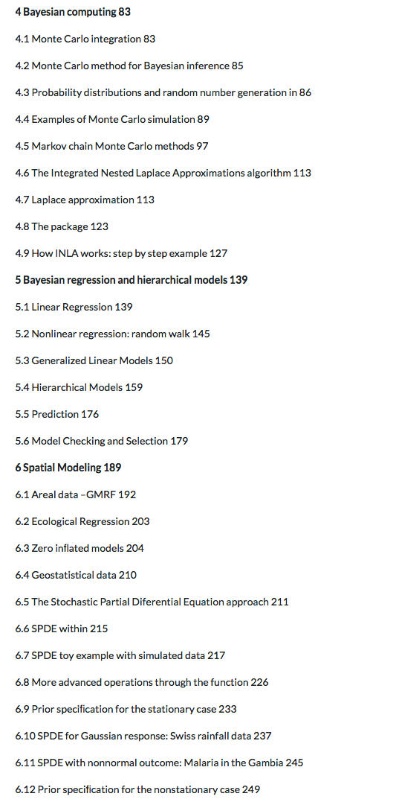
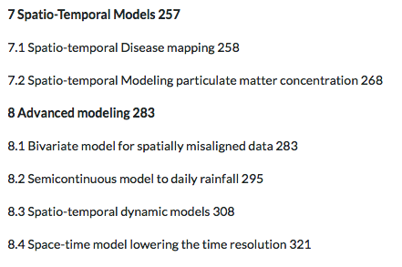
2015

Slide 7
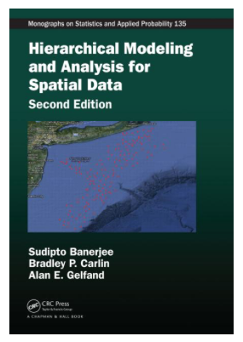
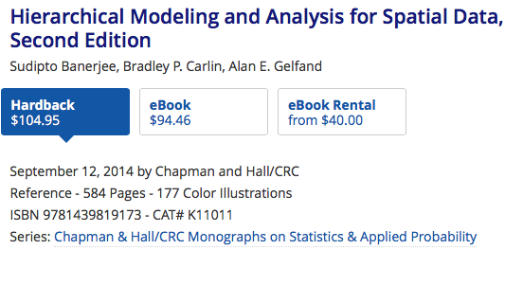
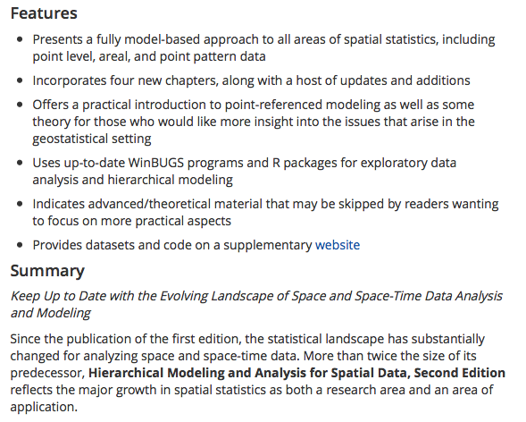
2014, 2nd edition
R package: spBayes

Slide 8
2017
RESeau Statistiques pour données Spatio-Temporelles
http://informatique-mia.inra.fr/resste/

Slide 9
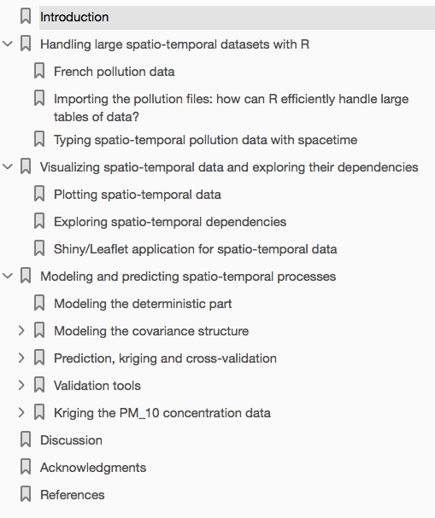

Slide 28
G&S 1989 Deformation model analysis

Slide 30
Evidence of asymmetry

