Slide 1



Spatio-temporal Modeling of Environmental Data for Epidemiologic Health Effects Analyses
Paul D. Sampson
University of Washington
Air Quality and Health:
a global issue with local challenges
Notes:
Thank you. I am honored to have been invited to speak here.

Slide 2
The MESA Air study

Slide 3
Multi-Ethnic Study of Atherosclerosis – Air Quality Monitoring Sites (MESA-Air)
Notes:
I want to show you the type of monitoring data that we needed to be able to analyze. It includes data from the U.S. EPA’s Air Quality System for regulatory purposes, and special purpose monitoring carried out by the MESA Air project to better characterize spatial variation in air quality in the areas of the epidemiological study cohort of interest.

Slide 4
Spatio-temporal modeling for MESA Air
2005 – 2009 …
PM_{2.5}, NO₂, NO_{X}, BC, O₃
2-week measurements
  Fixed Sites
    3 – 7 in each of 5 cities, 1 collocated with AQS site
  Home Outdoor Sites
    1 – 3 measurements (each a 2-wk ave) from ~100 participant residence locations in each city
  Snapshot Sites (NO_{X} and NO₂ only)
    Clusters around roadways
Notes:
The supplementary MESA Air monitoring was intended to better understand spatial variation in air quality, especially near sources like roads, and at homes of subjects in the epidemiologic studies.

Slide 5
Schematic of data. Each measurement is a point in space x time. AQS: temporally rich at multiple locations; MESA Air 2005-2009: 5 fixed sites, 177 “snapshot” sites, Home sites (4 monitors moving from one 2-week period to another)

Slide 6
Outline:
Background, spatio-temporal monitoring data and model structure (EOFs and land use regressions)
UW spatio-temporal model and SpatioTemporal R package
Model fitting procedures
NOx example application
Ozone application with CMAQ spatio-temporal covariate
Summary and development wish list.
Notes:
Here is the outline for the rest of my presentation.

Slide 7
1. Background: Methods in recent texts have not met our space-time modeling needs.
Nhu D. Le, and James V. Zidek, Statistical analysis of environmental space-time processes, 2010
Noel Cressie and Chris Wikle, Statistics for Spatio-temporal data. 2011
Sudipto Banerjee, Brad Carlin and Alan Gelfand, Hierarchical Modeling and Analysis for Spatial Data, 2nd ed. 2015
What we needed when we began 17 years ago was:
Flexible statistical modeling framework accommodating irregular space-time monitoring data from multiple networks
Ability to incorporate effects of spatial and/or spatio-temporal covariates explaining heterogeneous spatio-temporal trend at fine spatial scales (10s of meters)
A correspondingly convenient/flexible software system
Notes:
As most of you know, there is a lot of literature of spatio-temporal statistical modeling.

Slide 8
Spatio-temporal models
A general spatio-temporal process:
where:
is the spatio-temporal mean field or trend,
denotes a smooth spatio-temporal underlying process,
is a gaussian noise process, that represents the spatio-
temporal measurement error (and small scale spatial
variability).
Notes:
It is quite common to propose space-time models with structure like this. I will do so again a little later.

Slide 9
Strategies for spatio-temporal modeling:
  Spatial models varying (or evolving) in time, including “dynamic” models
  Temporal models (at monitoring sites and arbitrary locations) varying in space.
  UW Spatio-temporal model
  and R package SpatioTemporal adopt this second strategy, using a notion of temporal basis functions or empirical orthogonal functions.

Slide 10
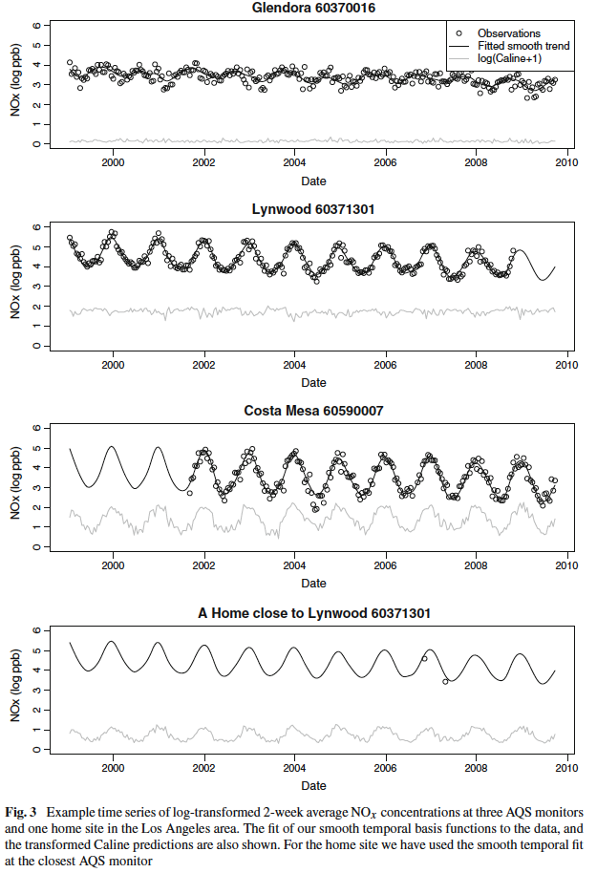
Examples of data series for log PM2.5 (left) and log NO2 (right)
Notes:
Examples of data series for log PM2.5 (left) and log NO2 (right). The plots on the left are from the first analysis MESA Air data. The data on the right are from a later analysis of NO2 data that also include as a spatial covariate the predictions of the CALINE dispersion model representing estimates of traffic contributions to air pollution.

Slide 12
A spatio-temporal model based on exploratory EOF
Cressie & Wikle’s chapter 5 on Exploratory Methods for Spatio-Temporal Data includes a section on Empirical Orthogonal Function (EOF) Analysis.
Our modeling strategy can be viewed as a hierarchical statistical model built on the foundation of an EOF analysis, with spatio-temporal variation explained by spatial (geographic or land use) and spatio-temporal covariates.

Slide 13
NO₂ Time Trends in CA
Represent time trends as combinations of smooth, temporal basis functions derived from the right singular vectors of an SVD of the AQS space x time data matrix
Because these derive from singular vectors, they represent temporal structure shared across monitoring sites.
Notes:
We capture long term trends, annual or seasonal patterns, and some smaller-scale temporal variation (depending on how smooth we make the components). (Looking back at the time series plot, the top site, Glendora, shows a different seasonality.)

Slide 14
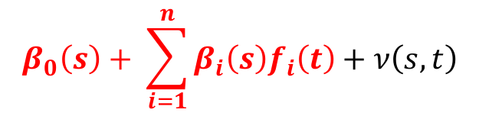
NO₂ Time Trends in CA
$$β_{0}\left(s\right)+ \sum_{i=1}^{n}{β_{i}\left(s\right)f_{i}\left(t\right)}+ν\left(s,t\right)$$
Notes:
Here are log NO2 data for a pair of sites, one an AQS site and one a “fixed” MESA Air monitoring site operating for almost 4 years. The smooth curves are one possible characterization of smooth seasonal trend, computed as a linear combination of smooth temporal basis functions fi(t). You will note that these curves do not appear to be as nearly sinusoidal as those drawn in the previous illustration. Of course, a basic issue to be addressed is how smooth these basis functions should be: what goes into the “mean” or “trend” and what we put in the “error” or “residual” structure of a model.

Slide 15
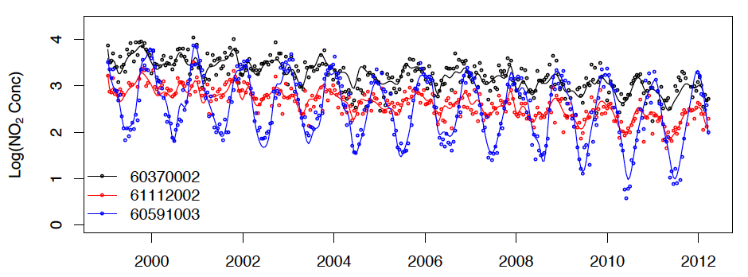
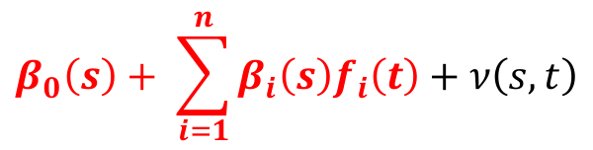
NO₂ Time Trends in CA
$$β_{0}\left(s\right)+ \sum_{i=1}^{n}{β_{i}\left(s\right)f_{i}\left(t\right)}+ν\left(s,t\right)$$
060370002: Azusa, Los Angeles county
061112002: Simi Valley, Ventura county
060591003: Costa Mesa, Orange county
Notes:
Here are three more illustrations emphasizing the fact that seasonality varies greatly in this southern California domain, with differences also in mean concentration levels and in long-term trends. The space-time trend is very clearly not additive or sepatable in space and time. (Unfortunately, I don’t have the map to show you were these sites are in southern CA.)

Slide 16
Smooth temporal basis functions
The f_{i}(t) represent the shared temporal variability in the monitoring observations. These could be specified a priori as deterministic (e.g. sinusoids), or as done here, obtained as smoothed right singular vectors of the n x T data matrix on n sites. But monitoring data always have missing observations.
Guttorp, Fuentes & Sampson, 2006, introduced an EM-like algorithm for imputing missing data and computing the SVD.
Then use smooth.spline in R to smooth the temporal (left) singular vectors
Cross-validation to determine how many singular vectors/temporal basis functions to retain.
(Tools for these computations are provided in the SpatioTemporal package.)
Notes:
Note that there remain questions as to whether and/or how much smoothing to do. Our current focus is on smoothing that leaves deviations from fitted trends temporally uncorrelated. Over-smoothing will result in residual temporal autocorrelation.

Slide 17
2. UW Spatio-temporal Statistical Model
  C(s, t) – (log) conc. at location s at time t
  – spatial random fields
    , i = 0,…,m
    X_{i} (s) – geographic (“land use”) covariates
    – spatial covariance function
    – long-term means at location s
  f_{i}(t) – temporal trend basis functions
  – residual space-time field
Notes:
The Beta fields are just spatial regression models, often called “land use regression”. Because the temporal basis functions f(t) are scaled to have mean zero, B0(s) represents the long-term mean air quality level.

Slide 18
2. UW Spatio-temporal Statistical Model

Slide 19
2. UW Spatio-temporal Statistical Model

Slide 20
Remark:
We “assume” that the residual space-time field is correlated in space but independent in time. We have generally not tried to fit effects of meteorological parameters, which drive correlated temporal patterns (over metropolitan spatial domains). A model fit that leaves temporally uncorrelated residuals has implicitly accounted for effects of meteorological factors either in the shared temporal structure of the trend basis functions (if they are not too smooth) or the spatially correlated residuals.
Notes:
We have thus side-stepped the complication of fitting a temporal correlation model and corresponding questions of space-time separability in the error structure. Some work has been done using our spatial deformation model permitting non-stationary correlation structure in the space-time residual field. But this is not incorporated in the current software.

Slide 21
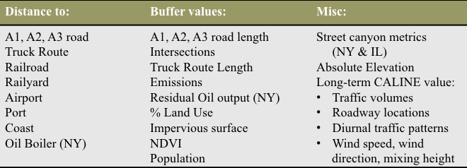
The “land use” regressions in the space-time model
where X_{i}(s) is a vector of covariates measured at location s. At the U.W. we have coded as many as 300 geographic, GIS-based covariates, including:

Slide 22
Covariate Selection
Variable selection or dimension reduction for the land use regressions of β_{i}(s) on X_{i}(s).
  with a large number of highly correlated covariates (e.g. lengths of roads in buffers of 50m, 100m, 150m, … ), we usually choose dimension reduction
Partial Least Squares (PLS)
  Conceptually similar to PCA, but components computed as linear combinations of original covariates to maximize covariance between Y and X.
  Typically retain small number of combinations, 1, 2, 3.
  PLS scores pre-computed from empirical estimates of β_{i}(s).

Slide 23
The SpatioTemporal R package
Lindström et al, 2014. A flexible spatio-temporal model for air pollution with spatial and spatio-temporal covariates. Environmental and Ecological Statistics.
Extends the model above to include spatio-temporal covariates (we’ll see this below)
Evaluates predictions of long term averages using a cross-validation strategy accounting for the complex monitoring design and for temporal effects
Uses “smart” methods (taking advantage of block structure of covariance residual covariance matrices) to make MLE computationally feasible.
Notes:
I initially implemented fitting of the Space-Time model using a pragmatic sequence of estimates of the parameters of the model components (e.g., separate “universal kriging” for empirical estimates of the land use regression models), not a comprehensive ML estimation. Adam Szpiro implemented the first ML estimation program and Johan Lindstrom then enhanced this considerably, producing our Spatiotemporal package.

Slide 24
The SpatioTemporal R package: Computation

Slide 25
The SpatioTemporal R package: Computation

Slide 26
The SpatioTemporal R package: Computation
The SpatioTemporal R package: Computation
The SpatioTemporal R package: Computation

Slide 27
SpatioTemporal R package summary:
Maximum likelihood estimation with unbalanced spatio-temporal response data
Incorporates spatio-temporal covariates M(s,t), such as meteorology, AQ model predictions (CTM or CMAQ), or satellite predictions
C(s,t) = β₀(t) + Σ β_{i}(s)f_{i}(t) + γM(s,t) + ν(s,t)
Predictions (w/ se’s) from ML-based “universal kriging”
where derive from ML-based kriging of these spatial fields and similarly.
Notes:
Note that the coefficient of the single spatio-temporal predictor, M(s,t), here is fixed, not spatially varying like the beta’s.

Slide 28
The current program permits only the coefficients β_{i}(s), multiplying the temporal basis functions, to vary spatially. There is an ad hoc approach to allowing the coefficient γ_{l} to vary spatially by introducing interactions of M_{l}(s,t) with a set of basis functions for spatial splines, but more is possible.

Slide 29
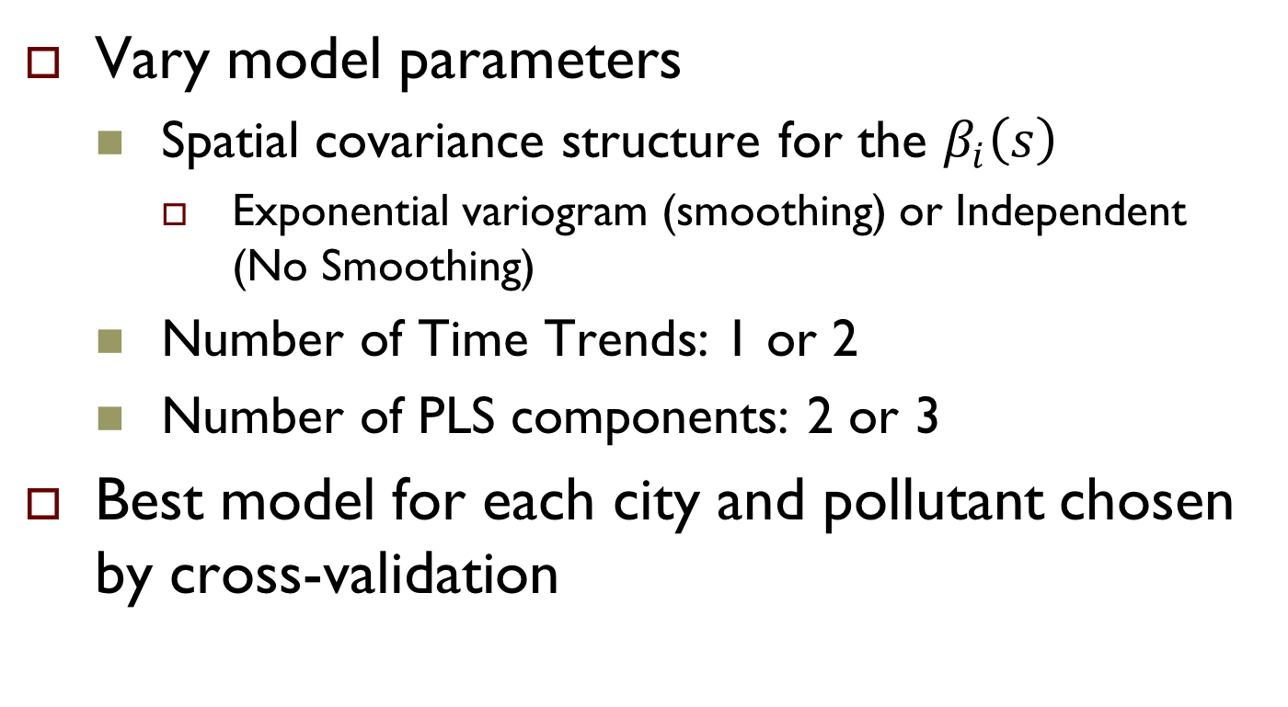
3. Model fitting procedures: Model Selection
Vary model parameters
  Spatial covariance structure for the $β_{i}\left(s\right)$
    Exponential variogram (smoothing) or Independent (No Smoothing)
  Number of Time Trends: 1 or 2
  Number of PLS components: 2 or 3
Best model for each city and pollutant chosen by cross-validation

Slide 30
Evaluation of model predictions
Standard cross-validation: repeatedly
  Split data into training and test sets
  Estimate parameters using training data
  Predict at space-time locations of test data
Compute MSE and R² of predicted vs. observed data
    measures fit to 1-1 line, not simply correlation

Slide 31
For the case of the monitoring data in MESA Air
AQS and Fixed sites
  Leave-one-out CV
Home sites
  10-fold CV
Snapshot Sites
  10-fold CV by cluster

Slide 32
Temporally adjusted R²
  Challenging to separate the spatial and temporal contributions to for cross-validation of temporally sparse datasets like MESA Air home sites.
  Lindström et al. (2013) introduced three temporally-adjusted adaptations of using data from neighboring AQS and fixed sites for the reference MSE instead of MSE_{obs} in order to focus on spatial prediction accuracy.

Slide 33
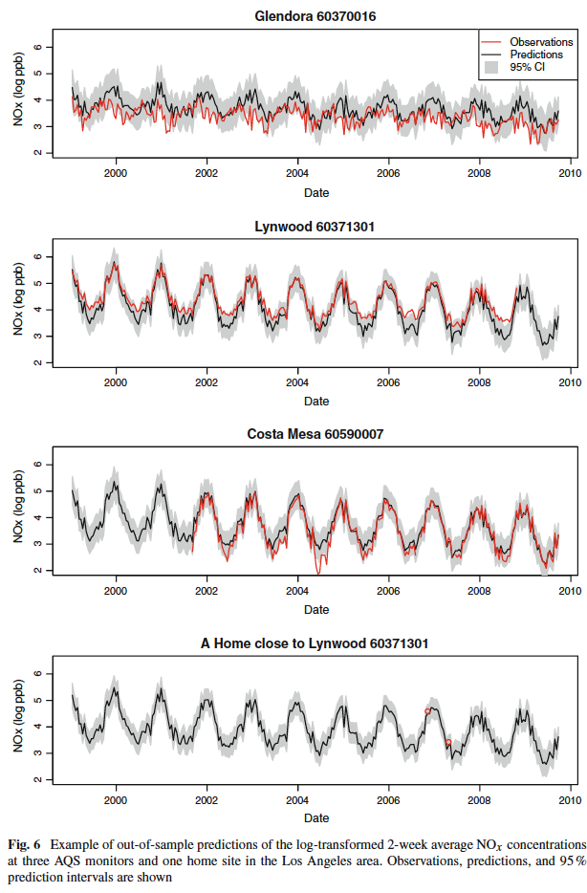
4. NOx example
Notes:
Comment on systematic error. If B0 is under/overestimated, the entire series will appear systematially low or high, which is the case for the first series. For the 2nd series it appears that there may be a combination of factors, including underestimation of the amplitude of seasonality.

Slide 34
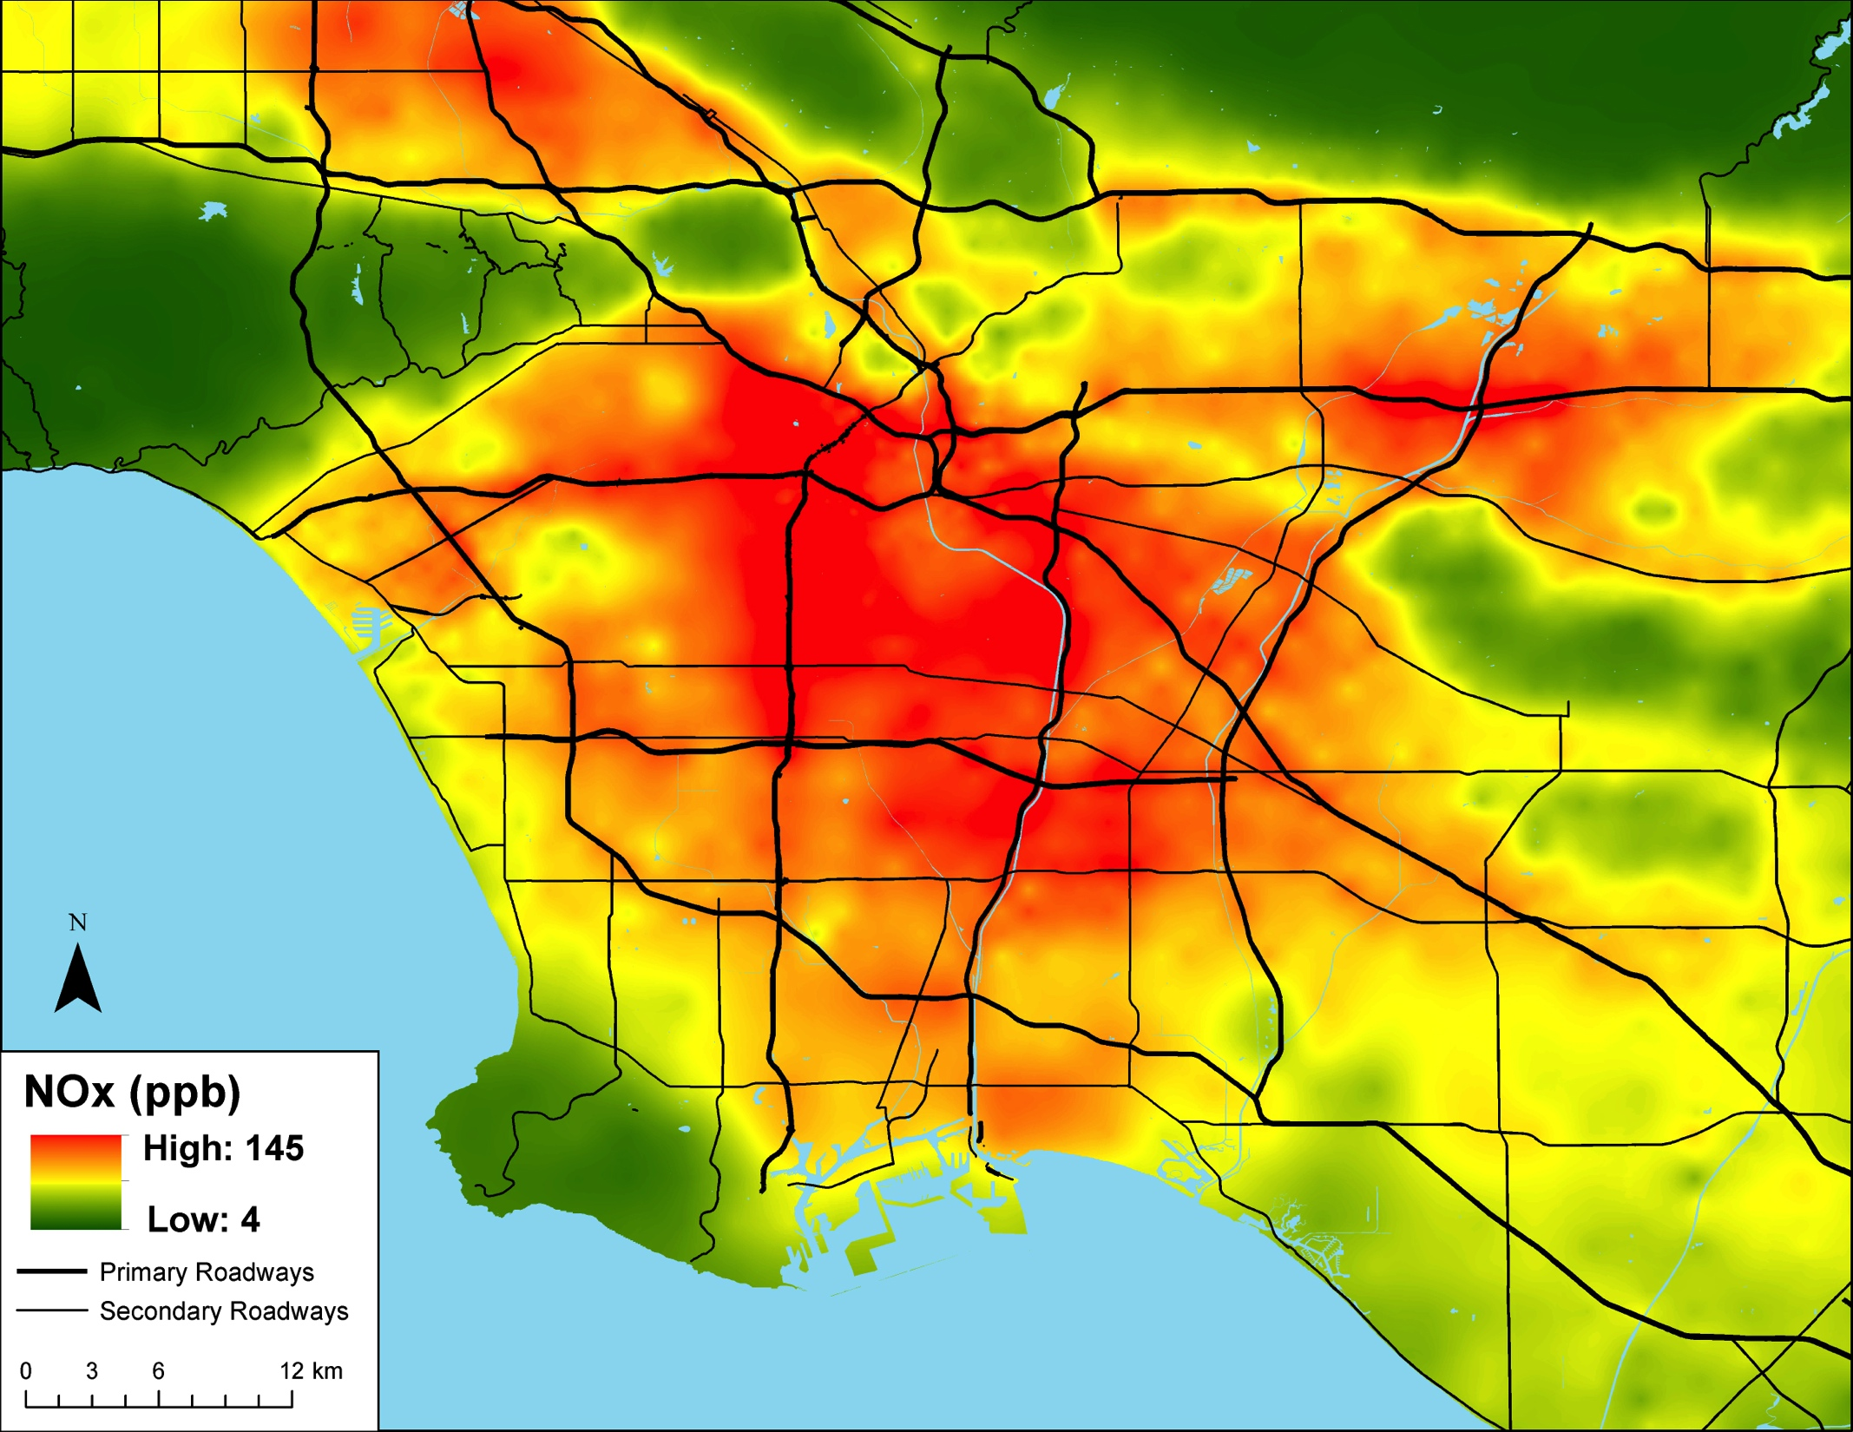
NO_{X} Predictions: 2000 Average

Slide 35
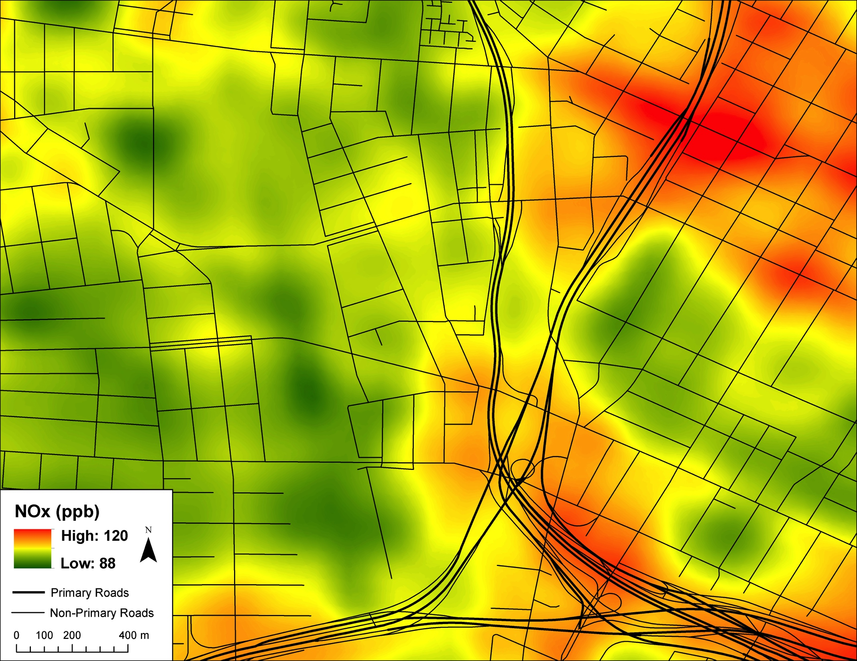
NO_{X} Predictions: 2000 Average
Notes:
Keep in mind that these prediction maps are a combination of land use regression components reflecting, for example, distances to roads, along with spatial interpolation/kriging of monitoring data.

Slide 36
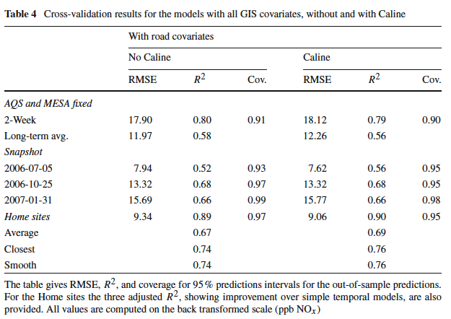

Slide 37
5. Gridded spatio-temporal covariates
CMAQ chemical transport model: gridded air quality model predictions as a spatio-temporal covariate:
  Must map CMAQ grid predictions to point observations and get clever to permit coefficient γ of CMAQ predictions M(s,t) to vary spatially, representing sub-grid scale spatial variability: incorporate a LUR model for the coefficient γ.
Satellite based aerosol optical depth (AOD) as a spatio-temporal covariate. Irregular gridded data full of missing data due to satellite path and meteorology (clouds, snow).
  Practical strategies to fill in missing data and calibrate the coefficient of AOD to vary spatially due to influences of meteorology and other factors
Models for daily time scale, with or without incorporating meteorology.
Notes:
The current literature, and a number of research groups, are giving increasing attention to merging different types of data, notably monitoring data with chemical transport model predictions, or monitoring data with remote sensing/satellite data. And they have different procedures and names for doing so (like “data fusion”).

Slide 38
Combining Land Use Regression and Chemical Transport Modeling in a Spatio-temporal Geostatistical Model for Ozone and PM_{2.5} in Los Angeles, California
Meng Wang¹, Paul D. Sampson², Michael Kleeman³, Joshua P. Keller⁴, Casey Olives¹, Adam A. Szpiro⁴, Sverre Vedal¹, Joel D. Kaufman¹
CTM uses deterministic equations with data on emissions, meteorological conditions and topographical data to dynamically simulate the physico-chemical processes of transport and atmospheric chemistry to simulate air pollution concentrations.
Relatively coarse spatial resolution of a CTM (≥ 4 km) cannot represent concentrations at very local scales (i.e. meters) for exposure assessment.

Slide 39
Details
UC-Davis-California Institute of Technology (UCD-CIT) air quality model to simulate O₃ (8-hour averaged) and daily PM_{2.5} concentrations over the South Coast Air Basin (SoCAB) from 2000 to 2008 (Figure below).
Inverse distance weighing (IDW) mapping of grid cell O₃ and PM_{2.5} predictions to the monitoring sites.
Two-stage calibration of daily CTM predictions to MESA Air 2-week average observations:
  Regress daily average monitoring observations on CTM predictions at each of the AQS and fixed sites, allowing slope and intercept to vary from site to site.
  Spatial variation in these calibration slopes and intercepts explained by land use regressions using Partial Least Squares (PLS).

Slide 40
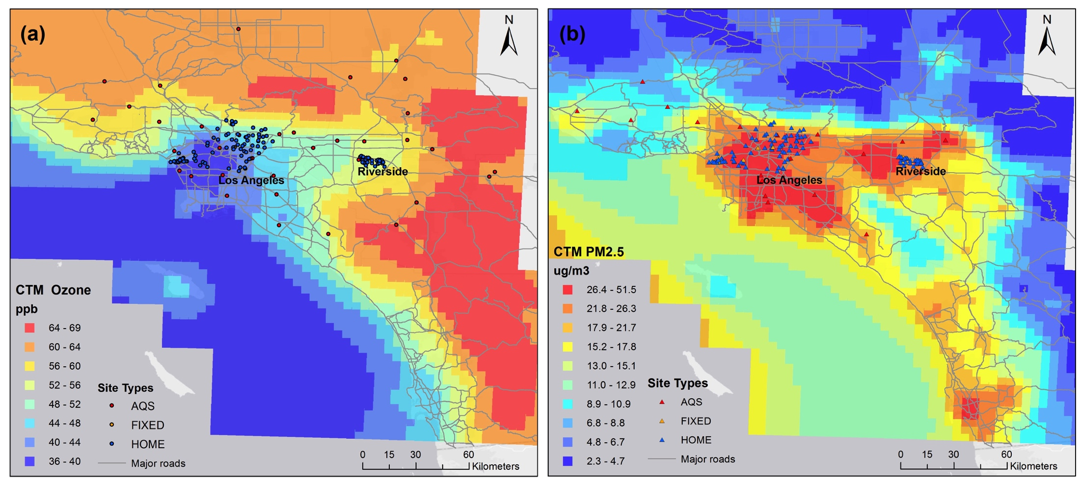
Figure 1. Long-term average of (a) O3 (daily 8 h maximum) and (b) PM2.5 (daily 24 h average) concentrations estimated by CTM with 4x4 km resolution and distribution of monitoring sites.

Slide 41
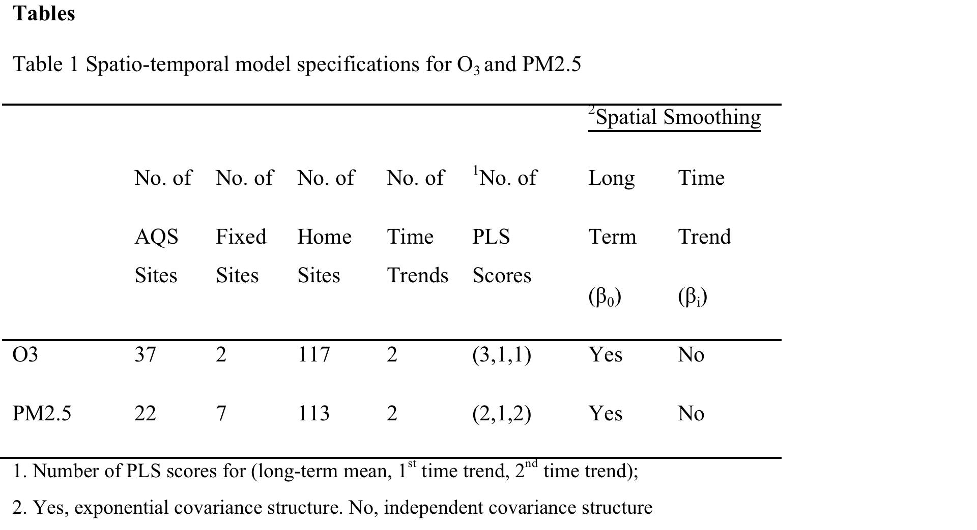

Slide 43
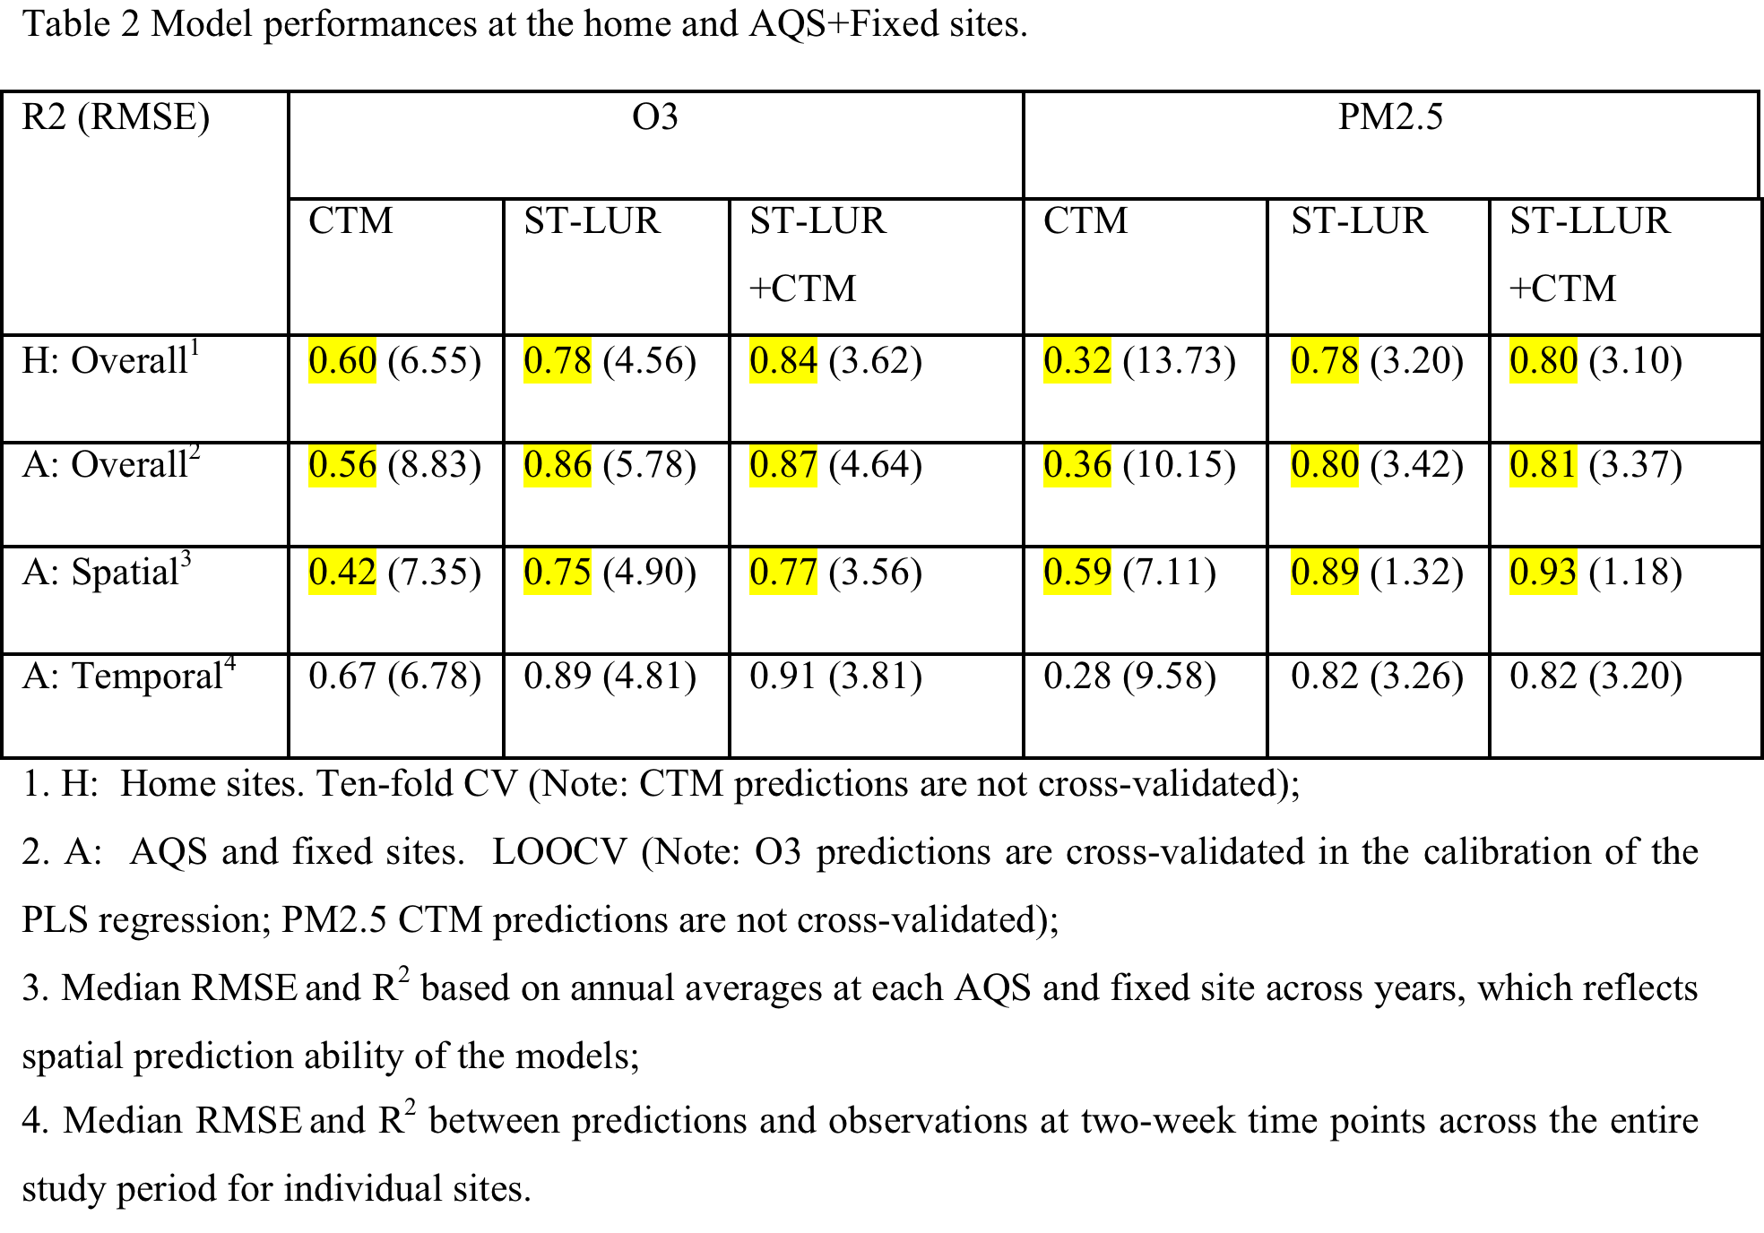
Notes:
Our conclusion, limited to this CTM and this domain, is that the CTM contributes to improved predictions for O3, but not for PM2.5.

Slide 44
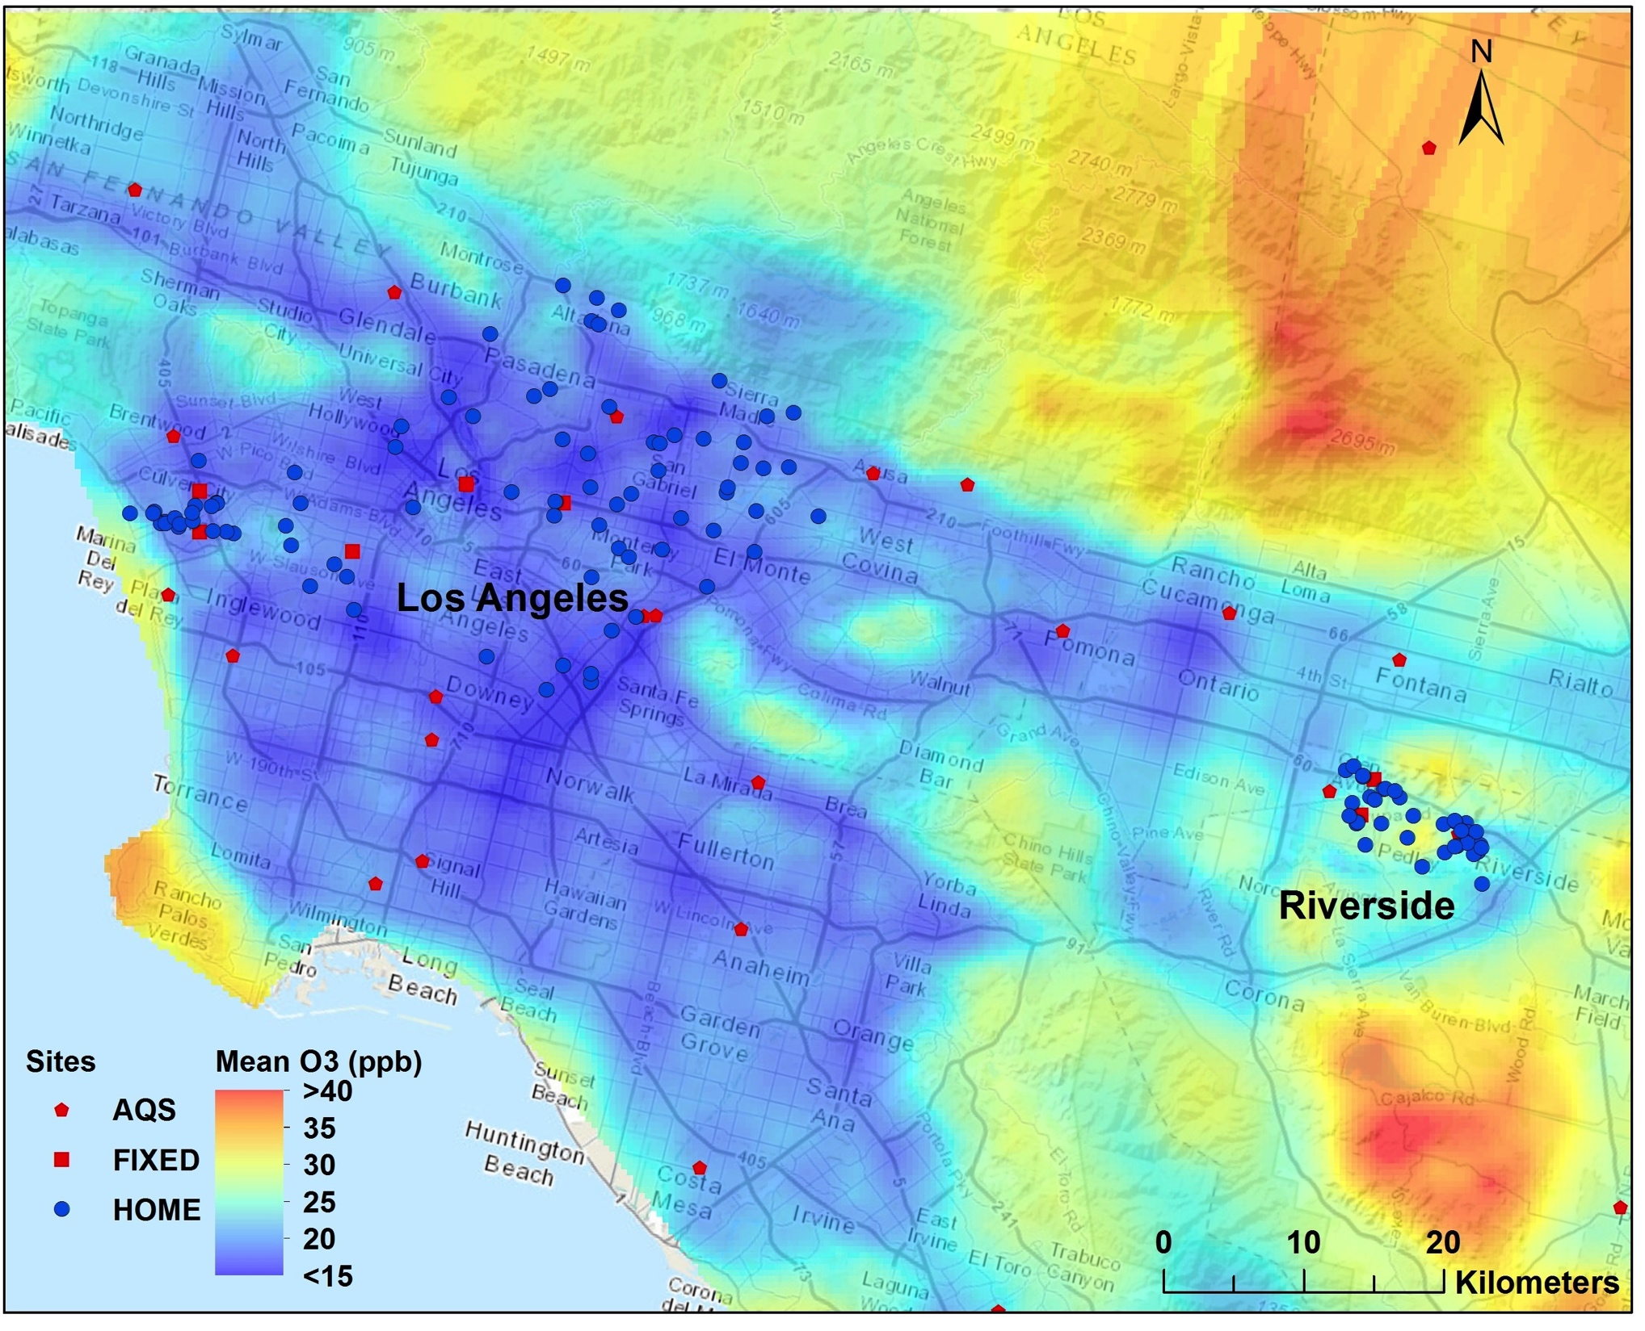
Long-term average O3 predictions from the composite LUR-CTM Spatio-temporal model

Slide 45
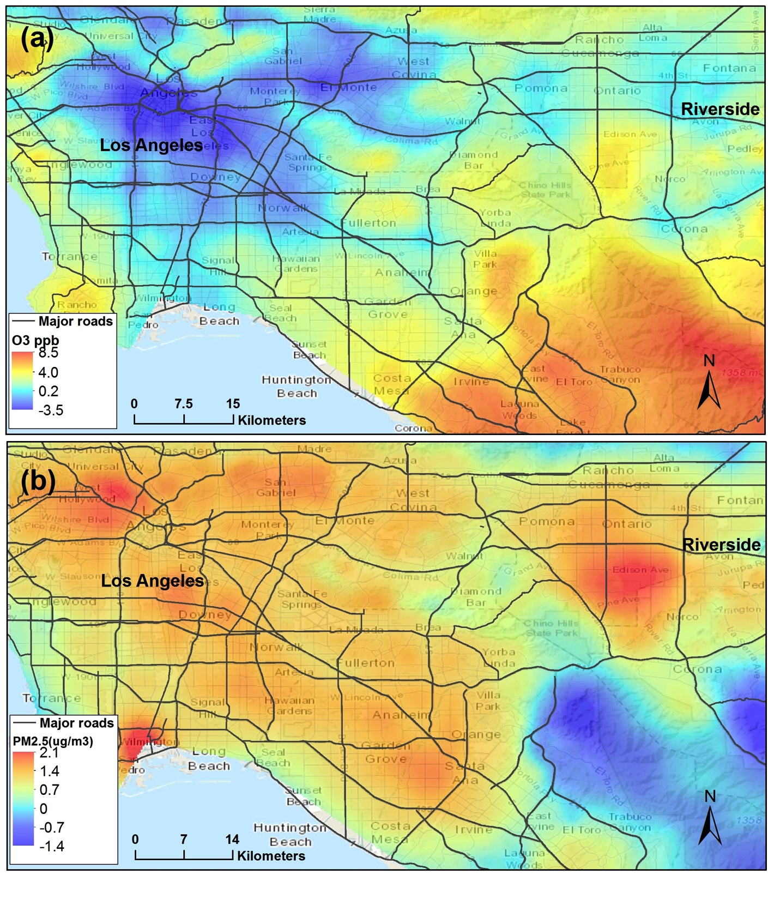
Differences between composite LUR-CTM ST model and LUR ST model alone.
Levels of O3 estimates were substantially higher in the rural areas and lower in urban areas by hybrid model than those by LUR model alone.
Levels of PM2.5 estimates were slightly higher in a large region across the Los Angeles area, except the mountain area.

Slide 46
6. Summary and wish list:
Spatiotemporal model summary
  Incorporates cohort-specific monitoring data
  Allows for unbalanced monitoring design
  Provides predictions at flexible time scales and with fine-scale spatial resolution
  Can use both spatial and spatio-temporal covariates, including deterministic CTM model or remote sensing (satellite) predictions.

Slide 47
6. Summary and wish list:
Topics for future development
  Spatially varying coefficients of spatio-temporal covariates, notably for satellite and CTM predictions as covariates
  Investigating strategies where there are too few sites (and perhaps too few temporal observations) for confidence in the SVD approach to temporal basis functions.
  Examining contribution of spatiotemporal meteorological data in addition to temporal basis functions (which can pick up most of the temporal variation attributable to meteorology).

Slide 48
6. Summary and wish list (cont.):
  New, more flexible strategies for covariate data, including
    imputation of missing covariate data (critical for satellite data); using CMAQ for imputation of missing satellite data
    more flexible strategies for covariate selection, such as penalized methods (alternative to PLS which requires multiple fixed sites)
  Incorporate nonstationary spatial covariance

Slide 49
7. Some References:
2010 Szpiro AA, Sampson PD, Sheppard L, Lumley T, Adar SD, Kaufman JD (2010). Predicting intra-urban variation in air pollution concentrations with complex spatio-temporal dependencies. Environmetrics, 21(6), 606-631.
2011 Sampson PD, Szpiro AA, Sheppard L, Lindstrom J, and Kaufman JD. (2011) Pragmatic estimation of a spatio-temporal air quality model with irregular monitoring data. Atmospheric Environment, 45, 6593-6606.
2013 Johan Lindstrom, Adam Szpiro, Paul D. Sampson, Silas Bergen and Assaf P. Oron (2013). SpatioTemporal: Spatio-Temporal Model Estimation. R package version 1.1.7. https://CRAN.R-project.org/package=SpatioTemporal
2014 Lindström, J. Szpiro, A.A., Sampson, P.D., Oron, A.P., Richards, M., Larson, T.V., Sheppard, L. (2014). A flexible spatio-temporal model for air pollution allowing for spatio-temporal covariates. Environmental and Ecological Statistics, 21, 411-433.
2015 Keller JP, Olives Kim SY, Sheppard L, Sampson PD, Szpiro AA, Oron AP, Lindstrom J, Vedal S, Kaufman JD. (2015). A Uniform Spatiotemporal Modeling Approach for Prediction of Multiple Air Pollutants in the Multi-Ethnic Study of Atherosclerosis and Air Pollution. Environmental Health Perspectives.
2015 Wang, M., Keller, J.P, Adar, S.D., Kim, S-Y., Larson, T.V., Olives, C., Sampson, P.D., Sheppard, L., Szpiro, A.A., Vedal, S., Kaufman, J.D. (2015). Development of Spatiotemporal Models for Ozone in Six Metropolitan regions of the United States: The MESA Air Study. Atmospheric Environment, 123, 79-87. 2011.
2016 Wang, M., Sampson, P.D., Hu, J., Kleeman, M., Keller, J.P., Olives, C., Szpiro, A.A., Vedal, S., Kaufman, J.D. (2016) Combining Land-Use Regression and Chemical Transport Modeling in a Spatio-temporal Geostatistical Model for Ozone and PM2.5. Environmental Science & Technology, 50(10), 5111-5118.

