Slide 1

Markov random fields
Help from David Bolin, Johan Lindström and Finn Lindgren

Slide 2

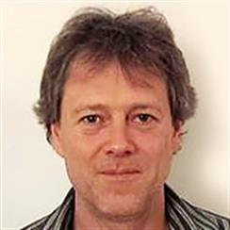
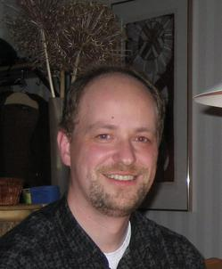
Julian Besag
1945-2010
Håvard Rue
1965-
Finn Lindgren
1973-

Slide 3
The big N problem
Log likelihood:
Prediction:
Covariance has O(N²) unique elements
Inverse and determinant take O(N³) operations

Slide 4
The Markov property
Discrete time:
A time symmetric version:
A more general version:
Let A be a set of indices >k, B a set of indices <k. Then
These are all equivalent.

Slide 5
On a spatial grid
Let δ_{i} be the neighbors of the location i. The Markov assumption is
Equivalently for
The p_{i} are called local characteristics. They are stationary if p_{i} = p.
A potential assigns a number V_{A}(z) to every subconfiguration z_{A} of a configuration z. (There are lots of them!)

Slide 6
Graphical models
Neighbors are nodes connected with edges.
Given 2, 1 and 4 are independent.
2
4
1
5
3

Slide 7
Gibbs measure
The energy U corresponding to a potential V is .
The corresponding Gibbs measure is
where
is called the partition function.

Slide 8
Nearest neighbor potentials
A set of points is a clique if all its members are neighbours.
A potential is a nearest neighbor potential if V_{A}(z)=0 whenever A is not a clique.

Slide 9
Markov random field
Any nearest neighbor potential induces a Markov random field:
where z’ agrees with z except possibly at i, so V_{C}(z)=V_{C}(z’) for any C not including i.

Slide 10
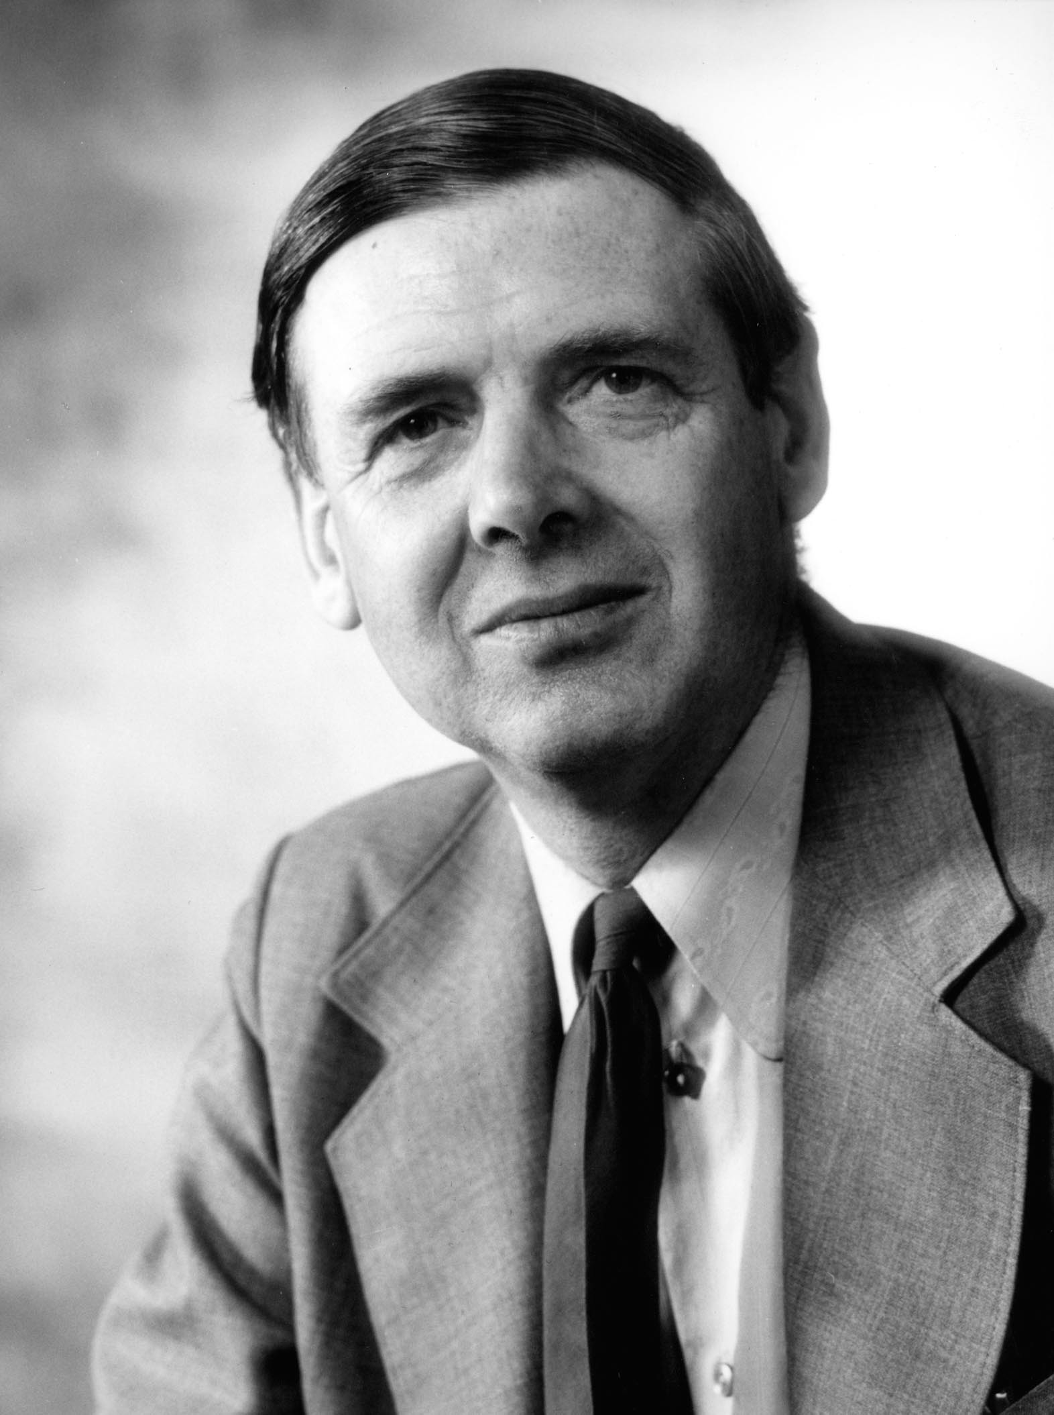
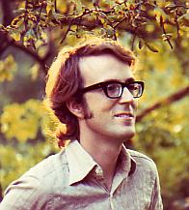
The Hammersley-Clifford theorem
Assume P(z)>0 for all z. Then P is a MRF on a (finite) graph with respect to a neighbourhood system Δ iff P is a Gibbs measure corresponding to a nearest neighbour potential.
Does a given nn potential correspond to a unique P?
Peter Clifford
1944-
John Hammersley
1920-2004

Slide 11
The Ising model
Model for ferromagnetic spin (values +1 or -1). Stationary nn pair potential V(i,j)=V(j,i); V(i,i)=V(0,0)=v₀; V(0,e_{N})=V(0,e_{E})=v₁.
so where

Slide 12
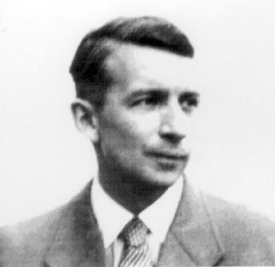
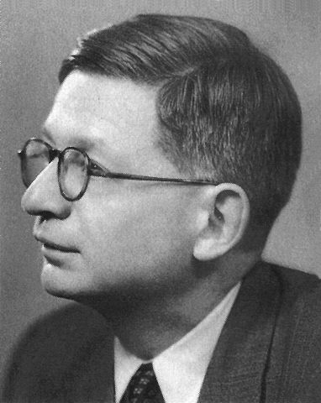
Interpretation
v₀ is related to the external magnetic field (if it is strong the field will tend to have the same sign as the external field)
v₁ corresponds to inverse temperature (in Kelvins), so will be large for low temperatures.
Rudolf Peierls
1907-1995
Ernst Ising
1900-1998

Slide 13
Phase transition
At very low temperature there is a tendency for spontaneous magnetization.
For the Ising model, the boundary conditions can affect the distribution of x₀.
In fact, there is a critical temperature (or value of v₁) such that for temperatures below this value, the boundary conditions are felt.
Thus there can be different probabilities at the origin depending on the values on an arbitrary distant boundary!

Slide 14
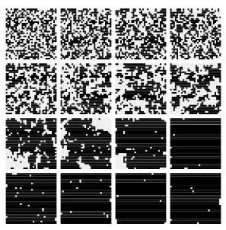
Simulated Ising fields

Slide 15
The auto-models
Let Q(x)=log(P(x)/P(0)). Besag’s auto-models are defined by
When and G_{i}(z_{i})=α_{i} we get the autologistic model
When and β_{ij}≤0 we get the auto-Poisson model

Slide 16
Pseudolikelihood
Another approximate approach is to write down a function of the data which is the product of the , I.e., acting as if the neighborhoods of each point were independent.
This as an estimating equation, but not an optimal one. In fact, in cases of high dependence it tends to be biased.

Slide 17
Recall the Gaussian formula
If
then
Let be the precision matrix. Then the conditional precision matrix is

Slide 18
Gaussian MRFs
We want a setup in which whenever i and j are not neighbors.
Using the Gaussian formula we see that the condition is met iff Q_{ij} = 0.
Typically the precision matrix of a GMRF is sparse where the covariance is not. This allows fast computation of likelihoods, simulation etc.

Slide 19
An AR(1) process
Let . The lag k autocorrelation is φ^{|k|}. The precision matrix has Q_{ij} = φ if |i-j|=1, Q₁₁=Q_{nn}=1 and Q_{ii}=1+φ² elsewhere, all other 0.
Thus Σ has N² non-zero elements, while Q has N+2(N-1)=3N-2 non-zero elements.
Using the Gaussian formula we see that

Slide 20
Conditional autoregression
Suppose that
This is called a Gaussian conditional autoregressive (CAR) model. WLOG μ_{i}=0. If also these conditional distributions correspond to a multivariate joint Gaussian distribution, mean 0 and precision Q with Q_{ii}=κ_{i} and Q_{ij}= -κ_{i}β_{ij}, provided Q is positive definite. If the β_{ij} are nonzero only when i~j we have a GMRF.

Slide 21
Likelihood calculation
The Cholesky decomposition of a pd square matrix A is a lower triangular matrix L such that A=LL^{T}.
To solve Ay = b first solve Lv = b (forward substitution), then L^{T}y = v (backward substitution).
If a precision matrix Q = LL^{T}, log det(Q) = 2 . The quadratic form in the likelihood is w^{T}u where u=Qw and w=(z-μ). Note that

Slide 22
Simulation
Let x ~ N(0,I), solve L^{T}v = x and set z = μ + v.
Then E(z) = μ and Var(z) = (L^{T})⁻¹IL⁻¹= (LL^{T})⁻¹ = Q⁻¹.

Slide 23
Spatial covariance
Whittle (1963) noted that the solution to the stochastic differential equation
has covariance function
Rue and Tjelmeland (2003) show that one can approximate a Gaussian random field on a grid by a GMRF.
Notes:
Delta=sum_i del^2/del s_i^2 epsilon(s) white noise

Slide 24
Solution
Write
where are piecewise linear on a (possibly nonregular) grid and
are appropriately chosen normal random variables.
Let and A=(A_{i•}).
If Y is Z observed with spatial error

Slide 25
Basis functions

Slide 26
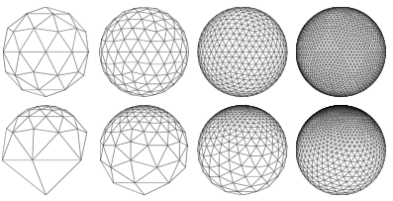
Unequal spacing
Lindgren and Rue show how one can use finite element methods to approximate the solution to the sde (even on a manifold like a sphere) on a triangulization on a set of possibly unequally spaced points.

Slide 27
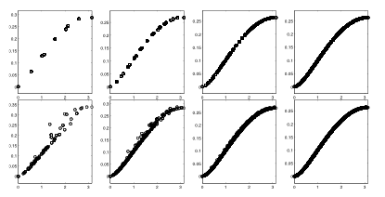
Covariance approximation
Notes:
Two approximations

Slide 28
Hierarchic model
Data model:
Latent model:
If Bayesian, parameter model:
For INLA, need

Slide 29
INLA
Laplace’s approximation:
x*=argmax(f(x)). Taylor expansion around x*: f(x)≈f(x*)+(x-x*)²f”(x*)/2
Interested in predictive distribution p(z|y) and posterior density p(θ|y)

Slide 30
f(x)=sin(x)/x

Slide 31
Posterior manipulation
Thus
Using the Laplace approximation on
f(x)=log( /N) we get a Gaussian
approximation
where depend on Q, β and D²f.

Slide 32
What INLA computes
Joint posterior of parameters (Laplace approximation)
Marginal posterior of latent variable (integral Laplace approximation or numerical integration)
Not computing the joint predictive distribution

Slide 33


Computational comparison
n=20×2500 obs, m=20×15000 kriging locs
Estimation O(n³), storage O(n²)≈20GB
Kriging O(mn+n³), storage O(mn+n²)≈130GB
INLA Estimation + kriging O(m^{3/2}), storage O(m+n)≈50MB

Slide 34
Global temperature analysis
obs = climate + anomaly + elevation + error
Climate covariance parameters:

