Slide 1


Extreme values
Peter Guttorp
NR and UW

Slide 2
“It seems that the rivers know the theory. It only remains to convince the engineers of the validity of this analysis.”
Emil Gumbel

Slide 3
What is extreme?
n=1000
Mean is 0.99
Largest value
is 7.1

Slide 6
0.99
7.1

Slide 7
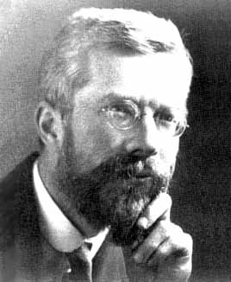
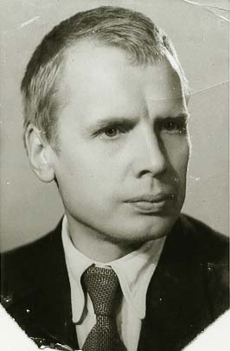
Fisher-Tippett-Gnedenko
If we can find normalizing constants a_{n} and b_{n} such that
where M_{n}=max(X₁,…,X_{n}) then
1890-1962
1912-1995

Slide 8
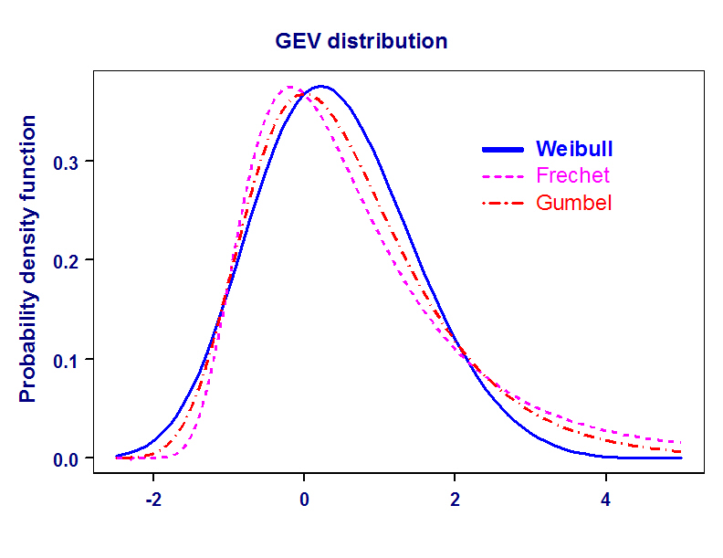
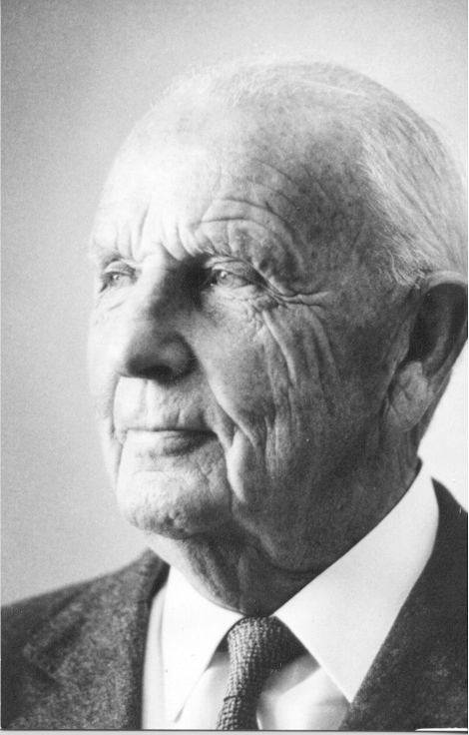
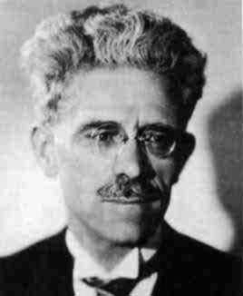
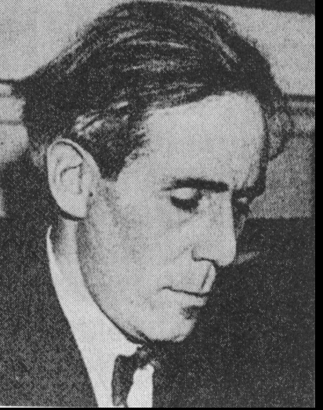
GEV model
1887-1979
1878-
1973
1891-
1966

Slide 9
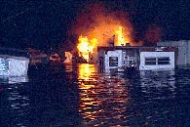
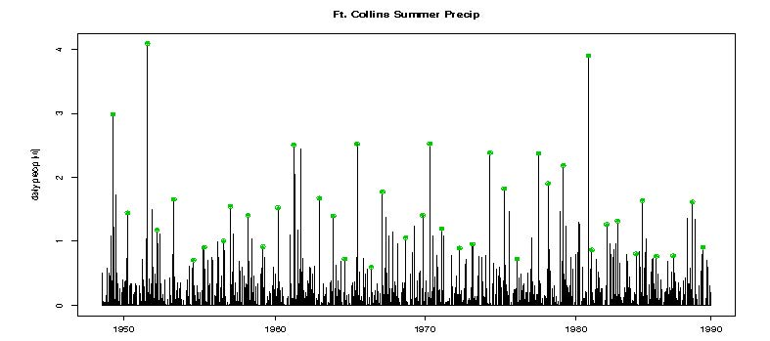
Fort Collins precip
1997 extreme precipitation event
5 dead
$250M damage
Daily prec 6.18”
4.09”
Notes:
Approximately top 3.5%

Slide 10
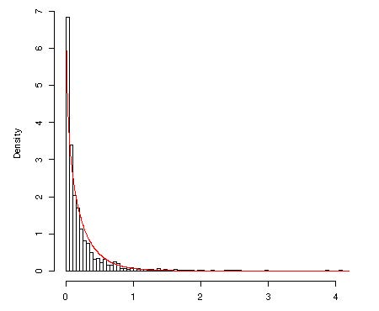
How extreme was 1997?
What is the probability that the annual maximum event is larger than 6.18 inches?
Using all data
Daily precip is 0 with prob 0.782
Given >0, Gamma(0.784, 3.52)

Slide 11
P(X>6.18) = (1 – F_{X|X>0}(6.18))×0.218
= 3.20 × 10⁻¹¹
P(Ann max > 6.18)
= 1 – P(all obs in year < 6.18)
≈ 1 – (1 – 3.20 × 10⁻¹¹)²¹⁴
= 6.86 × 10⁻⁹
= 1 / 145 815 245

Slide 12
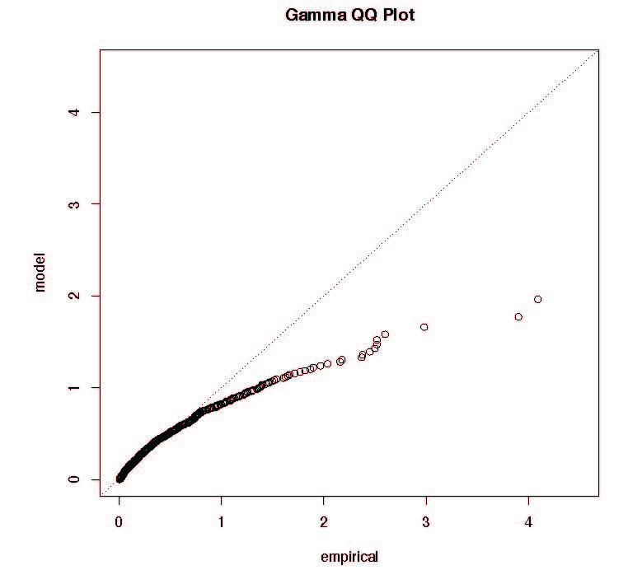
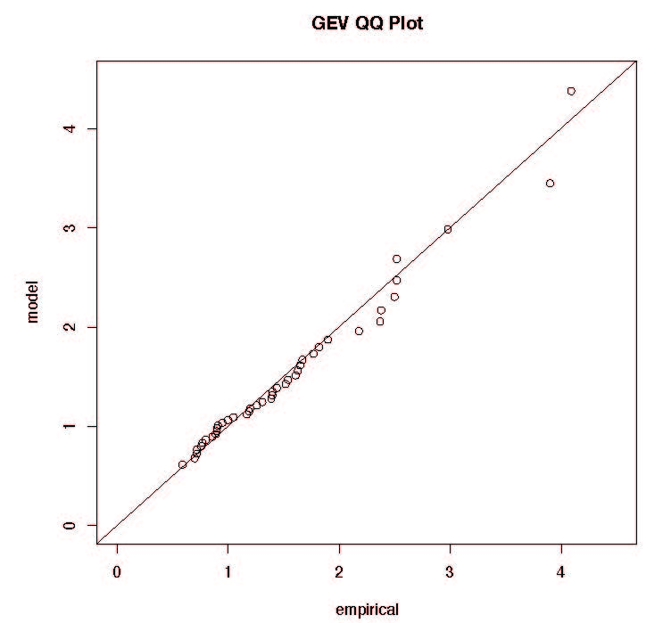
Using block maxima
Fitting GEV using annual maxima
P(ann max > 6.18) = 1– F_{M}(6.18)
= 0.008 = 1/121
98% of data <1

Slide 13
Peak over threshold
u=4

Slide 14
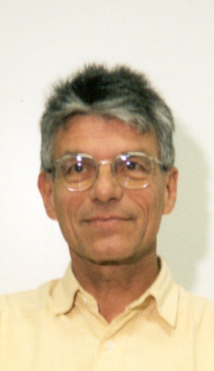
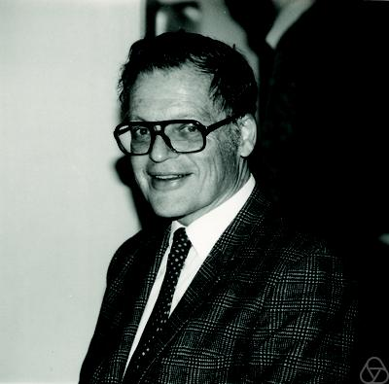
Pickands-Balkeema- de Haan theorem
Let
Then
where
is the generalized Pareto distribution (GPD).
Notes:
James Pickand III
Laurent de Haan

Slide 15
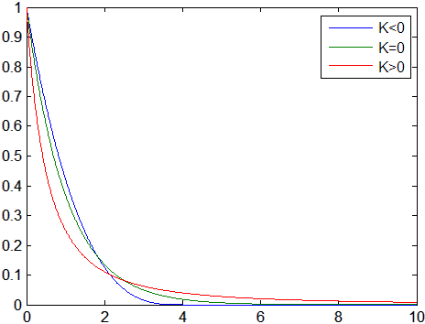
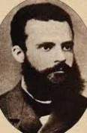
Generalized Pareto distribution
1848-
1923
Notes:
Vilfrido Pareto

Slide 16
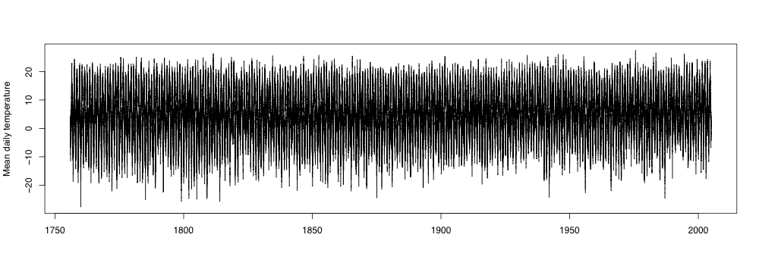
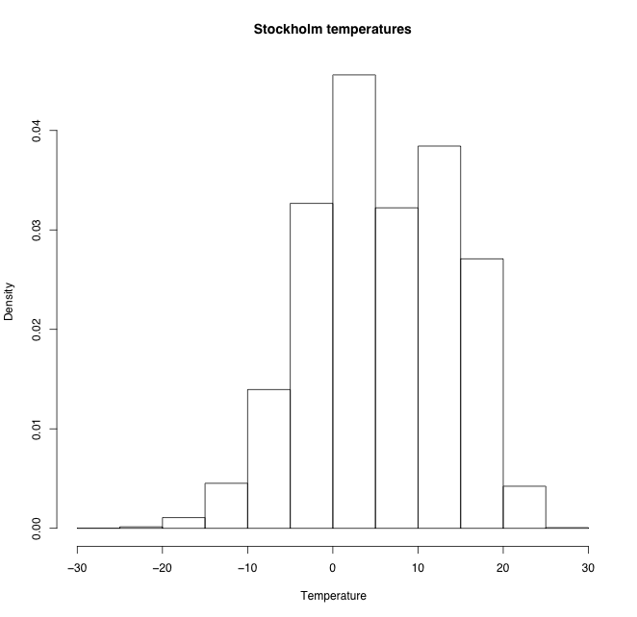
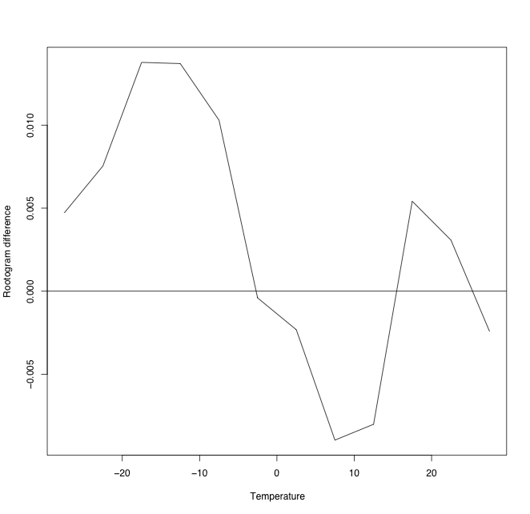
Stockholm daily temperatures
Before/after 1879

Slide 17
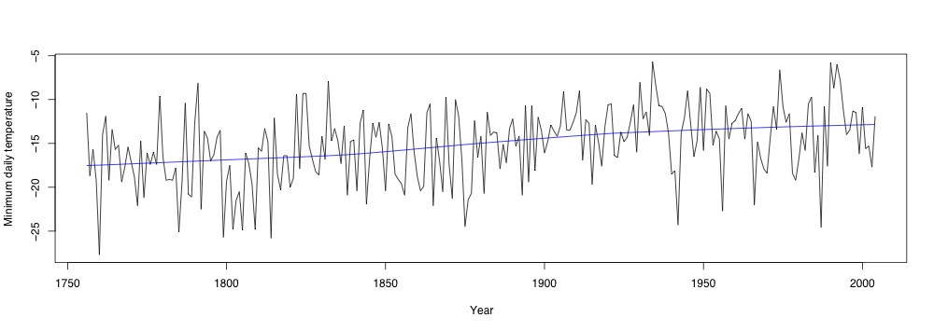
Annual minima

Slide 18
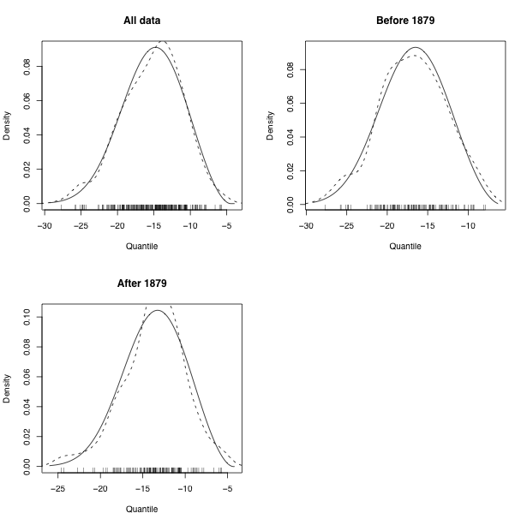
Before/after 1879
2 LLR=38.0 on 3df
P-value 2.8x10⁻⁸

Slide 19
Time-dependent location estimates
Stockholm data
(Guttorp and Xu, Environmetrics 2011)

Slide 20
Simple model
Model Estimate -LLR
Fixed μ, all -16.6 706.0
Fixed μ, early -18.1 336.8
Fixed μ, late -14.2 350.2
Early + late 687.0
Linear model in μ
(-18.9,-14.0) 687.9
A linear change in mean value for annual minima seems a good model.
Modal prediction for 2050: -11.5°C
2100: -10.5°C
Notes:
Scale: 4.06(.2) Shape -0.36(.03)

Slide 21
Space-time data

Slide 22
Some temperature data
SMHI synoptic stations in south central Sweden, 1961-2008
Notes:
Not homogenized

Slide 23
Annual minimum temperatures and rough trends

Slide 24
Location slope vs latitude

Slide 25
Dependence between stations
 | Sveg | Malung | Karlstad
Sundsvall | 19 | 12 | 13
Sveg |  | 25 | 11
Malung |  |  | 10
Common coldest day in 48 years
5 common to all 4 northern stations

Slide 26
Max stable processes
Independent processes Y_{i}(x)
(e.g. space-time processes with weak temporal dependence)
A difficulty is that we cannot compute the joint distribution of more than 2-3 locations. So no likelihood.

Slide 27
Spatial model
where
Allows borrowing estimation strength from other sites
Can include more sites in analysis

Slide 28
Trend estimates
Posterior probability of slope ≤ 0 is very small everywhere

Slide 29
Spatial structure of parameters

Slide 30
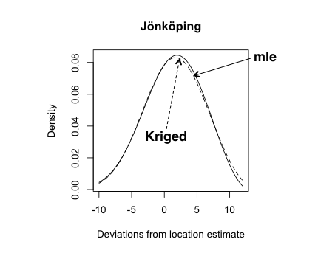
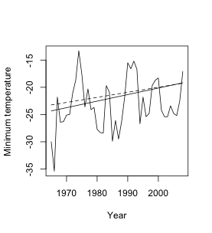
Prediction of Jönköping (44 yrs)
Spatial fit of GEV parameters vs mle fit

Slide 31
Location slope vs latitude

Slide 32
Location slope vs latitude site-by-site

Slide 33
Prediction Borlänge

Slide 34
R packages
ismev (developed for Coles’ book)
evir, evd (similar to ismev)
ExtRemes (based on ismev)
POT (only GPD fit)
SpatialExtremes
CompRandFld

