Slide 1
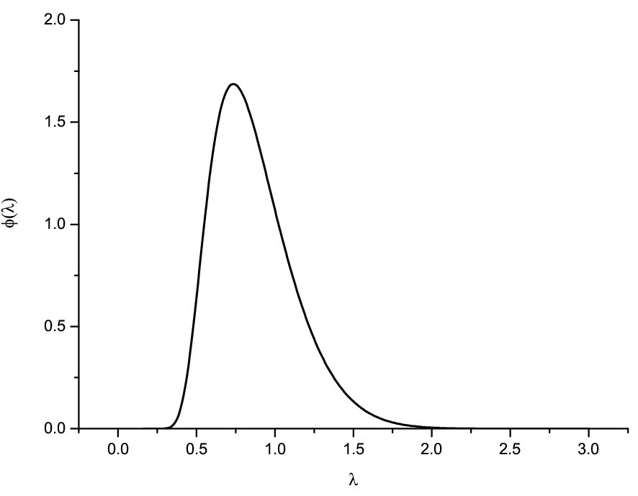
Kolmogorov distribution

Slide 2
Exponential QQ-plot with confidence band

Slide 3
Why a 45° line?
Theoretical Q-Q-plot is
What if F = G?

Slide 4
Climate
The weather aspect of climate:
Climate is the distribution of weather
Weather is a draw from this distribution
Thus climate covers extremes, means, variability, skewness etc. of weather
The distribution is changing over time: climate change means a changing distribution

Slide 5
Data and models
Five major global annual mean temperature data sets
Differ on how they compute average, how they deal with missing data etc.
CMIP5 has 45 different climate models. Historical runs in 38 of them, projections for 4 different scenarios for 2000-2100.

Slide 6
Climate models and data

Slide 7
Q-Q-plots

Slide 8
But how can we do this when climate changes?
If X_{i}~F_{i} what can we say about the edf?

Slide 9
Running value of the KS-statistic

Slide 10
The warming “hiatus”
1998 was a year of unusually warm temperatures.
Looking at a 16-year trend from then on seems to show a lower trend than earlier.
But 16 years is a pretty short period in a climate context (we usually look at 30 year stretches).
An Act of Dog

Slide 11
Do climate models reproduce recent data?
The models simulated since 2000

Slide 12
Q-Q-plot for recent data

Slide 13
More about the Q-Q-plot
Recall thet the graph of a function f is (x,f(x)) for all values of x in the domain of f.
The theoretical Q-Q plot is the graph of G⁻¹(F)
Let X ~ F. What is the distribution of G⁻¹(F(X))
T(x)=G⁻¹(F(x)) is sometimes called the treatment function.
X₁,X₂,...,X_{n} controls (untreated)
Y₁,Y₂,...,Y_{m} treated

Slide 14
Location-scale models
Let Z be a random variable. For real a and positive b let X = a + bZ.
E(X )=
Var(X )=
Cdf of X?
Quantile function of X?
Treatment function?
Location-scale family
b=1
a=0
Notes:
Parametric model generated by Z. If not specifying Z this is nonparametric.

Slide 15
Residual from Q-Q-plot
is called the shift function.
X + Δ(X) ~
Estimated using edf/eqf.
Confidence set:
where M=mn/(m+n) and G_{m}^{-I} is the right inverse.
If F = G we have Δ(x) = 0
Generalized
location shift

Slide 16
Back to climate change

Slide 17
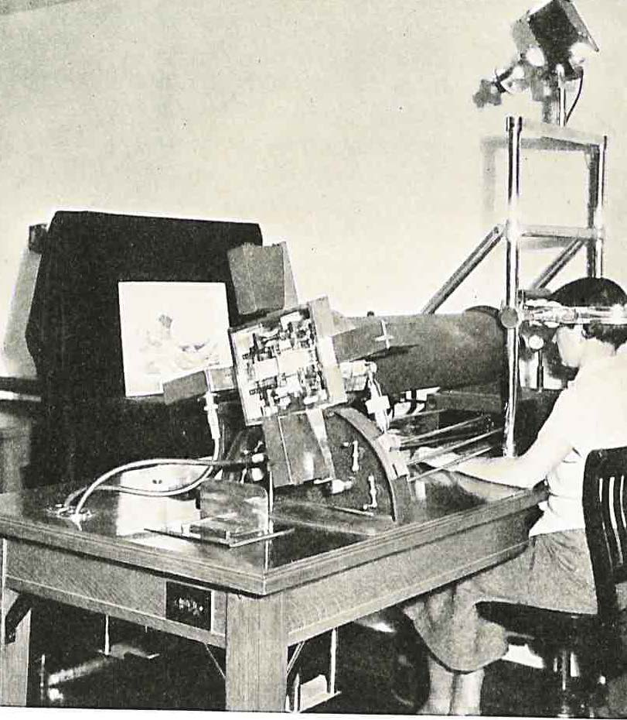
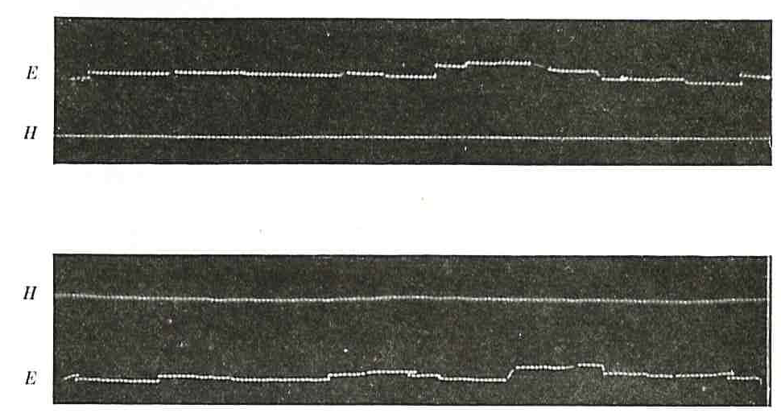
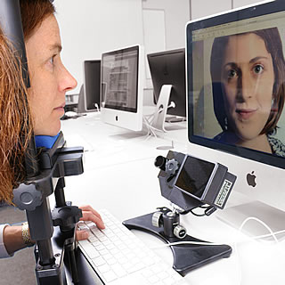
Looking at pictures
Old equipment
(30 frames/sec)
Analog data
and new
(1000 frames/sec)
Digital data

Slide 18
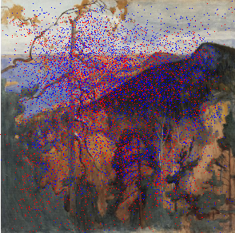
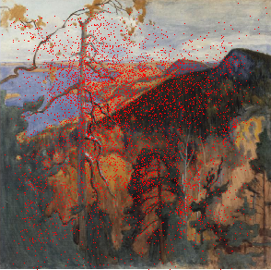
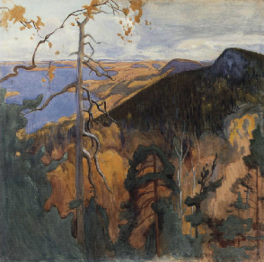
The image
Notes:
Eero Järnefeldt (1863-1937): Koli-landscape

Slide 19
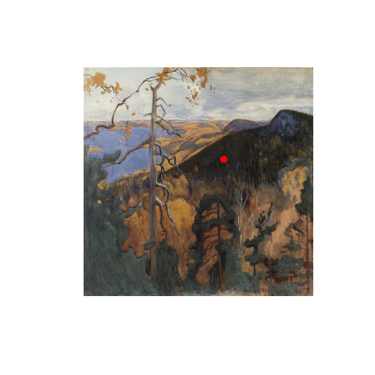





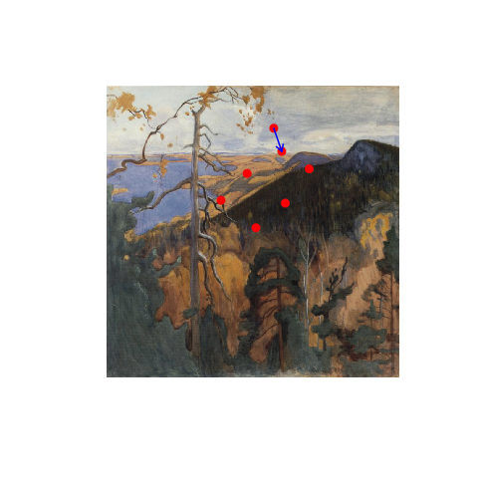
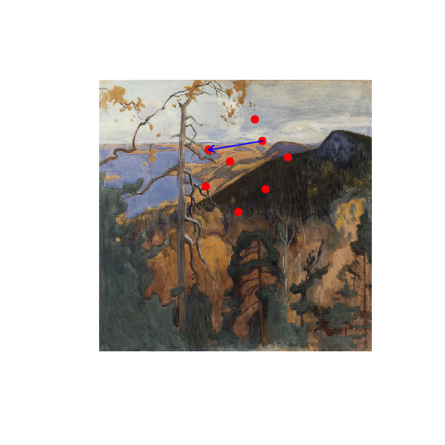







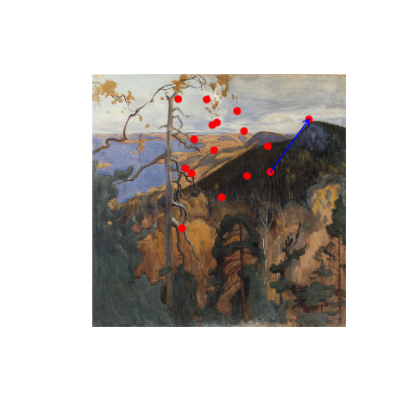
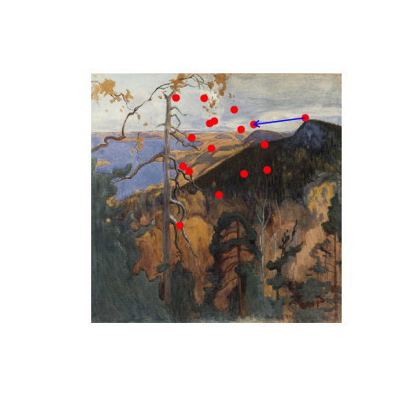



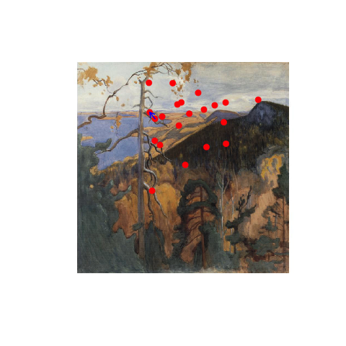




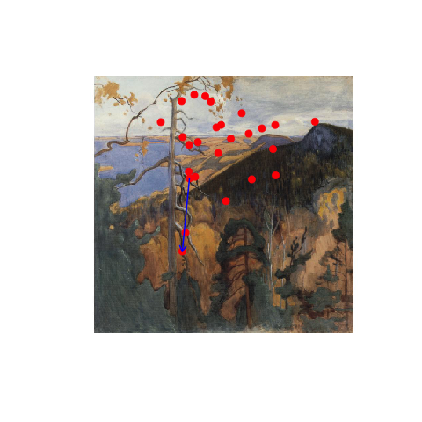




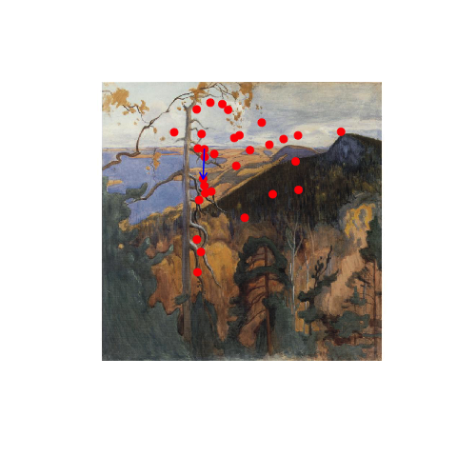









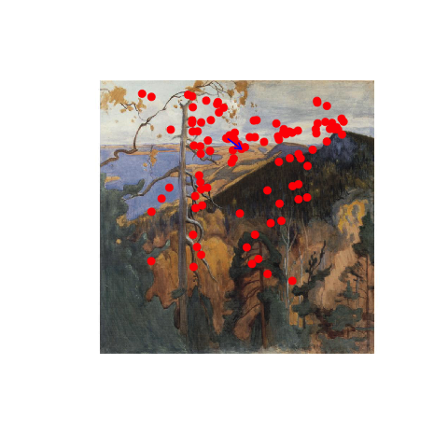
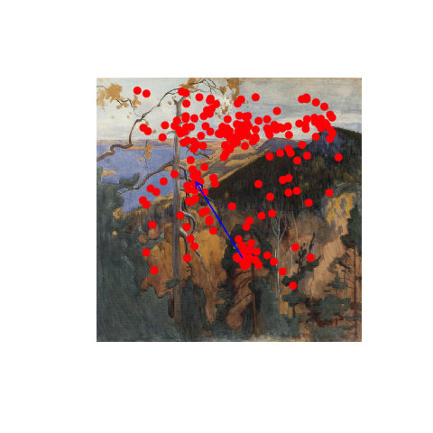
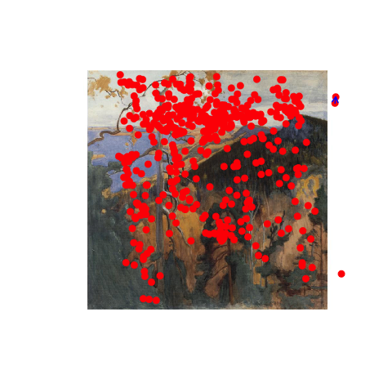

Slide 20
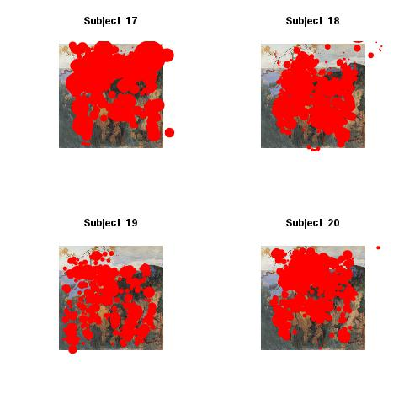
Nose-bleed pictures

Slide 21
Watching a picture
Eye movement consists of
fixations–stops of the gaze
saccades–jumps from one fixation to another
Saccades are extremely fast, and once started cannot be interrupted
Questions of interest:
Difference between experienced art viewers and novices
Difference between pictures

Slide 22
Comparing fixation durations for experienced viewers and novices

Slide 23
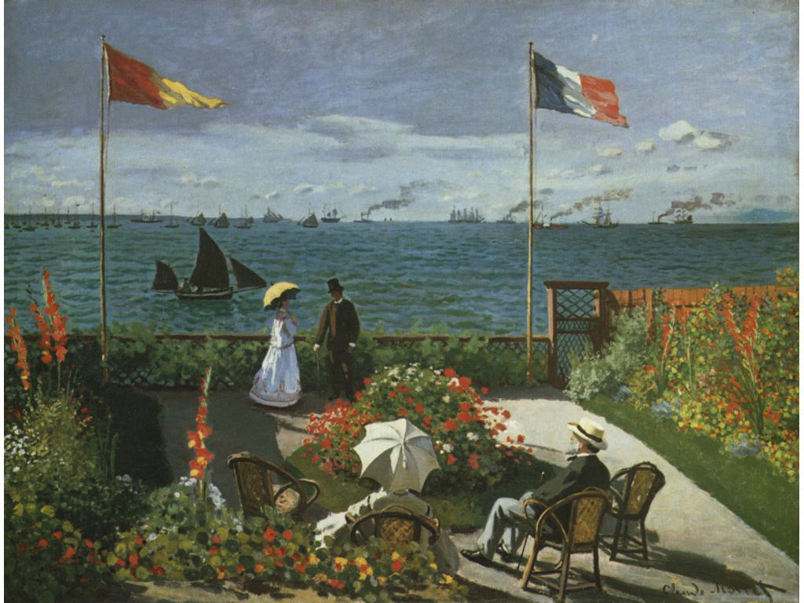
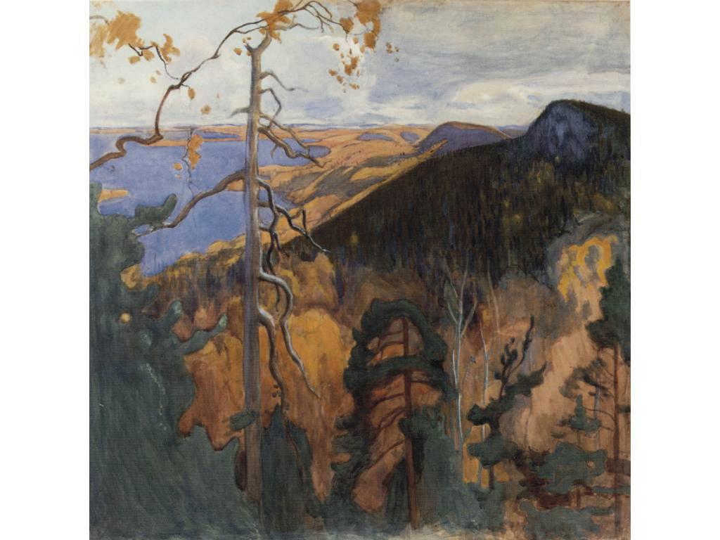
Comparing viewing of two pictures

Slide 24
Shiftplots for fixation durations

