Slide 1
Histograms
h=0.1
h=0.5
h=3
Notes:
Define histogram (fixed starting points)

Slide 2
Theoretically
The simplest form of histogram
B_{j} = [(j-1),j)h
Notes:
What happens as we change h?

Slide 3
Some asymptotics
Fact: If X ~ Po(μ) then for large μ
Suppose we have m bins in a histogram. Then
is approximately a 1-α CI for f(x) where
Notes:
Need m getting large with n and m log(n)/n getting small.

Slide 4
Risk
When looking at parametric estimators we often compare the mse. When estimating a function, we want the estimator to be good everywhere, so we may integrate the mean squared error:
Pick h to minimize the risk
Risk
Loss function

Slide 5
Density estimation
Estimate F(x) by F_{n}(x)
Difference quotient

Slide 6
Histogram confidence set revisited
We have
where Z₁,...,Z_{n} ~ N(0,1). The histogram estimates a discretized version of f, say
Let
and
Denote

Slide 7
Use and

Slide 8
Confidence band for the exponential histogram

Slide 9
The exponential sample

Slide 10
Smoothing
The idea of smoothing is to replace an observation at x with a smooth local kernel function K(x) ≥ 0.
The functions should satisfy

Slide 11
Kernels

Slide 12
Kernel density estimates

Slide 13
The exponential sample

Slide 14
Choice of kernel and bandwidth
Kernel is not very important (but better if it is smooth).
Bandwidth matters a lot. Standard methods:
(a) Based on f being Gaussian
h = 0.9 σ / n^{1/5} (R default, Silverman’s rule)
h = 1.06 σ / n^{1/5} (Scott’s rule)
(b) Based on estimating f”
(Sheather and Jones)

Slide 15
Bandwidth differences

Slide 16
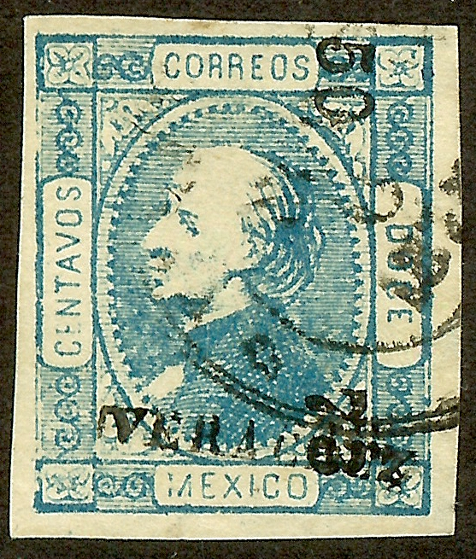
Mexican stamps
1872 stamp series issed by Mexico. Thickness of paper affects the value of these stamps.

Slide 17
Why clusters?
There are at least two different paper providers (hand made paper).
A stack of paper was determined by weight, so the manufacturer would have some extra thick or extra thin sheets sitting around to get the weight right.
Our data set has 485 thickness determinations from a stamp collection.

Slide 18
Histogram and density
We are hunting bumps in the density (clusters of paper types)

Slide 19
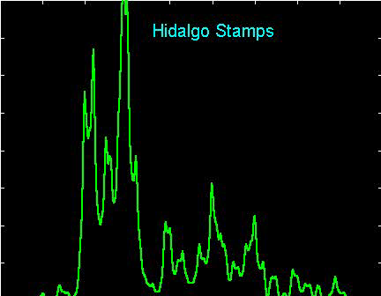
Possible model
If there are M bumps, consider a mixture of normals:

Slide 20
Assumptions matter!
Izenman & Sommer (J Amer Stat Assoc 1988) finds 7 modes using a nonparametric approach, and 3 using a parametric normal mixture model
Other authors find between 2 and 10 modes in the data set
Cannot just look at the stamps—the collection has been sold

