Slide 1
Coin tosses
Coin tosses
HTHTHTHTHTHTHTHT
HHHHHHHHTTTTTTTT
HHHTTHHHTTTTTHTH
p=0.5?
Random?
How can you tell?
Notes:
Each has probability 2^-16 = 0.00015

Slide 2
Runs
HTHTHTHTHTHTHTHT
20 runs
HHHHHHHHTTTTTTTT
2 runs
HHHTTHHHTTTTTHTH
7 runs
What is the probability of getting R=k runs in a string of 8H and 8T?

Slide 3
Runs distribution
k=2: 2 successful,
possible
P(R=2) = P(R=16) = 2/12870 = 0.000155
k=3: either all H or all T have to be together. If all T together, there are
places to divide the Hs,
so P(R=3) = 2 x 7 / 12870 = 0.00188
.

Slide 4
Note that the number k_{H} of H-stretches is at most one different from the number k_{T} of T-stretches.
And the number of runs is the total number of stretches, R = k_{H} + k_{T}.
Put together the sequence by breaking HHHHHHHH in k_{H} groups. ways, and insert
T-stretches, ways.
Can either start with H or T

Slide 5
so in particular P(k=7) = 0.114, which is 735 times more likely than k=2 or k=16.
R package randtests
druns(2:16,8,8)
qruns(c(0.025,0.975),8,8): 5,13

Slide 6
General case
Suppose we have m H and n T. Then

Slide 7
Expected value and variance
Let Z_{j} = 1(j^{th} and j+1th outcome different), j=1,...,m+n-1.
E(Z_{j})=
E(R) =
Notes:
Hypergeometric computation for EZ_i
ER=1+2(mn)/(m+n)

Slide 8
Median test for independence
Let X₁,...,X_{n} be random variables. Define Y_{i} = 1(X_{i} >m) where m is the median of the X_{i}.
P(Y_{i} = 1) =
If the X_{i} are independent, the number R of runs among the Y_{i} should follow the runs distribution.
If there are too few runs there is a tendency for Y_{i} to clump, while if there are too many they tend to alternate between 0 and 1.

Slide 9
Temperature series
P-value 0.006 95% CI (11,21)

Slide 10
Looking for trends
We have checked
distributional assumptions
independence assumption
equality of distributions
location-scale changes
Most common situation of data that are independent, but not identically distributed

Slide 11
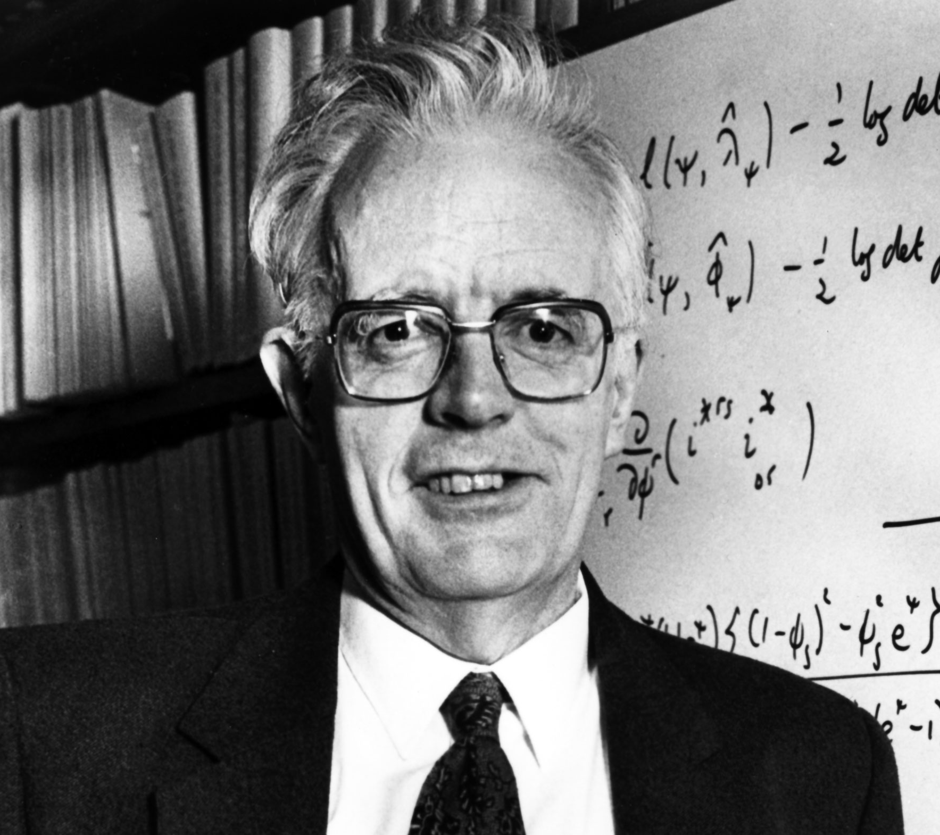
Testing for monotone trend
Cox-Stuart test
n=2m
Let Y_{i} = 1(X_{m+i} – X_{i} > 0), i=1,...,m
n=2m+1, ignore X_{m+1}
If no trend, T ~
David R Cox
1924-

Slide 12
NCEI series
T = 63 (only 3 negative differences)
P-value 3.3 x 10⁻¹⁶

Slide 13
Pairwise comparison
A number of patients are trying a new diet. The differences between weights before and after the diet are (in order from smallest)
-7.8 -6.9 -4.0 3.7 6.5
8.7 9.1 10.1 10.8 13.6
14.4 15.6 20.2 22.4 23.5
If the diet has no effect, what should the median weight loss be?

Slide 14
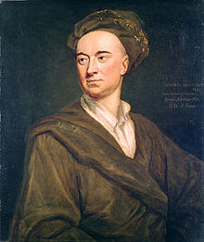
Sign test
We have n observations, and want to test H₀: θ = 0.
Test statistic: T=#{X_{i}<0}
Null distribution: T ~
In our example, n=15, T=3
P(T≤3) = 0.0176
One- or two-sided?
Jphn Arbuthnot
1667-1735

Slide 15
Assumptions for sign test
Independent
Identically distributed
Continuous distribution
Notes:
Third needed for no ties and unique median

Slide 16
Inverting the test
Test is based on T = Σ sgn(X_{i} – θ) for all possible θ.
Note that the observations split the real line into n+1 sets. T only changes when θ goes by an observation.
So the confidence interval must consist of a low order statistic and the corresponding high one, i.e. (-7.8,23.5) or (-6.9,22.4) or (-4.0,20.2) or (3.7,15.6) etc.
What are the confidence levels?

Slide 17
Confidence level
X₍₁₎,X_{(n)} fails to cover θ only if θ is outside that range so all X_{i} – θ have the same sign. The probability of that under H₀ is
P(T=0 or n)=2P(T=0), so the confidence level of that interval is 1- 2P(T=0)
(X_{(i)},X_{(n+1-i)}) has confidence level 2(1 - P₀(T ≤ i))
For n=15 the possible levels are
.9999, .9990, .993, .965, .882 etc.
A 97.9% Ci for θ is (3.7,15.6)

Slide 18
Point estimate
We get a point estimate for the median by shrinking the confidence set to just one point (if n odd) or to two (n even).
The single point is the sample median, and the interval is the interval of possible sample medians
Conventionally, the average of the two middle points is taken as the sample median if n is even.
In our example the median is between 9.6

Slide 19
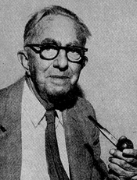
Signed ranks
The rank of an observation is where it falls in the ordered set:
When can the sign test be fooled?
To deal with this, Wilcoxon suggest to use the signed ranks R_{|i|} of the absolute values
Frank Wilcoxon
1892-1965

Slide 20
Null distribution
We are interested in the hypothesis that the median is 0.
For the general hypothesis θ = θ₀ replace X_{i} by X_{i} – θ₀.
If the true distribution is symmetric, P(sgn(X_{i}=1) =
Consider n=4. How many possible sign orders are there?
For the general case, use
dsignrank(x,n)
Notes:
Note only even values/ Always?
dsignrank is the distribution of the sum if the positive ranks—needs some shuffling

Slide 21
Diet trial
n=15, T=98, P-value 0.0034

Slide 22
Alternative forms
T⁺ = sum of positive ranks
T⁻ = - sum of negative ranks
T = T⁺ - T⁻
T⁺ + T⁻ =
Let m = n(n+1)/2, and (X_{i} + X_{j})/2, i≤j, the Walsh averages. W₍₁₎,...,W_{(m)} are the ordered Walsh averages. Then
(*) T⁺ = #{W_{(i)} > 0}.
We call the rhs of (*) W⁺

Slide 23
Proof that T⁺ = W⁺
If θ is bigger than all X_{i} it is bigger than all W_{i}, and all X_{i} – θ are negative so T⁺ = 0. Likewise all W_{i} – θ are negative, so W⁺ = 0.
Now let’s move θ from right to left. We first show that T⁺ and W⁺ only change value when θ goes by a Walsh average.
Obvious for W⁺
T⁺ changes when the sign of X_{i} – θ
changes, but X_{i} is a Walsh average (i=j), or when the rank of |X_{i} – θ| changes.

Slide 24
Then some other rank, of |X_{j} – θ|, must also change. So for some θ they must be equal but of opposite sign, since decreasing θ cannot change the order of X_{i} – θ and X_{j} – θ. Hence X_{i} – θ = - (X_{j} – θ) or θ = (X_{i} + X_{j})/2.
Now we need to show that T⁺ and W⁺ change by the same amount when they change. First look at θ going by X_{i} (from right to left). W⁺ increases by one. So does T⁺, since |X_{i} – θ| must be the smallest difference (rank one) and the sign changes to +.

Slide 25
Finally, if i ≠ j, W⁺ increases by 1 again as θ passes that point. There θ is equal to that Walsh average W_{k}, so X_{i} – θ = - (X_{j} – θ). WLOG X_{i}<θ<X_{j}.
When θ > W_{k} by just a little the i-rank is greater than the j-rank, and when θ < W_{k} it is smaller. The sign of the i-rank is negative, and that of the j-rank is positive. Note that, the i- and j-ranks must be consecutive integers.
As θ passes W_{k} the j-rank goes up by one, so T⁺ goes up by one. The i-rank goes down by one, which does not matter since it is negative.

Slide 26
Confidence set
Just as in the sign test case, we will look at symmetric pairs (equally far in among the ordered Walsh averages from either side). The function 1-2*psignrank(k,15) computes the confidence level for going in k steps. For k=25 we get confidence level 0.952, and the interval is (3.30,15.15).

Slide 27



Estimate
When we shrink the confidence interval width to 0, we get the point estimate the median of the Walsh-averages. It is sometimes called the pseudo-median, or the Hodges-Lehmann-Sen estimator.
Joe Hodges
1922-2000
Erich Lehmann
1917-2009
Pranab Sen
1937-

Slide 28
Assumptions for signed rank test
Independent
Identically distributed
Continuous distribution
Symmetric distribution
Notes:
Third needed for no ties and unique median

Slide 29
Could we make a normal assumption?

Slide 30
But formally...

Slide 31
So what does the t-test say?
P-value 0.0027
CI (3.80, 14.76)
Point estimate 9.28
Comparison:
Test | P-value | CI | Estimate
Sign | 0.035 | (3.7,15.6) | 10.1
Signed rank | 0.003 | (3.3,15.2) | 9.6
t | 0.003 | (3.8,14.8) | 9.3

Slide 32
Comparison of assumptions
Independent
Identically distributed
Continuous distribution
Symmetric distribution
Normal distribution
Sign test
Signed rank test
t-test

Slide 33
Does it matter?
Simulate t test from different distributions, same sample size (15), look at histogram of P-values
Simulate F-test from different distributions, two samples, same sample size (15), look at histogram of P-values

Slide 34
t-tests (n=15)

Slide 35
F-tests (n₁=n₂=15)

Slide 36
Review
Parametric vs nonparametric
Distribution-free
Pivots
1. Testing distributional assumptions
Edf/Eqf
Kolmogorov distance
Kolmogorov-Smirnov test
Simultaneous confidence bands
  for edf
  for eqf
  for shift function

Slide 37
Location-scale families
Histogram
Empirical density estimate
Kernel density estimates
2. Testing iid assumption
Runs distribution
Randomness test
Trend test
3. Testing hypotheses about median
Sign test
Signed rank test
Walsh averages

