Slide 1
Midterm

Slide 2
T/F
(a) False—step function
(b) False, F_{n}(x)~Bin(n,F(x)) so
Inverting and estimating the standard error we see that a factor of n^{-1/2} is missing
(c) False, we would change n (by deleting the ties)
(d) True—the averages cannot get outside the range
(e) True—it looks at the sign of the pairwise slopes

Slide 3
The effect of a sleep treatment
The average amount of sleep in two weeks were recorded for a control group (n=15) and a treatment group (m=20). The treatment was advise on how to get more sleep.

Slide 4
A shift plot

Slide 5
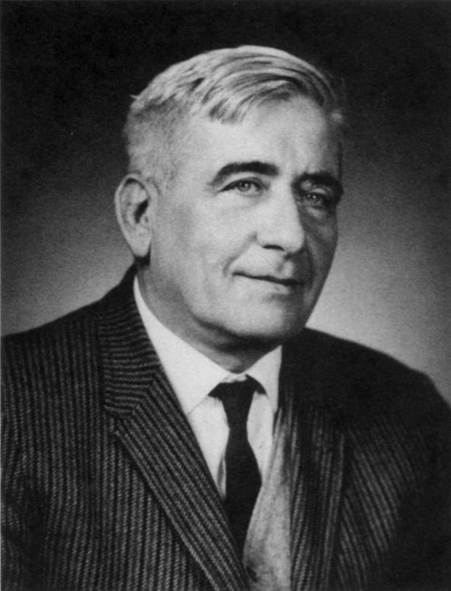
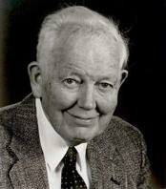
A two-sample test of equal location
X₁,...,X_{n} and Y₁,...,Y_{m} iid samples from two distributions, F and G.
Let r_{i} be the rank of X_{i} in the combined sample, and W = Σr_{i}
W is called the Wilcoxon two-sample statistic
An equivalent statistic, due to Mann and Whitney counts the number U of X_{i} > Y_{j} .
Henry Mann
1905-2000
Ransom Whitney
1915-2007

Slide 6
Sleep treatment data
4.76 4.92 5.71 5.91 5.93 6.33 6.54 6.54
6.65 6.67 6.68 6.70 6.77 6.79 6.93 7.02
7.02 7.05 7.06 7.12 7.22 7.23 7.59 7.60
7.63 7.73 7.74 7.78 7.78 7.88 8.03 8.16
8.26 8.46 8.67
Treatment Control
Sum of treatment ranks 324
U = 324 – 20*21/2 = 114

Slide 7
Test procedure
Reject for large or small values of U = W – n(n+1)/2
The distributions of U and W are symmetric about their midpoints
To see that for U, consider the case n=1. Under H₀ these m+1 variables are iid, so Y₁ is equally likely to be between any two X_{i}. Thus #{X_{i} – Y₁>0} is equally likely to be 0,...,m, a distribution symmetric around m/2. Thus U is the sum of n iid Unif{0,...,m}, also symmetric, and E(U)=nm/2.

Slide 8
Null distribution
For small values of n,m use exact distribution ( dwilcox(x,n,m) in R)
For larger values (n,m≥30) a normal approximation works well, using the variance
Var(U)=mn(m+n+1)/12.
For dealing with a null hypothesis of a shift θ, we just subtract θ from each Y_{j}
Confidence band : go in equal number from each side among ordered X_{i} - Y_{j}

Slide 9
Estimate
Possible confidence levels for m=15, n=20 are computed by, e.g., 1-2*pwilcox(70:120,15,20)
99%: 73 in from either side
95%: 90 in
90%: 100 in
The Hodges-Lehmann estimator corresponding to WMW is the median of the mn differences, here -0.365 (difference in medians is -0.259)

Slide 10
Sleep data, cont.
P-value = 0.268
95% CI (-0.96,0.25)

Slide 11
Null hypothesis
The null distribution actually requires P(X>Y-θ)= 1/2.
That follows if Y-X has a symmetric distribution about θ.
If G(y)=F(x-θ) this is true, and in that case we are just comparing medians.
The WMW test does not work well when G and F have different shape (in particular, different spread)

Slide 12
Dealing with ties
For any rank-based method ties can be dealt with by replacing the tied values by their average rank, the midrank
This affects the variance
For the Wilcoxon test there is an R function called wilcox.exact in the library exactRankTests, or you can use wilcox.test in the package coin
Note that since all we need is ranks, the WMW test can be used for ordinal data

Slide 13
Comparison with t-test
The WMW test is equivalent to the two-sample t-test with equal variances applied to the ranks instead of the data
This approach is particularly helpful if there are outliers in the data

Slide 14
How about the sign test?
For the sleep treatment data, the overall median is 7.05. Assuming that the two samples have the same median, we can set down a 2x2 table
Why aren’t there 20 treated values?
What (row and column) totals are fixed?
Sample | <7.05 | >7.05 | Total
Treatment | 11 | 8 | 19
Control | 6 | 9 | 17
Total | 17 | 17 | 34

Slide 15
Fisher’s exact test
Consider a table
n₁₁ n₁₂ n_{1•}
n₂₁ n₂₂ n_{2•}
n_{•1} n_{•2} n••
Think of column 1 as success (in our example obs < 7.05), column 2 as failure, while the rows are different groups (in our case treatment and control).
Since all row and column sums are given, only one observation matters, say N₁₁=n₁₁.
What is the distribution of N₁₁?

Slide 16
Odds and odds ratio
In a 2x2-table, a “natural” parameter is the odds ratio:
If the treatment has no effect, the odds ratio is 1. The larger the odds ratio, the stronger the effect of the treatment.

Slide 17
Estimating the odds ratio
CI?
Figure out possible values x of
n₁₁ from the hypergeometric
distribution, write
Notes:
11x9/6x8 = 2.0625 (R computes cond mle which is slightly different)

Slide 18
Fisher’s test revisited
P-value 2 P(X ≥ 11) = 0.49
To get confidence interval, use x=7,8,...,12, so the odds ratio CI is between 0.29 and 3.43 (R function uses a different calculation).
Notes:
The estimate we use is not the conditional mle given the margins which the R code computes.

Slide 19
Assumptions
iid observations
distribution of X-Y is symmetric
Fisher’s exact test of median equality
WMW test

