Slide 1
Testing for equal variance
Scale family: Y = sX
G(x) = P(sX ≤ x) = F(x/s)
To compute inverse, let y = G(x) = F(x/s) so x/s = F⁻¹(y)
x = G⁻¹(y) = sF⁻¹(y)
Δ(x) = G⁻¹(F(x)) – x = s F⁻¹(F(x)) – x
= (s-1)x

Slide 2
Shiftplot
Blue slopes (-0.65,-0.20)
CI for scale ratio
(0.35,0.8)

Slide 3
Assumptions
Iid
Scale family
Need moderately large samples

Slide 4
Testing equal variance for distributions with equal locations
Ranking m X-values and n Y-values, the average rank is (n+m)(n+m+1)/4
If F is more spread out than G, and the locations are the same, we would tend to have more large and small residuals from the mean rank for the X-values.
One way to get at this is to assign rank 1 to the smallest and largest values, 2 to second smallest and second largest, and continue in towards the middle.

Slide 5
The Ansari-Bradley test
Compute the sum of the X-ranks as
where p=[(m+n+1)/2] and 1_{i}^{X} is the indicator of the i^{th} observation in the combined ordered sample is an X.
Small values of W correspond to F being more dispersed.
In practice, align the locations first.

Slide 6
Null distribution
Let f(w,m,n) be the number of orders with m 1 and n 0 that yield the statistic value W=w.
Assume 2N=m+n is even. If we add one more X, either it or a Y is N+1. If it is a Y there are f(w,m,n) ways, while if it is an X, there are f(w-N-1,m-1,n+1) ways. Thus we get the recursion
f(w,m,n+1)=
f(w,m,n) + f(w-N-1,m-1,n+1)
Notes:
Need to assume that both samples have the same location
Work out the case m=n=2. What does the recursion say for m=2,n=3?

Slide 7
Null distribution, cont.
Thus
E(W)=m(m+n+2)/4
R: ansari.test(x,y)
On the exponential samples, subtracting the median from each sample, p = 5x10⁻⁸
CI = (0.40,0.60)
estimate 0.49
Notes:
using shift function 0.35,0.8
F test yields (.38,.57)
estimate 0.47

Slide 8
Assumptions
Iid
Known difference between locations
“No rank test (i.e., a test invariant under strictly increasing transformation of the scale) can hope to be a satisfactory test against dispersion alternatives without some sort of strong restrictions (e.g., equal or known medians) being placed on the class of admissible distribution pairs. “ (Moses, 1963)

Slide 9
Another rank test of variability
Siegel-Tukey:
1 4 5 8 9 7 6 3 2
Sum of green ranks 14
-4x5/2 = 4
Compare to Mann-Whitney distribution
P-value 2 x 0.095 = 0.19
For exponential samples P-value is 0.0005
Notes:
Why compare to Wilcoxon?

Slide 10
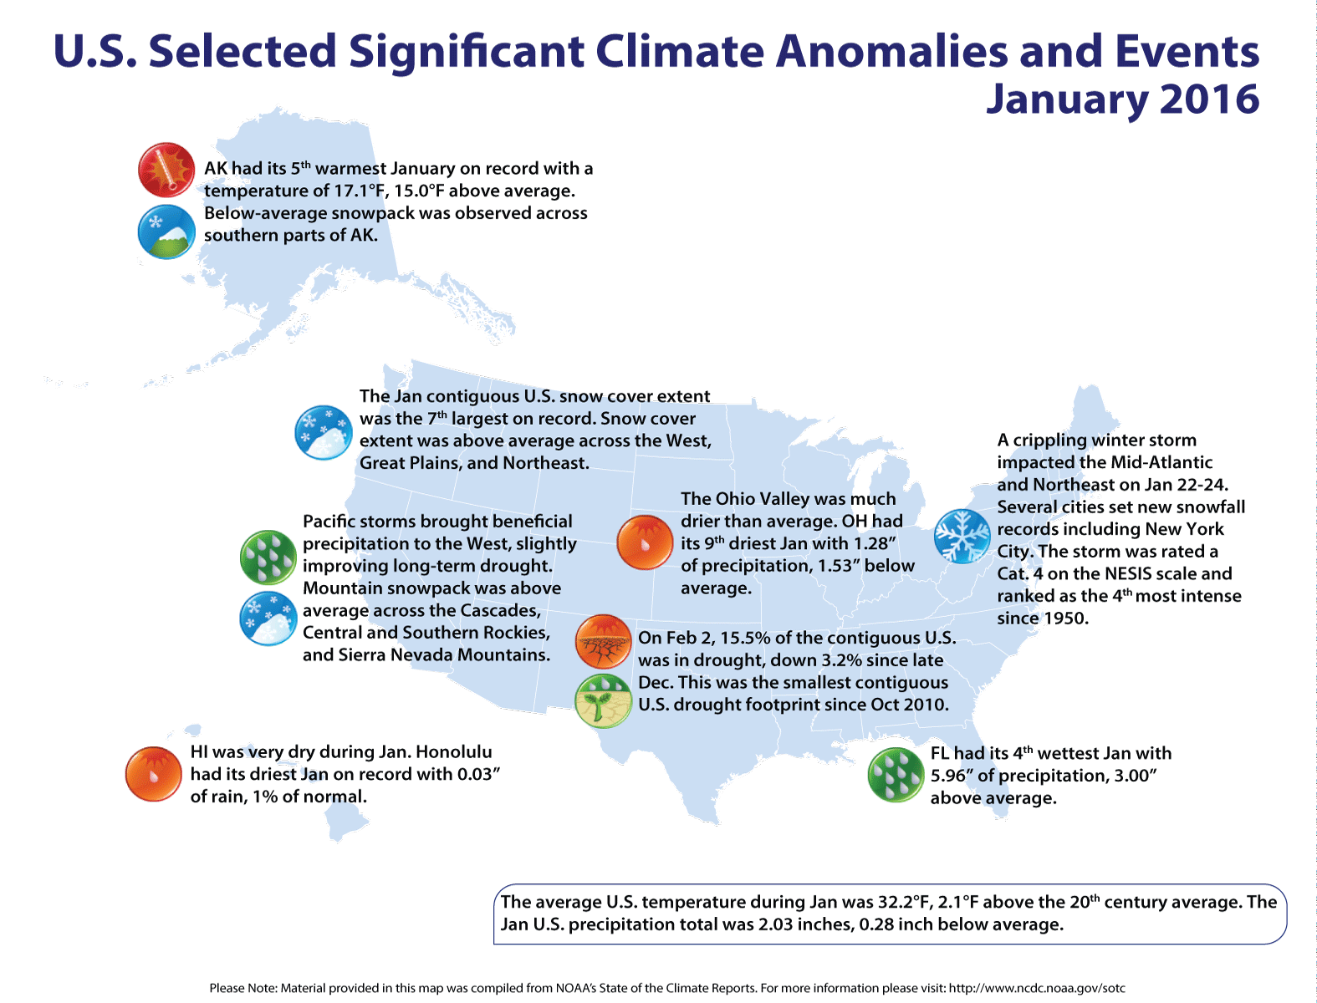
NOAA State of the Climate web site

Slide 11
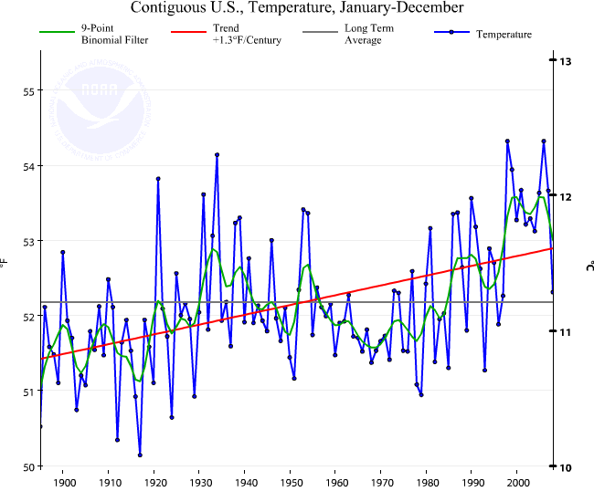
State of the Climate 2008
rwrwrw
Notes:
The 2006 average annual temperature for the contiguous U.S. was the 2nd warmest on record and within 0.1°F of the record set in 1998.

Slide 12
Shen et al. (2012)
1921, 4th warmest
2nd warmest
–14th warmest

Slide 13
So we don’t really know
which is the fourth warmest year
But we have standard errors for each year
Can we use the standard errors to assess the uncertainty in ranks?

Slide 14
Simple approach
Draw independent normal random numbers with the right mean and sd for each year
Rank
Repeat to get an ensemble of paths. R code:
http://www.statmos.washington.edu/wp/wp-content/uploads/2012/10/Uncertainty-analysis.txt

Slide 15
Rank distribution

Slide 16
But aren’t years dependent?
Autocorrelation = correlation with itself shifted over

Slide 17
Lagged plots

Slide 18
Autoregression
Idea: Predict the current value from previous values
k’th order autoregression
R commands
library(forecast)
acf(series)
ar(series)

Slide 19
Moving average
Idea: Current value is obtained by weighted average of previous errors
Moving average of order k
auto.arima(series)

Slide 20
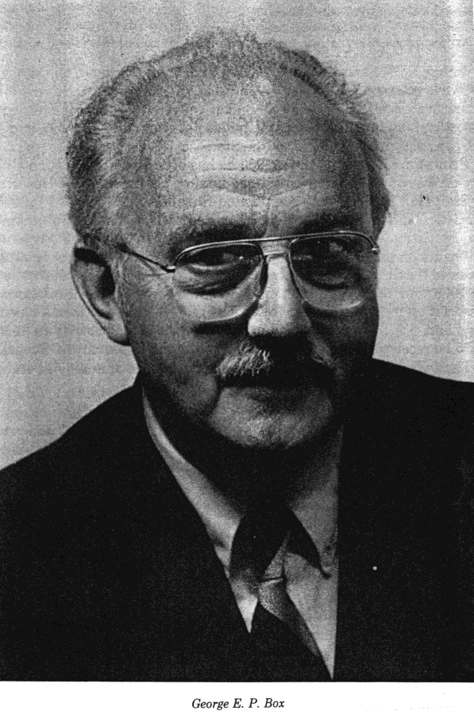

ARIMA models
George Box and Gwilym Jenkins
We have already seen AR and MA
ARIMA(0,1,0): X_{t} = X_{t-1} + ε_{t}
or ε_{t} = X_{t} – X_{t-1}, differencing
Can be iterated.
ARIMA(p,1,q) has ε_{t} following an ARMA(p,q) model.
1919-2013
1932-1982

Slide 21
Why worry?
In climate contexts we are often interested in fitting trends. Here is a sequence of slope fits to US monthly average temperature:
OLS 0.0055°C/y sd 0.0012***
WLS 0.0048°C/y sd 0.0014***
GLS (AR4) 0.0053°C/y sd 0.0026*
GLS (ARMA(3,1)
0.0059°C/y sd 0.0032
The same data, increasingly realistic models. Significance disappears.

Slide 22
Does dependence matter?
Structure iid
Structure ARMA(3,1)

Slide 23
Effect of dependence
Independent
Dependent

Slide 24
Rank sd

Slide 25
Notes:
Prob in top 10
2007 differs from 2005 in third decimal place

Slide 26
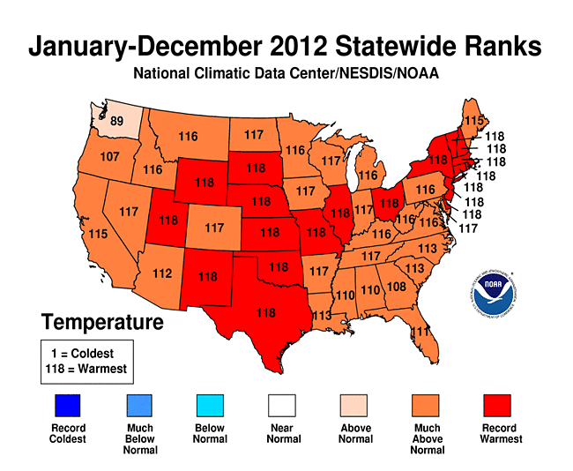
Back to
State of the Climate
“2012 ... was the warmest year in the 1895-2012 period of record for the nation.”

Slide 27
Need to extrapolate standard error
se(2012) ≈ 0.08
anomaly(2012) = 1.7
anomaly(1998) = 1.2
0.5/0.08 ≈ 6 !!!

Slide 28
And the uncertainty in the ranking of 2012 is...

Slide 29
NOAA State of the Climate 2014
The probability that 2014 was...
Warmest year on record: 48.0%
One of the five warmest years: 90.4%
One of the 10 warmest years: 99.2%
One of the 20 warmest years: 100.0%
Warmer than the 20th century average: 100.0%
Warmer than the 1981-2010 average: 100.0%

Slide 30
IPCC report
The latest IPCC report claimed that the last three decades were the warmest on record, based on global decadal averages. Using the Hadley Center series, we investigate this claim.

Slide 31
Notes:
Order from smallest (warmest) to largest (coldest). 16 decades.

Slide 32
Last year warmest on record?
2015 was widely reported as the warmest year on record for annual global average temperature. We use the Hadley temperature series to investigate this claim.
Based on 100,000 simulations, 2015 is the warmest in all but 724, but it could be as low as the 6th warmest.
Other candidates for warmest year are 2014, 2010, 2004 and 1997.
No year before 1997 was ranked warmest.

