Slide 1
Running and jumping
Time and space records:
long jump, one hundred meters
are getting closer. (NG)
Notes:
WR 100m 9.58, long jump 8.95

Slide 2
Scatter
Correlation 0.58
Leaving out obs 9: 0.94

Slide 3
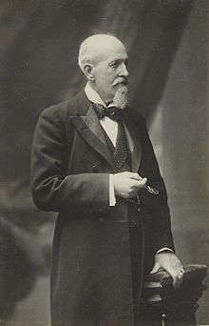
Rank correlation
Correlation between ranks is 0.67
Spearman correlation
Charles Spearman
1863-1945

Slide 4
Properties of r_{S`}
-1 ≤ r_{S} ≤ 1
When is r_{S} = 1? -1?
If X and Y are independent,
E(r_{S}) = 0
Can be applied to ordinal data, eg comparison of judges who rank participants in a competition
Also works when one variable is ordinal and one is interval.
Notes:
-1: r(i,Y)=n-r(i,X)+1

Slide 5
Figure skating
2002 olympics, Salt Lake City:
Each skater skates a short and a long program, get points for technical merits and artistic presebtation. Each of nine judges give each skater a rank based on the sum of the scores. Placement is based on the median ordinal, the place in which the majority of the judges place the skater at or better. In the ladies event there were 23 participants.

Slide 6
The German judge had the US skater Sarah Hughes first, the Russian Irina Slutskaya second, and American Michelle Kwan third. Same order as they finished.
The Slovakian judge had them placed 3,1, and 2, respectively.
Hughes had 5 first place votes, and Slutskaya 4.
The German judge had rank correlation 0.98 with the result.
The Slovakian had rank correlation 0.88.
How do we judge that number?

Slide 7
Bootstrap judge

Slide 8
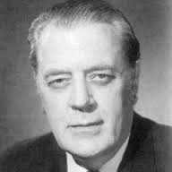
Kendall’s tau
Drawbacks with Spearman’s rank correlation:
Not directly related to a population parameter
Sensitive to errors
No exact distribution available
An alternative was proposed by Kendall (1938)
Maurice Kendall
1907-1983

Slide 9
Definition of tau
Idea: if X and Y are positively related, then for a pair (i,j), i≠j, with X_{i}>X_{j} we expect Y_{i}>Y_{j} as well. Such a pair is called concordant. The opposite kind is called discordant.
Let n_{c} be the number of concordant pairs, n_{d} the number of discordant. Then
Clearly, n_{c} + n_{d} = n(n-1)/2.
Let S = n_{c} - n_{d}
Notes:
Note -1 ≤ tau

Slide 10
A graphical approach
100m and long jump, revisited
100m: 1 2 4 5 3 8 7 6 9
Long jump: 1 2 7 6 3 8 9 5 4
1 2 3 4 5 6 7 8 9
1 2 3 4 5 6 7 8 9
The number of intersections is the number of discordant pairs, n_{d} = 9 so n_{c} = 36 – 9 = 27 and t_{K} = (27-9)/36 = 0.5
Notes:
36=9x8/2

Slide 11
What is the population parameter?
Assume (X_{i},Y_{i}) are iid F(x,y), and let B_{ij} = (Y_{j} – Y_{i})/(X_{j} – X_{i}).
b_{ij} > 0 means the pair (i,j) is concordant.
P(B_{ij} > 0) =
P(Y_{j} > Y_{i} and X_{j} > X_{i}) + P(Y_{j} < Y_{i} and X_{j} < X_{i}) = [ if F(x,y)=G(x)H(y) ]
P(Y_{j} > Y_{i}) × P(X_{j} > X_{i}) + P(Y_{j} < Y_{i}) × P(X_{j} < X_{i})
Since Y_{i} and Y_{j} are iid,
P(Y_{j} > Y_{i}) = 0.5
Notes:
b_i,j is an observation of B_ij

Slide 12
Thus when X and Y are independent
P(B_{ij} > 0) = 0.5×0.5+0.5×0.5 = 0.5
Let τ = 2 P(B_{ij} > 0) - 1
If X and Y are independent, τ = 0.
If Y_{i} > Y_{j} implies X_{i} > X_{j}, τ = 1.
n_{c}/(n_{c}+n_{d}) estimates P(B_{ij} > 0), so t_{K} estimates τ.
All we assume is that (X,Y) are iid pairs.

Slide 13
Properties of t_{K}
Under the null hypothesis of independence
E(t_{K}) = τ = 0
Var(t_{K}) = 2(2n + 5)/(9n(n – 1))
The distribution is symmetric, and approaches normality fairly quickly.
Confidence interval based on normal approximation for the athletics events is (0.02,0.98)
Notes:
Do distribution for n=3

Slide 14
Comparison to Pearson’s estimate
Pearson’s product moment estimate r of correlation measures linear correlation. Rank-based measures handle monotone non-linear relations.
Confidence intervals for r are based on underlying normal distribution.

Slide 15
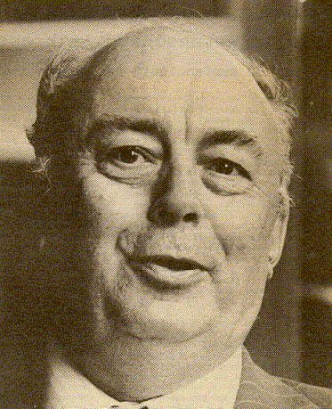
Theil regression
Least squares lines are heavily influenced by outliers.
A different option is to look at lines between all pairs of points, and estimate slope by the median of all slopes, and intercept by the median of all intercepts.
Theil proposed this in 1950
Sen generalized
Kendall related to tau
Henri Theil
1924-2000

Slide 16
Olympics again

Slide 17
Statistical properties
Let . Then
b_{ij} = + (e_{j} – e_{i})/(x_{j} – x_{i})
Note that b_{ij} > iff i and j is a concordant pair.
Since we are choosing the slope as the median of the b_{ij} we have half of them above and half of them below, i.e is median unbiased.
We can get a confidence interval for by testing for tau = 0. By symmetry that involves taking the k lowest and k highest b

Slide 18

Siegel regression
Andy Siegel (1982) improved the Theil(-Sen-Kendall) regression by a two step approach:
first calculate for each x-value all the slope/intercepts coming out of that point
then compute the median of these slopes and intercepts
This line is even more robust
Andrew Siegel

Slide 20
Monotone regression
For the Berkeley temperature series, it seems more reasonable to fit a nonlinear increasing function than a straight line.

Slide 21

Isotonic regression
The idea of optimization under constraints dates back at least to Lagrange
Constance van Eeden defended her thesis in 1958 on ordered parameters
Find b₁≤ ... ≤ b_{n} to minimize
Constance van
Eeden 1927-
Notes:
Convex optimization came later—Terry Rockafellar et al

Slide 22
Pool adjacent violators
Start with y₁. Move right until monotonicity is violated, then average with the previous value/values until you get monotonicity. Kepp doing this moving right until you reach y_{n}

Slide 24
Berkeley series
Notes:
Not smooth

Slide 25
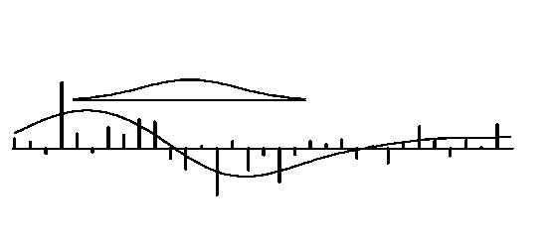
Locally weighted regression
In order to fit a smooth function to a set of data we can use the idea of kernel smoothing from density estimation. Moving average.
Notes:
Locally constant fit

Slide 26
Locally linear fit
To get a smoother fit we can use a weighted linear (or polynomial) fit.
Let w_{k}(x_{i})=w((x_{k}-x_{i})/h_{i}) where h_{i} is the r^{th} smallest of |x_{k}-x_{i}|, r = f n.
Now fit
where are the coefficients minimizing

Slide 27
Robustifying
After computing the locally linear fits, smooth the residuals from the current fit to get rid of particularly large ones.
This can be repeated several times.
The smoothing kernel for the robust step can be different from the kernel for the locally linear fit.

Slide 28
Choices
Kernel(s)
Often w(x)=(1-|x|³)³, |x|≤1 for regression
Bisquare for robustness
Bandwidth
f for regression
6MAD for robustness

Slide 29
Olympics
r=0.9
r=2/3
r=1/4

Slide 30
Temperature
r=2/3
r=1/4
Notes:
Edge effects

