Slide 1

Misalignment and use of deterministic models
NRCSE

Slide 2
Work with
Veronica Berrocal
Peter Craigmile
Wendy Meiring
Paul Sampson
Gregory Nikulin

Slide 3
The choice of spatial scale–some questions
1. Which spatial scale is correct?
2. What if there is spatial misalignment?
3. How do we change from one spatial scale to another?
4. What if we have different spatial datasets that come to us on different spatial scales?
5. How do we combine data sources?
We need to be careful not to be misled in our inferences.

Slide 4
Changes of support
Observed | Inference | Method
point | point | kriging
point | line | contouring
point | area | block kriging
area | point | ecological inference
area | area | misalignment

Slide 5
Some issues in model assessment
Spatiotemporal misalignment
  Grid boxes vs observations
Types of error
  Measurement error and bias
  Model error
  Approximation error
Manipulate data or model output?

Slide 6
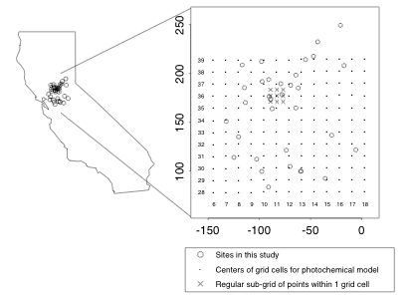
Assessing the
SARMAP model
60 days of hourly observations at 32 sites in Sacramento region
Hourly model runs for three “episodes”

Slide 7
Task
Estimate from data the ozone level in a grid square.
Issues:
  Transformation
  Diurnal cycle
  Temporal dependence
  Spatial dependence
  Space-time interaction

Slide 8
Transformation
Heterogeneous variability–mean and variance positively related
Square root transformation
All modeling now on square root scale–approximately normal

Slide 9
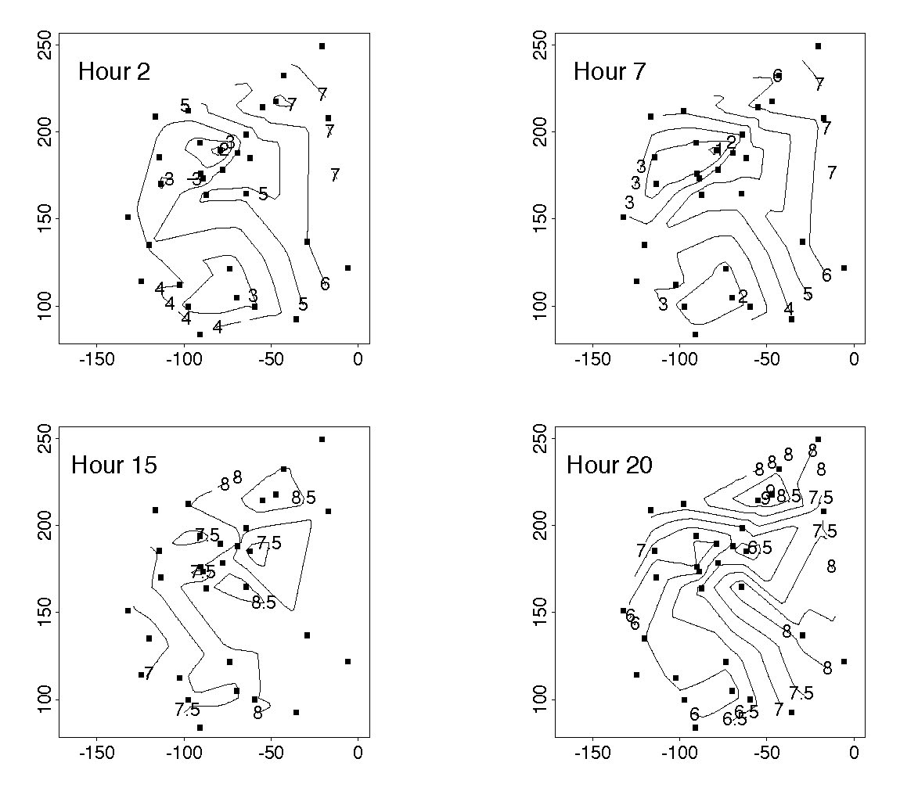
Diurnal cycle

Slide 10
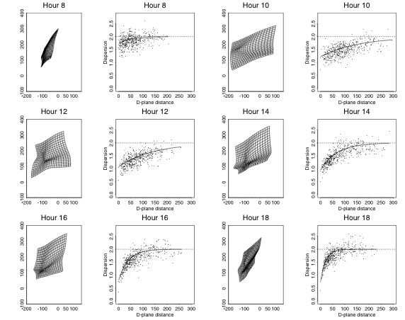
Spatial dependence

Slide 11
Estimating a grid square average
Estimate using
(not averages of squares of kriging estimates on the square root scale)

Slide 12
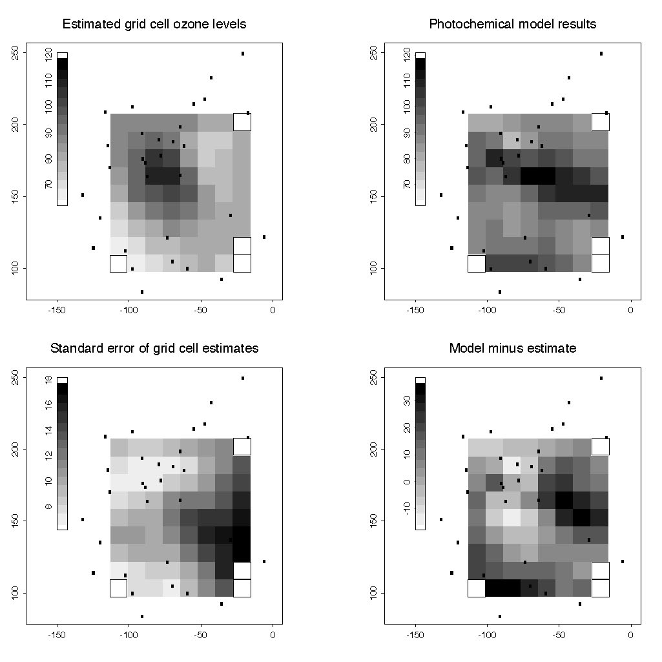
Afternoon comparison

Slide 13
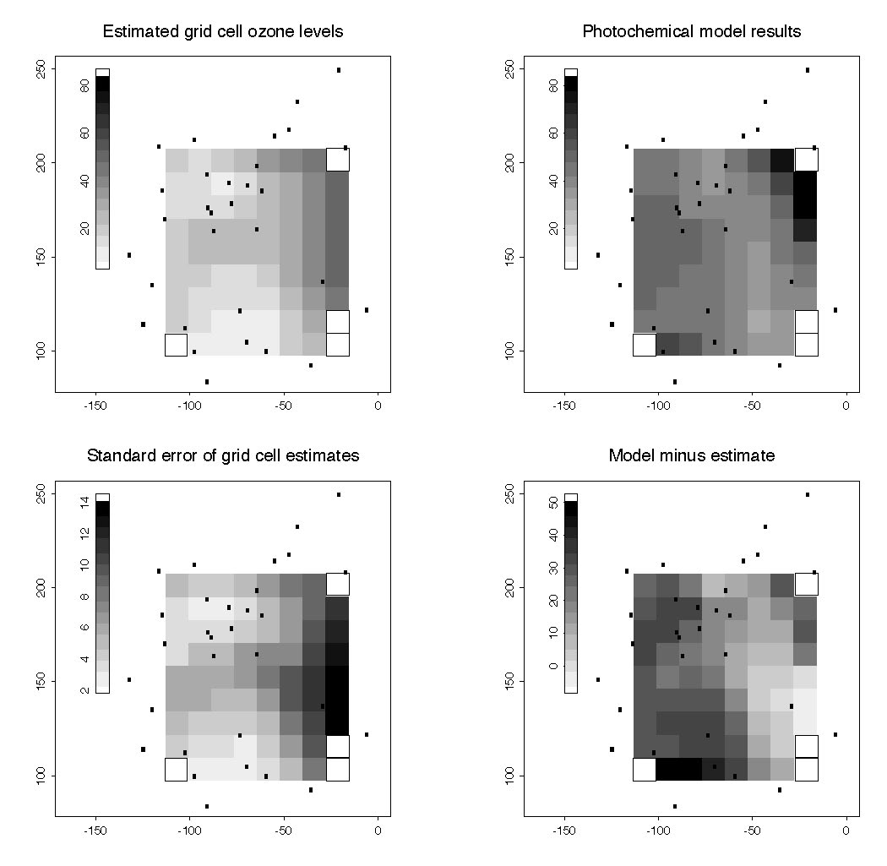
Nighttime comparison

Slide 14
Regional climate models
Not possible to do long runs of global models at fine resolution
Regional models (dynamic downscaling) use global model as boundary conditions and runs on finer resolution
Output is averaged over land use classes
“Weather prediction mode” uses reanalysis as boundary conditions

Slide 15
Comparison of model to data
Model output daily averaged 3hr predictions on (12.5 km)² grid
Use open air predictions only
RCA3 driven by ERA 40/ERA Interim
Data daily averages point measurements (actually weighted average of three hourly measurements, min and max)
Aggregate model and data to seasonal averages

Slide 16
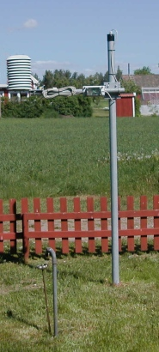
Data
SMHI synoptic stations in south central Sweden, 1961-2008
Notes:
Not homogenized

Slide 17
Upscaling
Geostatistics: predicting grid square averages from data
Difficulties:
Trends
Seasonal variation
Long term memory features
Short term memory features

Slide 18
Long term memory models

Slide 19
A “simple” model
space-time trend
noise
periodic seasonal
component
seasonal
variability

Slide 20
Seasonal part

Slide 21
Seasonal variability
Modulate noise
two term Fourier series

Slide 22
Both long and short memory
Consider a stationary Gaussian process with spectral density
Examples:
B(f) constant: fractionally differenced process (FD)
B(f) exponential: fractional exponential process (FEXP) (log B truncated Fourier series)
Short term
memory
Long term
memory
Notes:
delta positive here

Slide 23
Estimated SDFs of standardized noise
Clear evidence of both short and long memory parts
FD
FEXP

Slide 24
Space-time model
Gaussian white measurement error
Process model in wavelet space
  scaling coefficients have mean linear in time and latitude
  separable space-time covariance
Gaussian spatially varying parameters

Slide 25
Dependence parameters
LTM
Short term

Slide 26
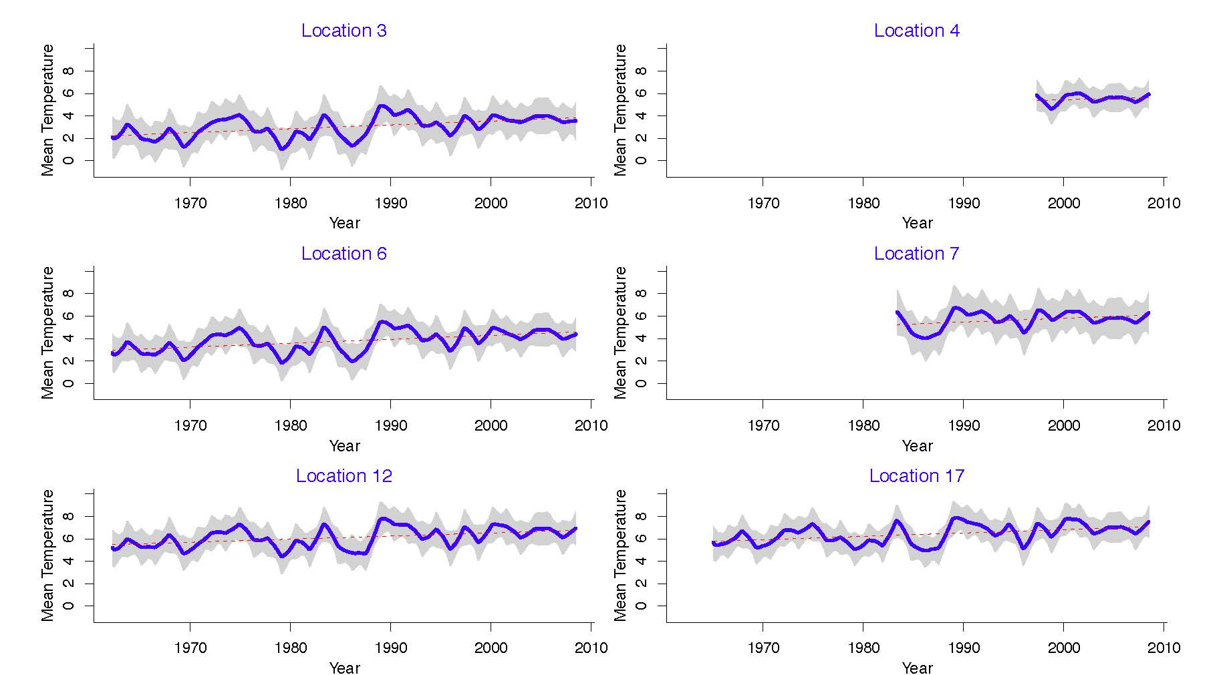
Trend estimates

Slide 27
Estimating grid squares
Pick q locations systematically in the grid square
Draw sample from posterior distribution of Y(s,t) for s in the locations and t in the season
Compute seasonal average
Compute grid square average

Slide 28
Downscaling
Climatology terms:
Dynamic downscaling
Stochastic downscaling
Statistical downscaling
Here we are using the term to allow
data assimilation for RCM
point prediction using RCM

Slide 29
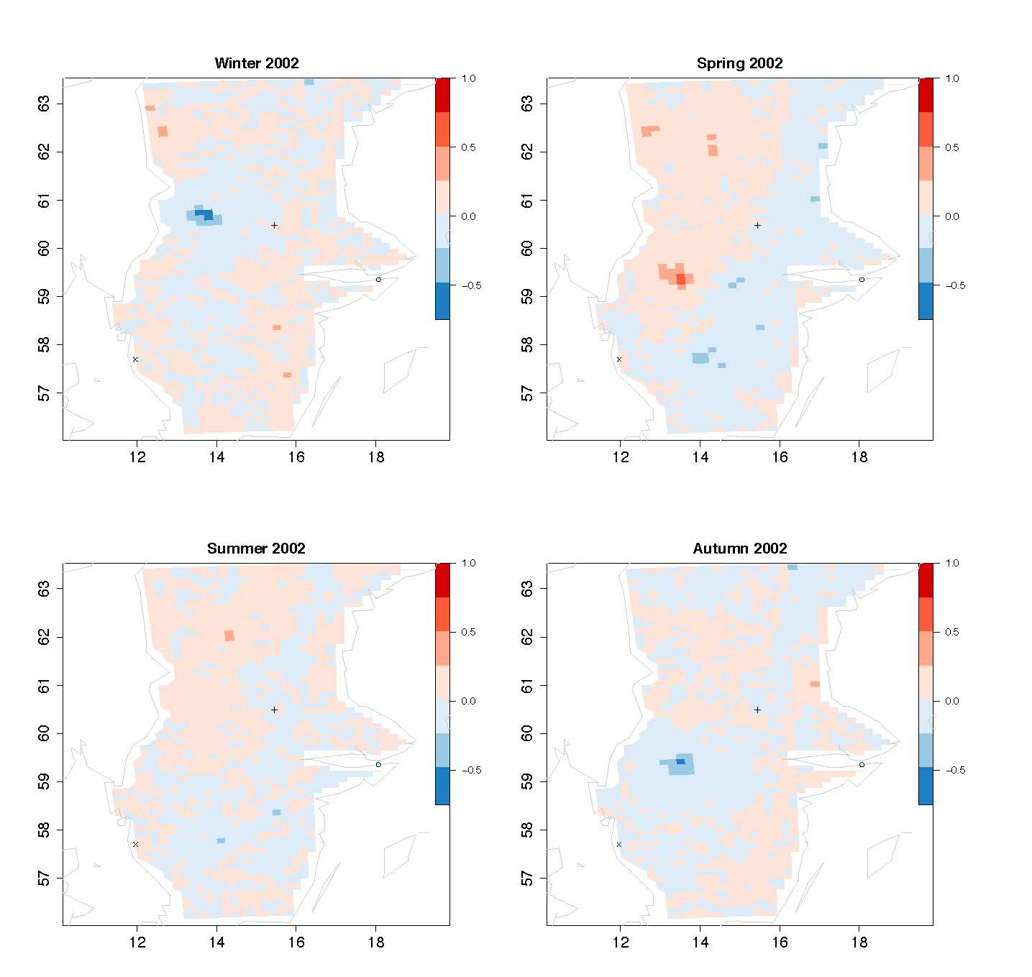
Downscaling model
(0.91,0.95)
smoothed
RCM

Slide 30
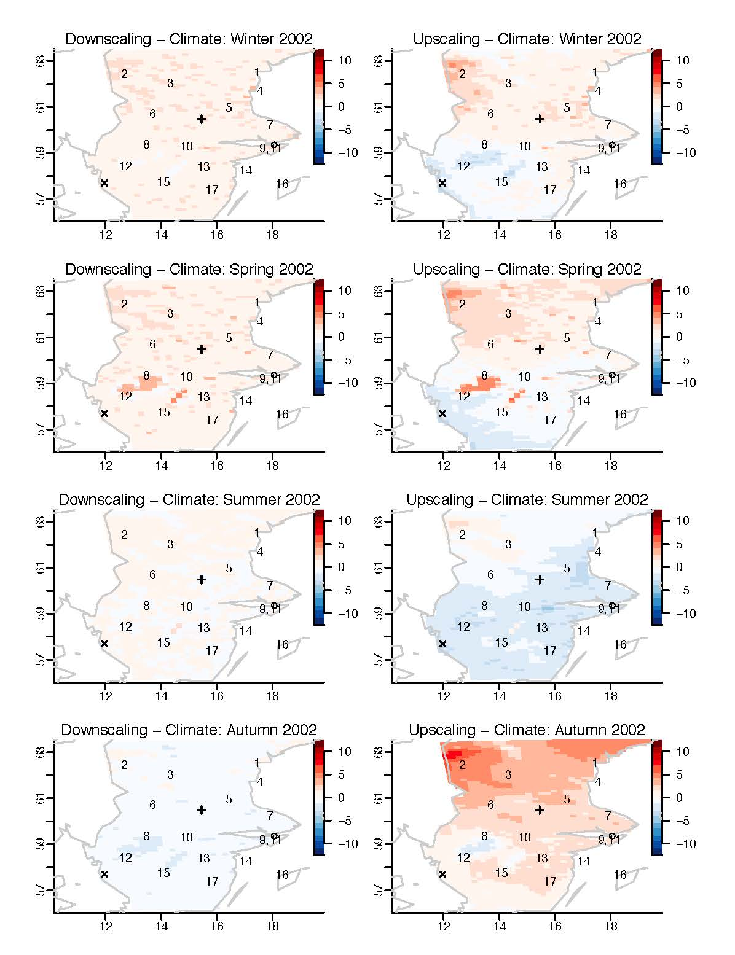
Comparisons

Slide 31
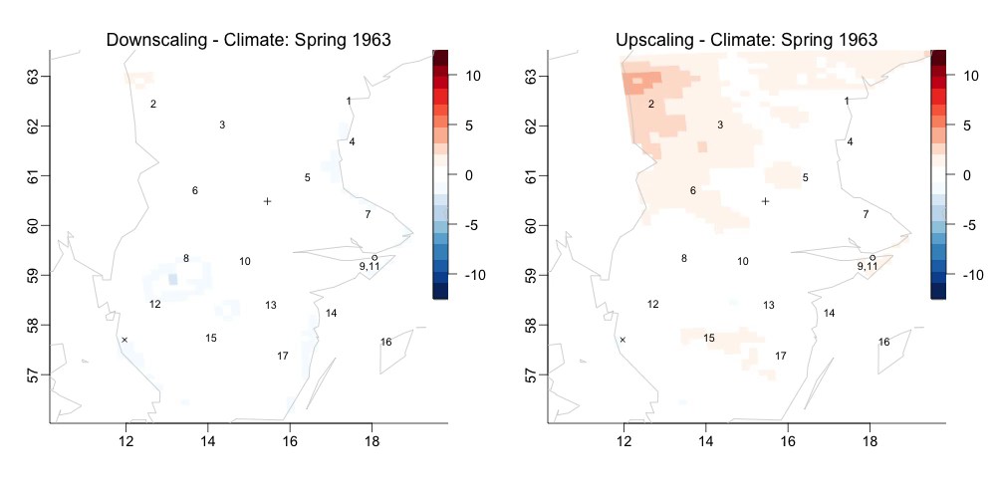

Slide 32
Reserved stations
Borlänge: Airport that has changed ownership, lots of missing data
Stockholm: One of the longest temperature series in the world. Located in urban park.
Göteborg: Urban site, located just outside the grid of model output

Slide 33
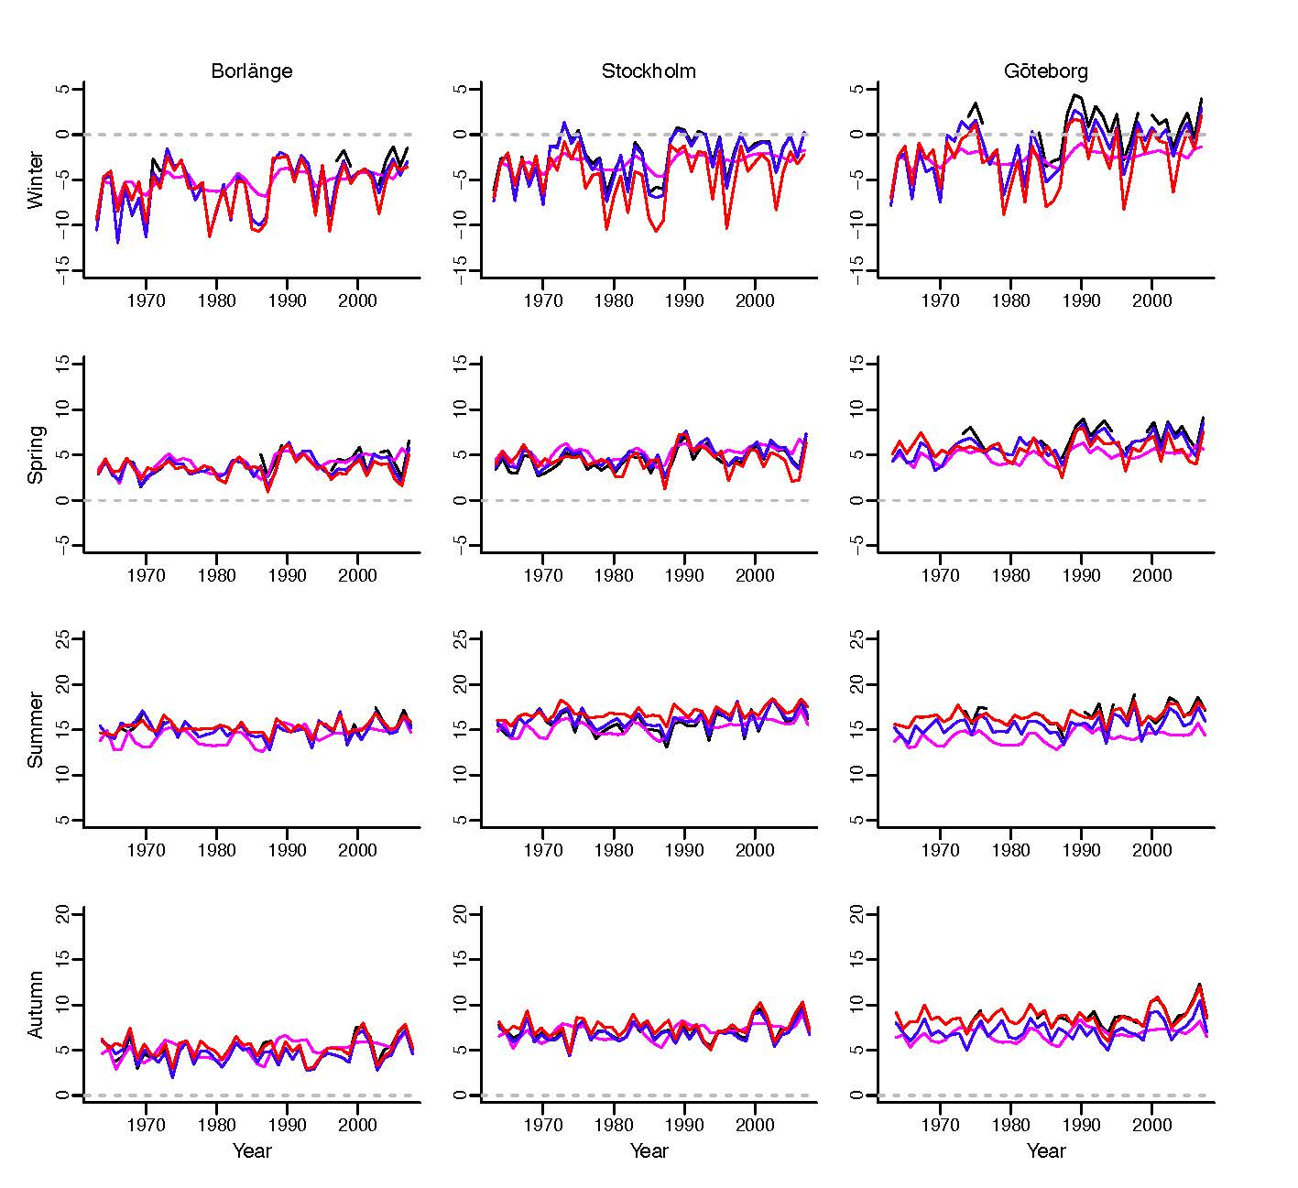
Predictions and data

Slide 34
Annual scale
Borlänge
Stockholm
Göteborg

Slide 35
Comments
Nonstationarity
in mean
in covariance
Uncertainty in model output
”Extreme seasons” where down-and upscaling agree with each other but not with the model output
Model correction approaches

Slide 37
Statistical analysis of computer code output
Often the process model is expensive to run (in time, at least), especially if different runs needed for MCMC
Need to develop real-time approximation to process model
Kalman filter is a dynamic linear model approximation
SACCO is an alternative Bayesian approach

Slide 38
Basic framework
An emulator is a random (Gaussian) process η(x) approximating the process model for input x in R^{m}.
Prior mean m(x) = h(x)^{T}β
Prior covariance
Run the model at n input values to get n output values, so

Slide 39
The emulator
Integrating out β and σ² we get
where q = dim(β) and
where t(x)^{T} = (c(x,x₁),…,c(x,x_{n}))
m** is the emulator, and we can also calculate its variance

Slide 40
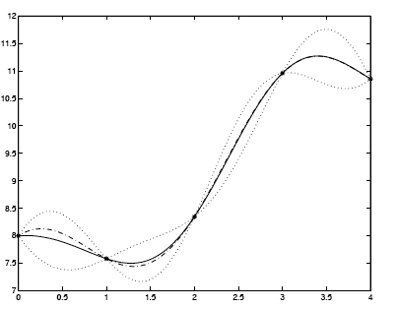
An example
y=7+x+cos(2x)
q=1, h^{T}(x)=(1 x) n=5

Slide 41
Conclusions
Model assessment constraints:
amount of data
data quality
ease of producing model runs
degree of misalignment
Ideally the model should have
similar first and second order properties to the data
similar peaks and troughs to data (or simulations based on the data)

